Slide 1

TPC simulations and prototype design
Lev Shekhtman
Budker Institute of Nuclear Physics
SB RAS, Novosibirsk, Russia

Slide 2
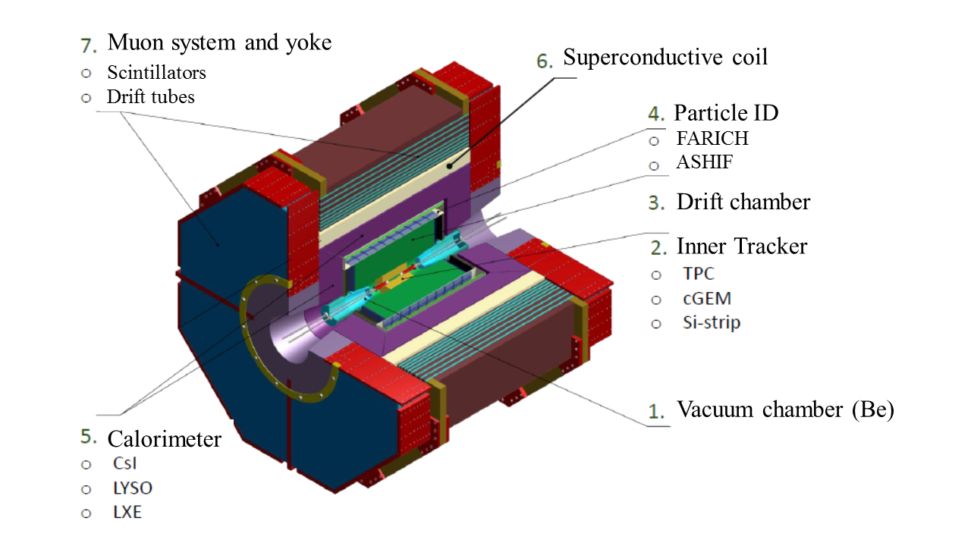
Novosibirsk Super Charm-Tau Factory Detector
100-1000 charge clusters per track
TPC
CmuRWELL
Si-strips
Allows precise stand-alone soft tracks reconstruction and soft hadrons identification following dE/dx measurements

Slide 3
TPC dimensions: 40 cm in diameter, 60 cm long (two halves of 30 cm)
Main issues with TPC as Inner Tracker:
Tracks from many bunch crossings are overlapping
electron drift time is ~6 μs (Ar-10%CH₄), 1200 bunch-crossings, ~ 50 tracks in TPC acceptance (θ > 0.1 rad). Specific reconstruction algorithm is needed
Ions from end-cap detectors drift back into the TPC volume and build-up a space charge

Slide 4
How many background tracks will be detected in TPC?
Primary processes:
Two-photon processes e⁺e⁻ → γ∗γ∗→e⁺e⁻e⁺e⁻ (E_{e+e-}>2MeV) - 2.9mb (at 3 GeV per beam), DIAG36
However at 1.5 T field radius of electron trajectory with p_{t} = 1 MeV/c will be ~2 mm
For p_{t} = 15 MeV/c trajectory radius will be ~3 cm (inner radius of TPC)
For E_{e+e-} >30 MeV cross-section for e⁺e⁻ → γ∗γ∗→e⁺e⁻e⁺e⁻ is equal to 5.5 μb (3 GeV per beam), that gives 2.8x10⁻³ particles/bunch crossing (L=10³⁵ cm⁻² s⁻¹ )
2. Radiative Bha-Bha e⁺e⁻ →e⁺e⁻γ(nγ) (θ>5mrad), Eγ>1MeV) - 1.2mb (at 3 GeV per beam), BHWIDE
Particles with θ=5mrad will interact with vacuum pipe wall at Z=3m (VP radius is equal to 15 mm). Acceptance of TPC is 0.1 rad < θ < π/2.
For θ>100 mrad, Eγ>1MeV cross-section of e⁺e⁻ →e⁺e⁻γ(nγ) process is equal to ~2.8 μb (3 GeV per beam), that gives ~1.4x10⁻³ particles/bunch crossing

Slide 5
How many background tracks will be detected in TPC?
Drift velocity in 1.5 T B-field for one of the most popular TPC mixtures Ar+10%CH₄ is 5 cm/μs for
electric field of 100-200 V/cm.
Electrons drift time is 6 μs -> 1200 bunch crossings -> ~5 primary background tracks
How many secondaries?

Slide 6
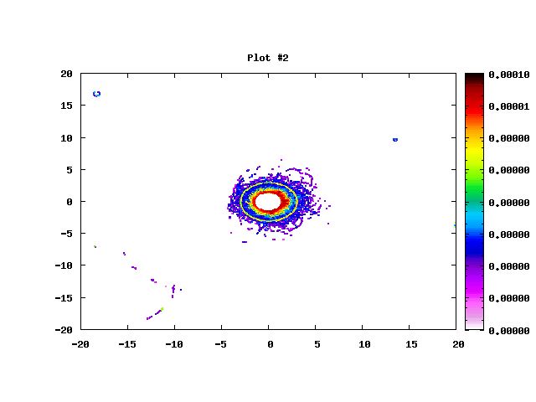
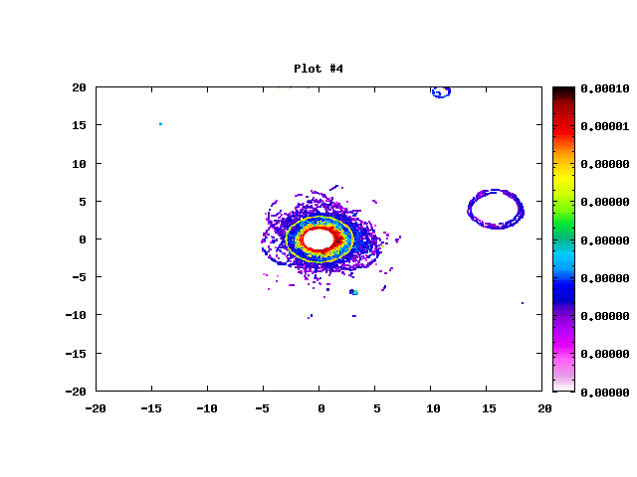
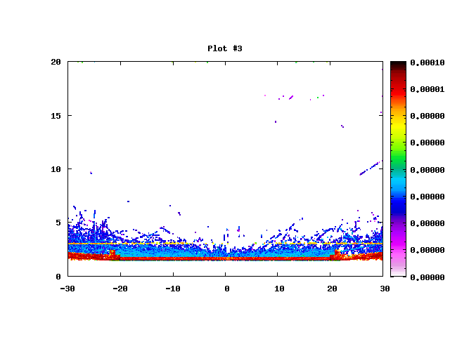
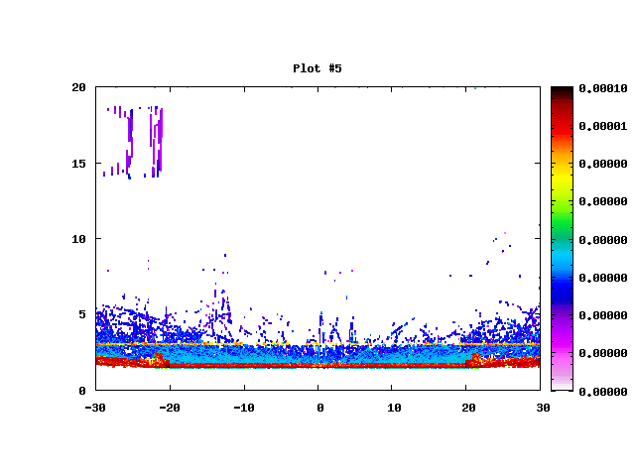
Examples of TPC occupancy (energy depositions) within 6 μs
Sample 1
Sample 2
Y, cm
Y, cm
X, cm
X, cm
R, cm
R, cm
Z, cm
Z, cm

Slide 7
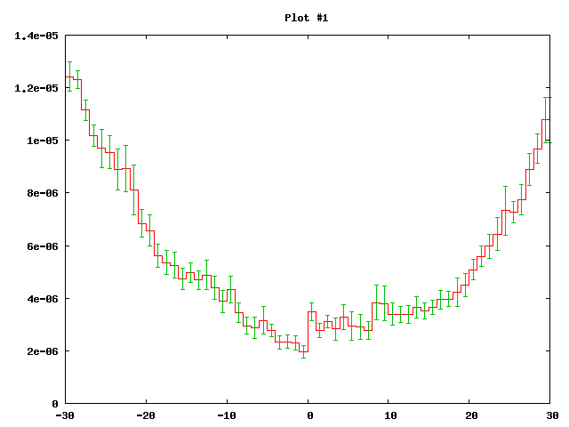
How many background tracks will be detected in TPC?
84
72
60
48
36
24
12
0
Number of charge particle tracks per TPC cross-section within 6 μs
Particles/TPC /6μs
Z, cm

Slide 8
Objectives for the TPC prototype
Measurement of spatial resolution (on tracks) as a function of
readout pad size
gas mixture
reconstruction algorithm
readout electronics and its parameters (clock frequency,
shaping time, amplification, noise)
track angle
and validation of simulation
Analysis and solving of all technological issues during construction
Comparison of several detector technologies for the readout detector:
GEM, muRWELL+GEM, thick RWELL+GEM
Assessment of existing ASICs for TPC readout (DMXG64, VMM3a…) and input for the development of specialized ASIC

Slide 9
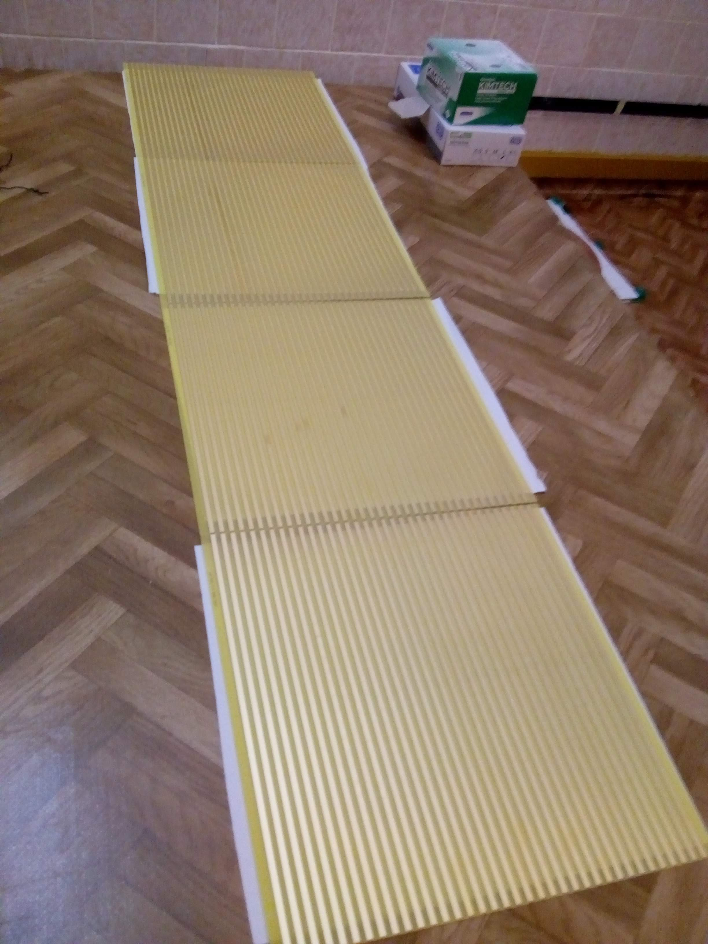
Design of the HV electrodes
6
These PCBs are produced
300
1
4
4
6
6
4
Contacts from the outer side
314.2
8
Cross section
0.5 мм
Cremlin+ Internal BINP WP5 meeting

Slide 10
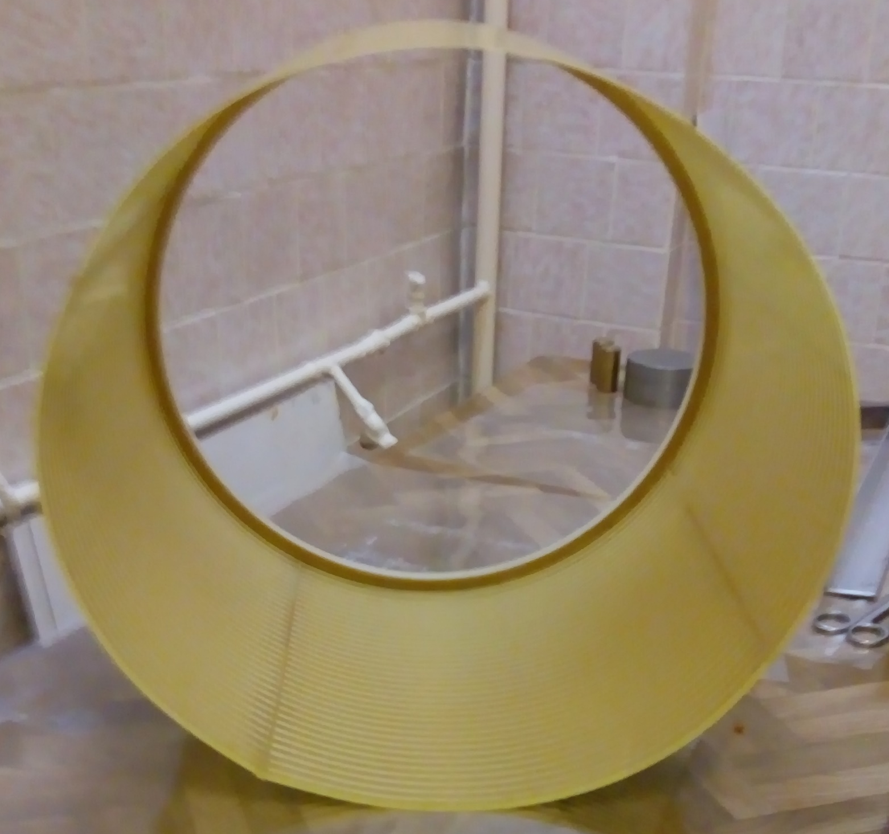
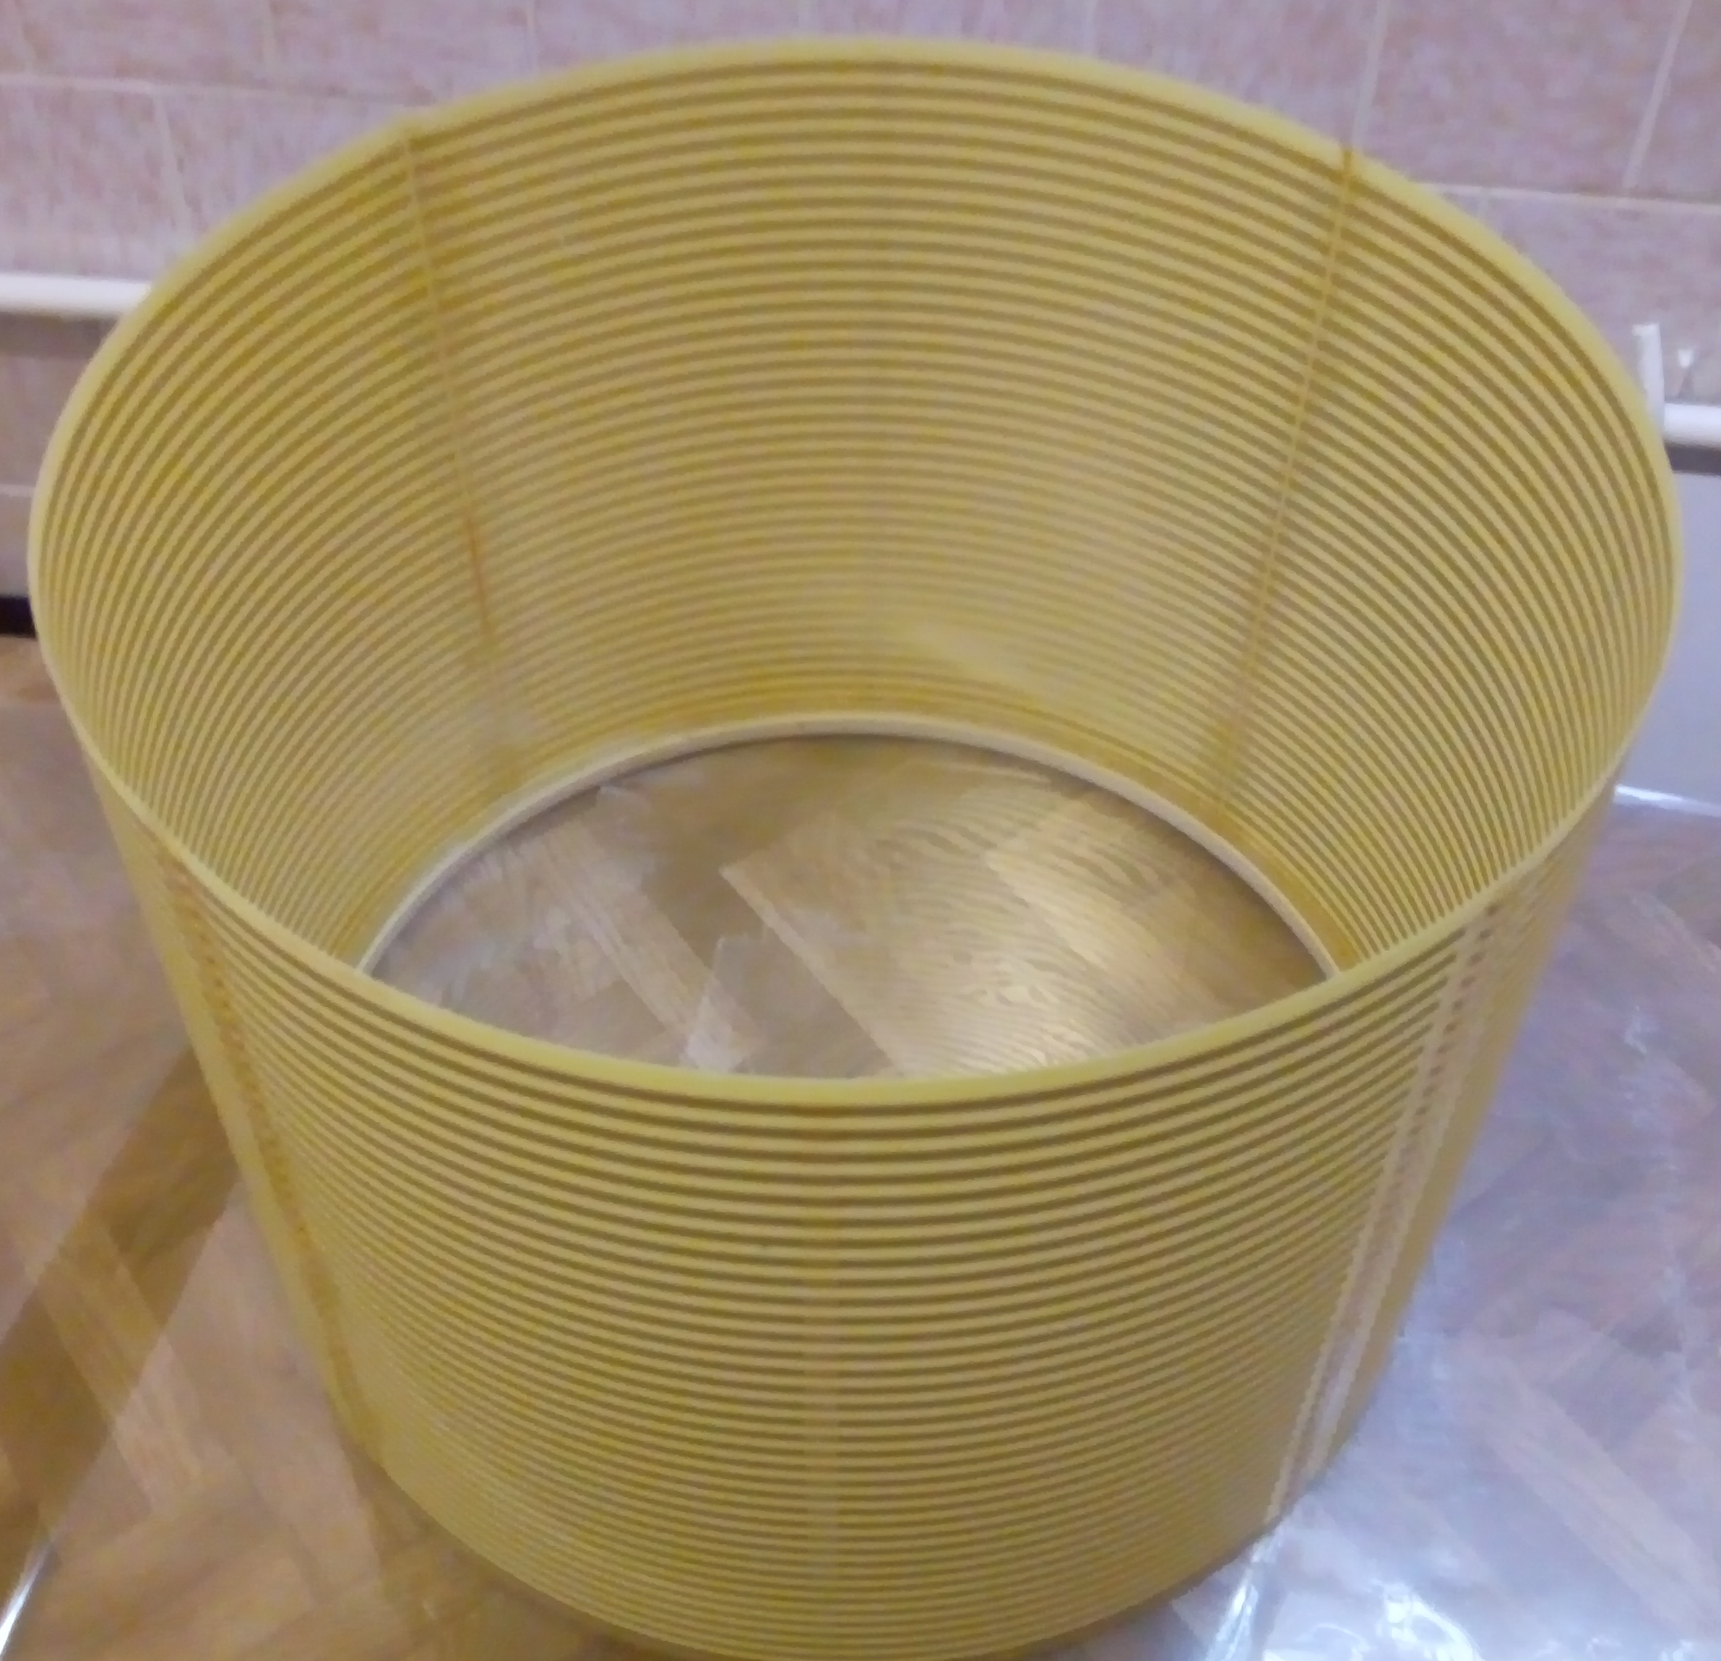
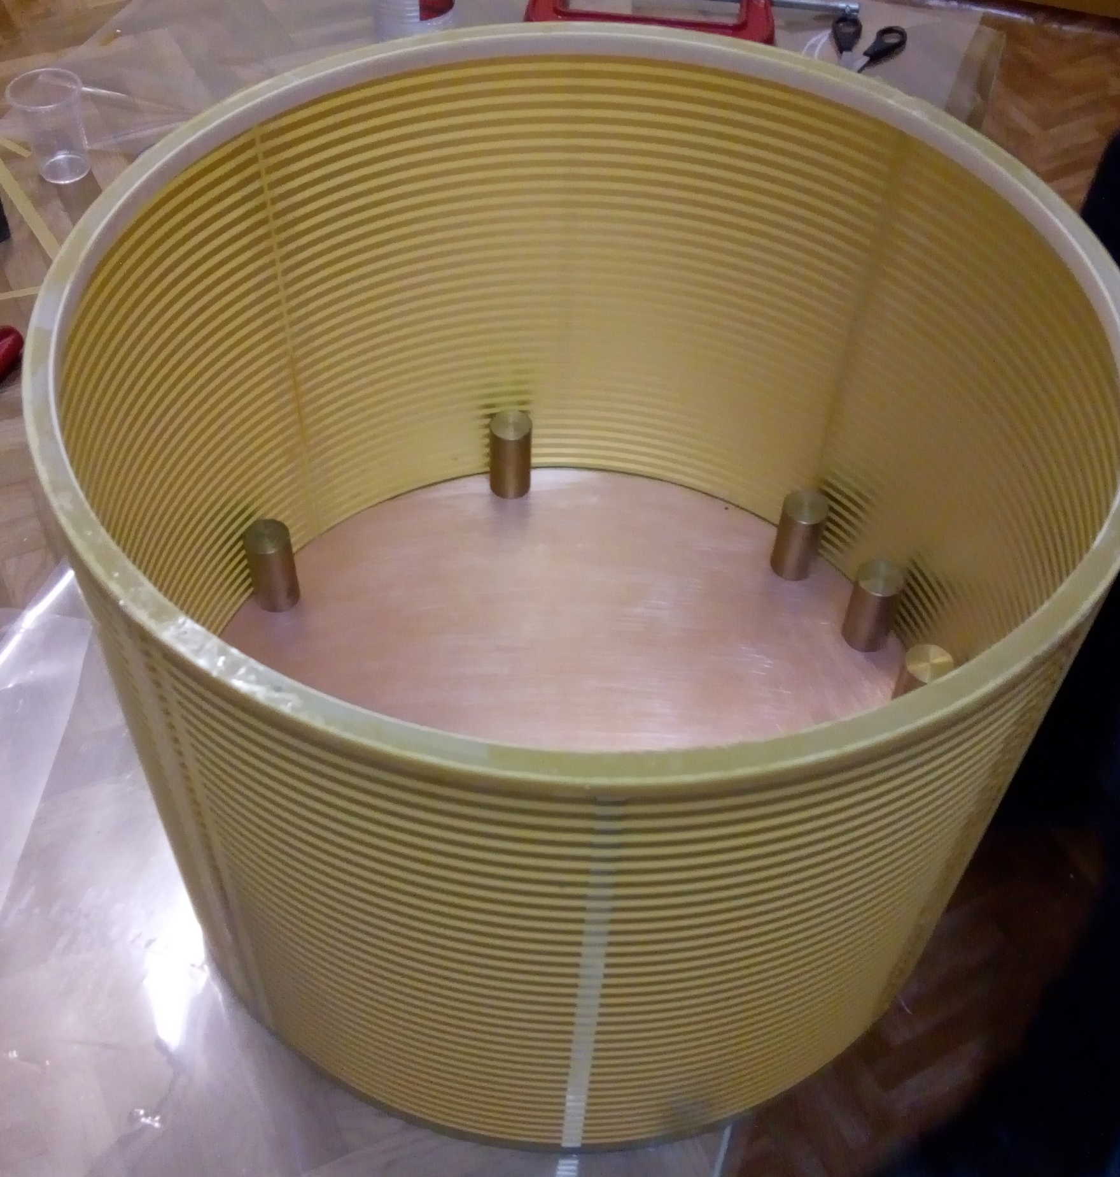
TPC field cage construction

Slide 11
Glueing
End-cap plate with HV electrode and rings
400
Cylinder with HV divider
Cross-section of the edge of the end-cap plate

Slide 12
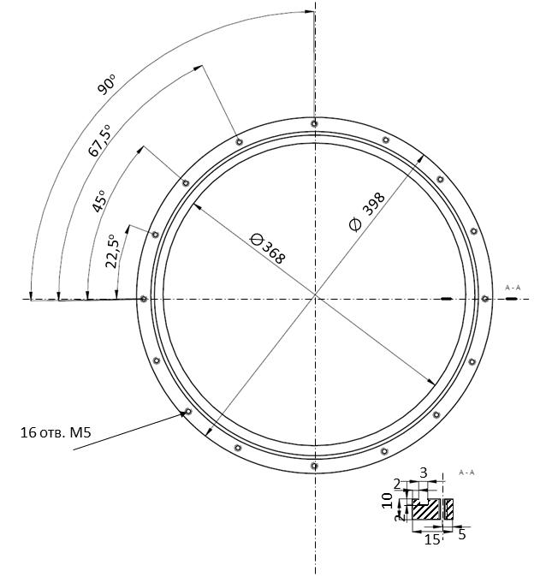
End-cap plate
with readout
structure
Cylinder wall
Fixation ring with gasket

Slide 13
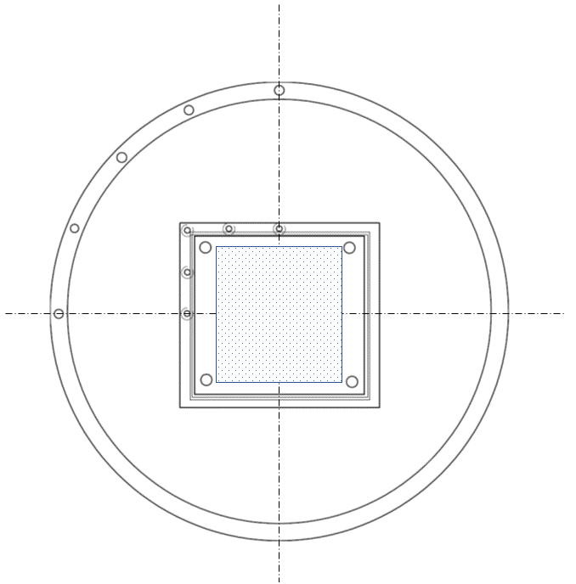
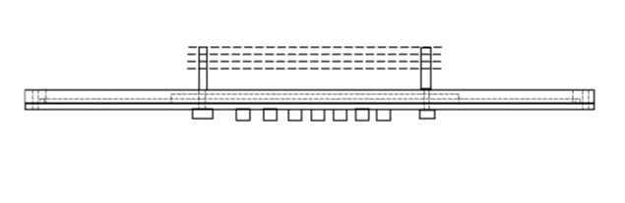
End-cap plate
with readout
detector
Readout detector
Connectors for electronics

Slide 14
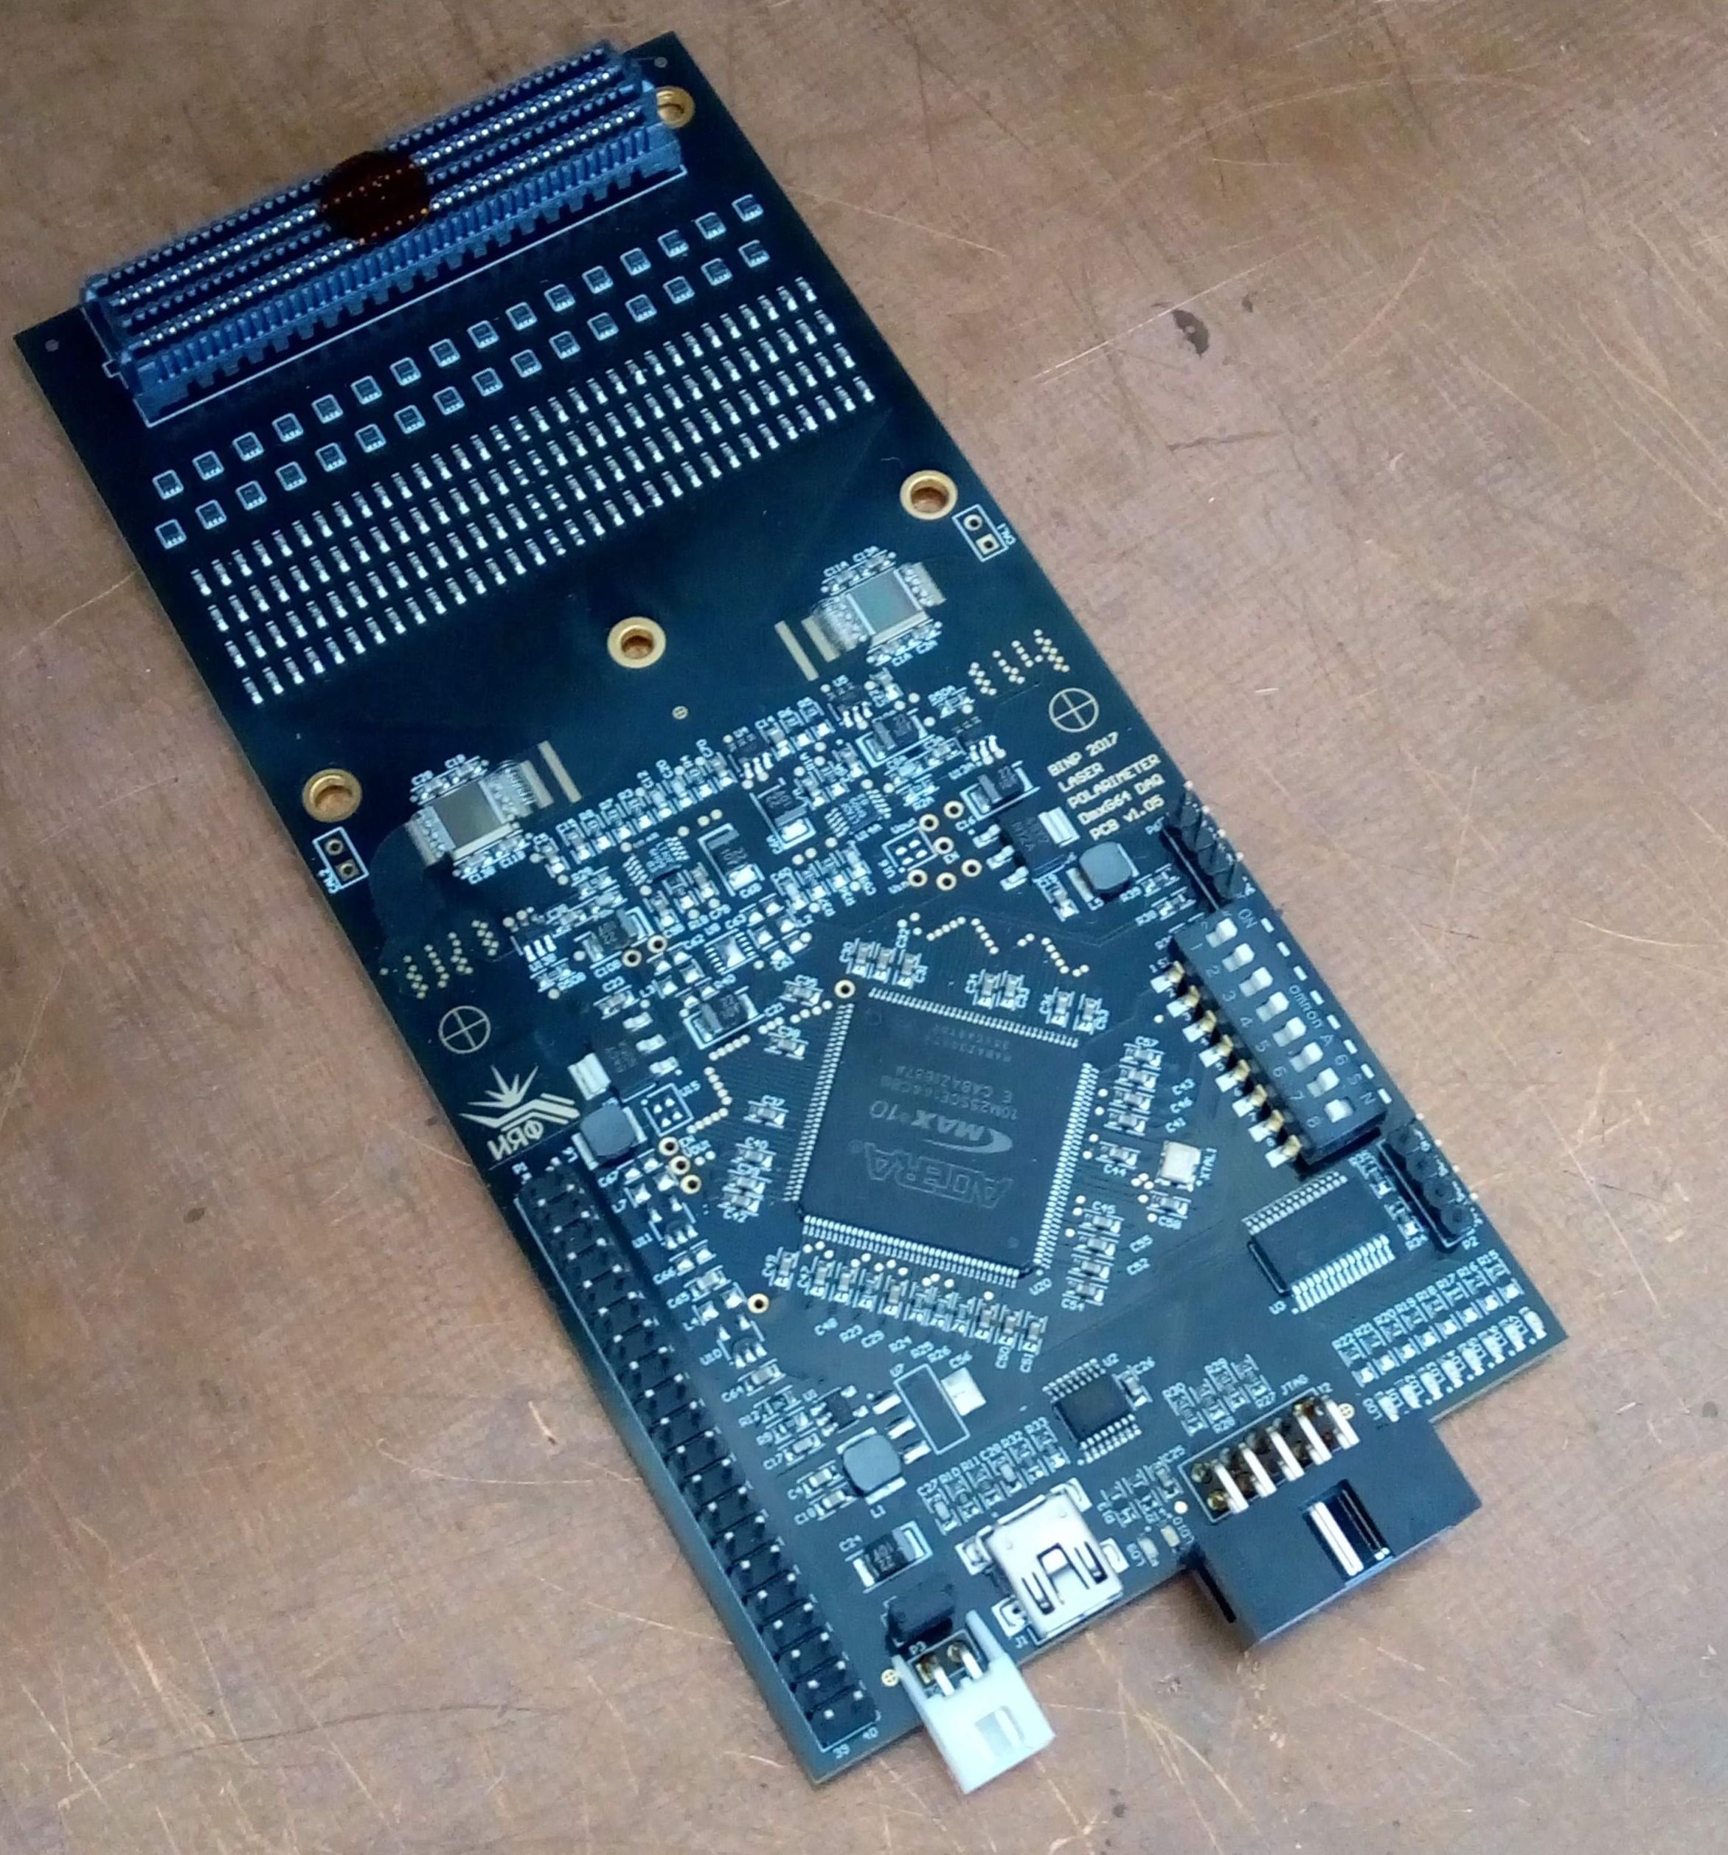
Readout detector and electronics
First readout detector – quad-GEMs, then 2(3)GEMs-muRWELL
Readout structure with several groups of pads with different size 1-4 mm
Electronics based on DMXG64B ASIC (CSA+100 cells of analogue memory)
128-channel board

Slide 15
Current status:
Field cage is almost ready
Design drawings of readout end-cap and its parts are prepared
Concept of the readout board is ready
TDR of the prototype is on the way
Next steps for 2021:
Prototype
Order parts of the readout end-cap
Design of the readout board
Finish TDR for the prototype
Assemble the prototype
Simulations
Simulation of spatial resolution (hit and track)
Simulation of space charge fluctuations
Learning of TPC track reconstruction software with CERN group

