Slide 1
How many background tracks will be detected in TPC?
Primary processes:
Two-photon processes e⁺e⁻ → γ∗γ∗→e⁺e⁻e⁺e⁻ (E_{e+e-}>2MeV) - 2.9mb (at 3 GeV per beam), DIAG36
However at 1.5 T field radius of electron trajectory with p_{t} = 1 MeV/c will be ~2 mm
For p_{t} = 15 MeV/c trajectory radius will be ~3 cm (inner radius of TPC)
For E_{e+e-} >30 MeV cross-section for e⁺e⁻ → γ∗γ∗→e⁺e⁻e⁺e⁻ is equal to 5.5 μb (3 GeV per beam), that gives 2.8x10⁻³ particles/bunch crossing (L=10³⁵ cm⁻² s⁻¹ )
2. Radiative Bha-Bha e⁺e⁻ →e⁺e⁻γ(nγ) (θ>5mrad), Eγ>1MeV) - 1.2mb (at 3 GeV per beam), BHWIDE
Particles with θ=5mrad will interact with vacuum pipe wall at Z=3m (VP radius is equal to 15 mm). Acceptance of TPC is 0.1 rad < θ < π/2.
For θ>100 mrad, Eγ>1MeV cross-section of e⁺e⁻ →e⁺e⁻γ(nγ) process is equal to ~2.8 μb (3 GeV per beam), that gives ~1.4x10⁻³ particles/bunch crossing

Slide 2
TPC as Inner Tracker
Outer radius 20 cm
Beam pipe, inner radius 1.5 cm
Inner radius 3 cm
-30 cm < Z < 30 cm

Slide 3
How many background tracks will be detected in TPC?
Drift velocity in 1.5 T B-field for one of the most popular TPC mixtures Ar+10%CH₄ is 5 cm/μs for
electric field of 100-200 V/cm.
Electrons drift time is 6 μs -> 1200 bunch crossings -> ~5 primary background tracks
How many secondaries?

Slide 4
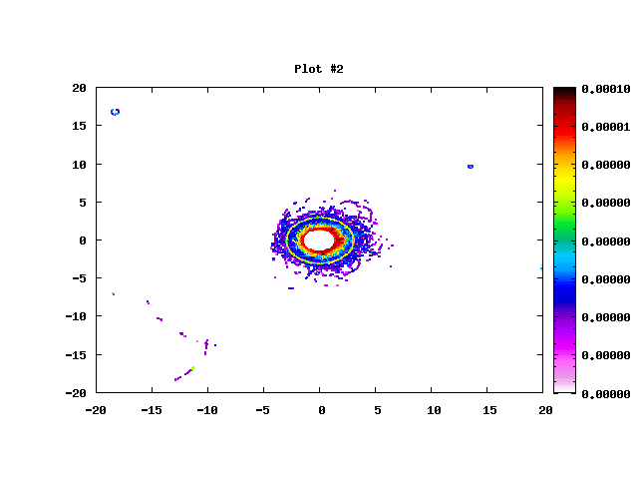
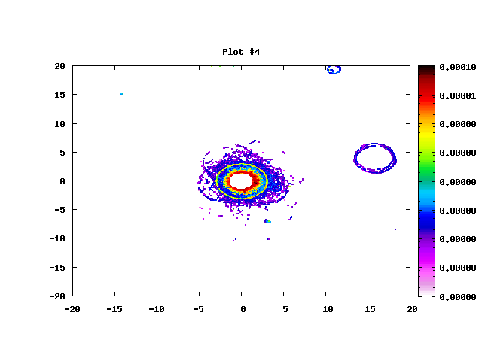
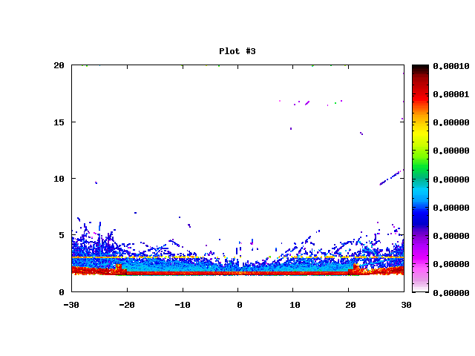
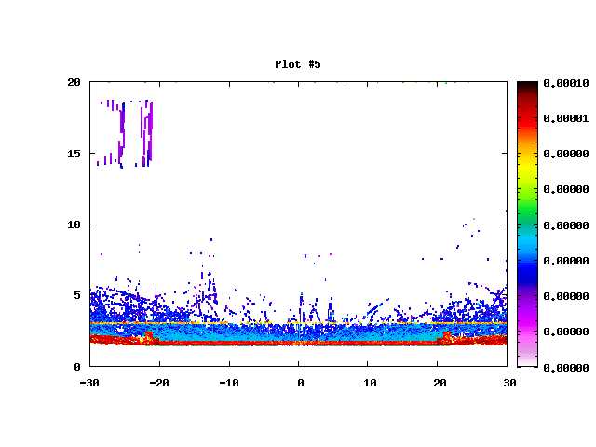
Examples of TPC occupancy (energy depositions) within 6 μs
Sample 1
Sample 2
Y, cm
Y, cm
X, cm
X, cm
R, cm
R, cm
Z, cm
Z, cm

Slide 5
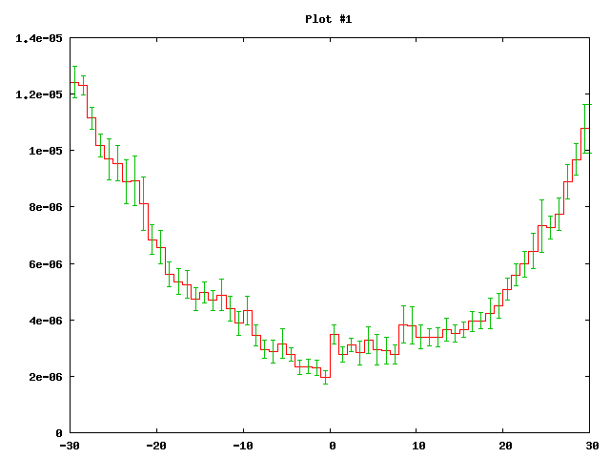
How many background tracks will be detected in TPC?
84
72
60
48
36
24
12
0
Number of charge particle tracks per TPC cross-section within 6 μs
Particles/TPC /6μs
Z, cm

