Slide 1
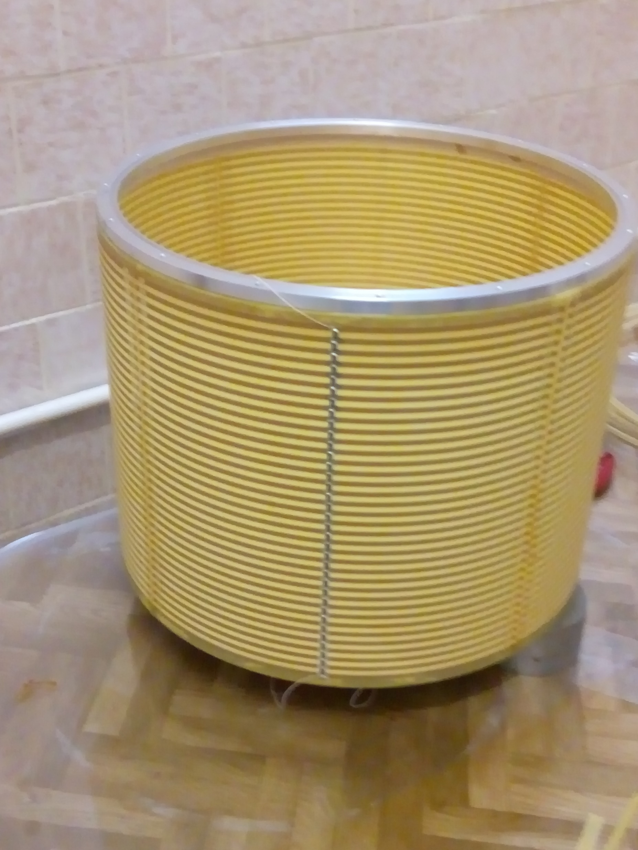
Status of the TPC prototype
Flange for the end-cap detector
Field cage is ready
Design of the end-cap detector is going on
The main problem that we are addressing now is high potential at the top electrode of the end-cap detector that has to be equal to the potential at the wall of the field cage.
Resistive divider
40 cm
0.5 kV
15 kV
37 cm
~3 kV
Readout electronics
Amplification structure (triple GEM)

Slide 2
Solution of the problem: different positions of the readout detector depending on the gas mixture and type of the amplification structure
6 kV
~2 kV
9 cm
Ar-CH₄(90-10), 0.2 kV/cm
30 kV
~3 kV
2 cm
Ar-CO₂ (80-20), 1 kV/cm

Slide 3
Plan for the prototype:
Define 2-3 gas mixtures
Finalize design drawings for the end-cap detector parts
Technical design report (October-November)

