Slide 1

Status of Novosibirsk SCTF
A.Bogomyagkov (BINP)
The 4th CREMLINplus WP5 general meeting
08-09 July 2021
Notes:
call,file="ct_ring-49_6.str; call,file="ct_ring-49_6.seq";

Slide 2
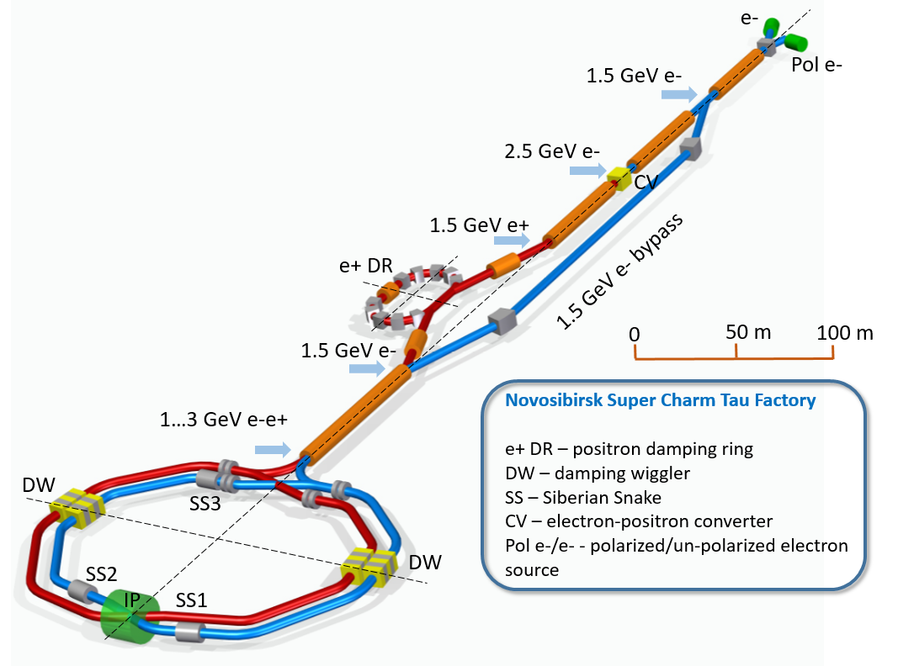
The whole facility

Slide 3
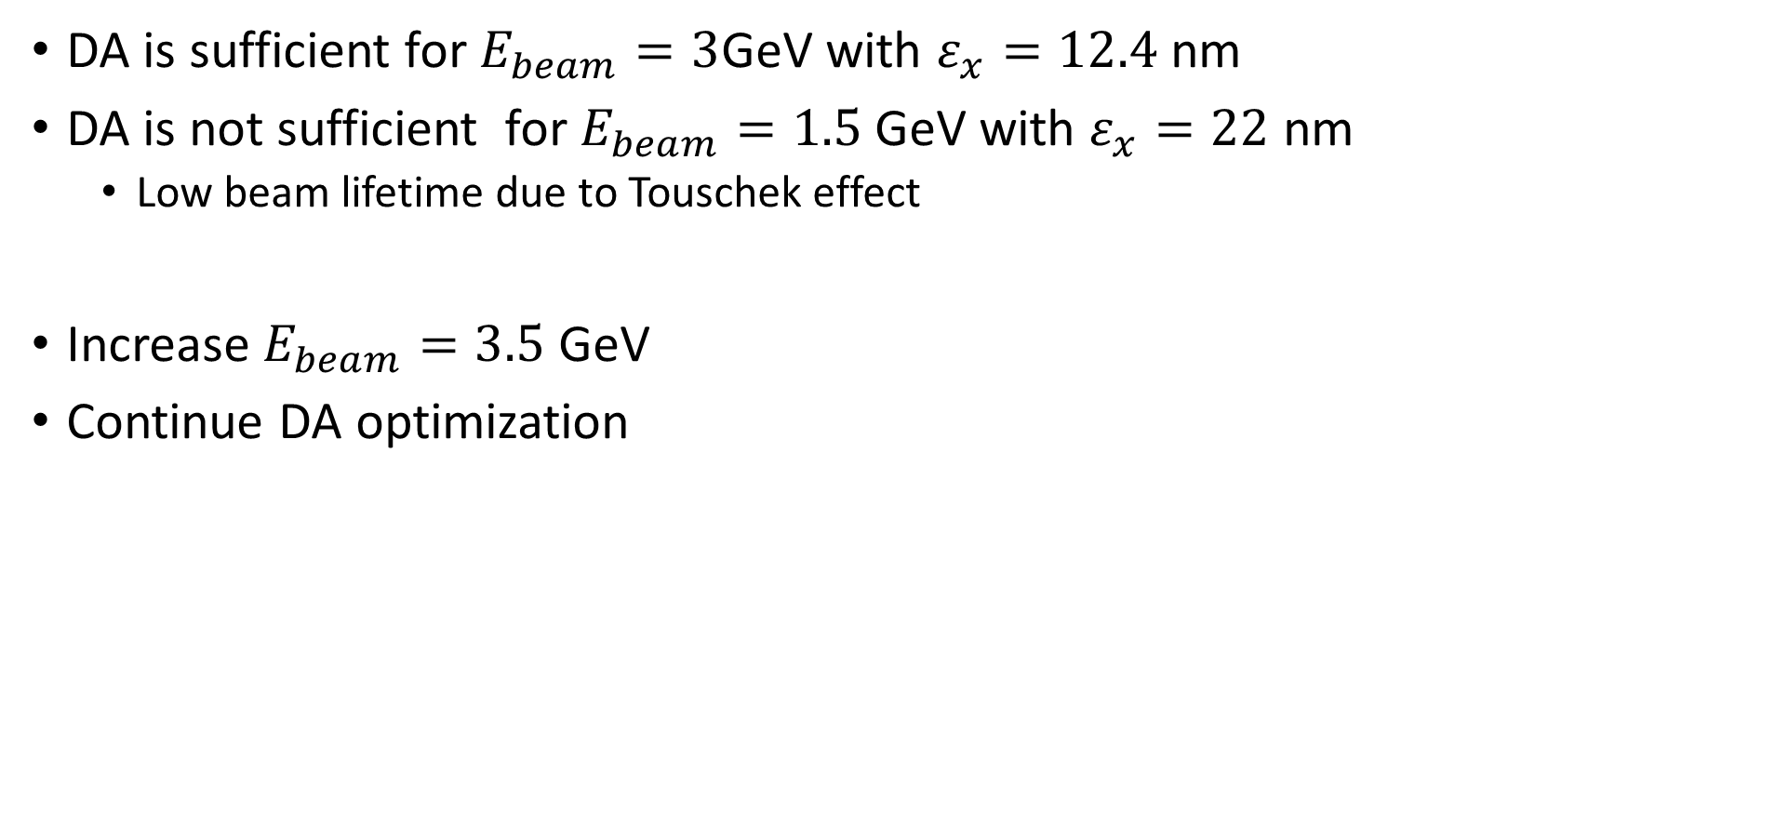
Status at the 2020 and Tasks for 2021
DA is sufficient for $E_{beam}=3$GeV with $ε_{x}=12.4$ nm
DA is not sufficient for $E_{beam}=1.5$ GeV with $ε_{x}=22$ nm
  Low beam lifetime due to Touschek effect
Increase $E_{beam}=3.5$ GeV
Continue DA optimization

Slide 4
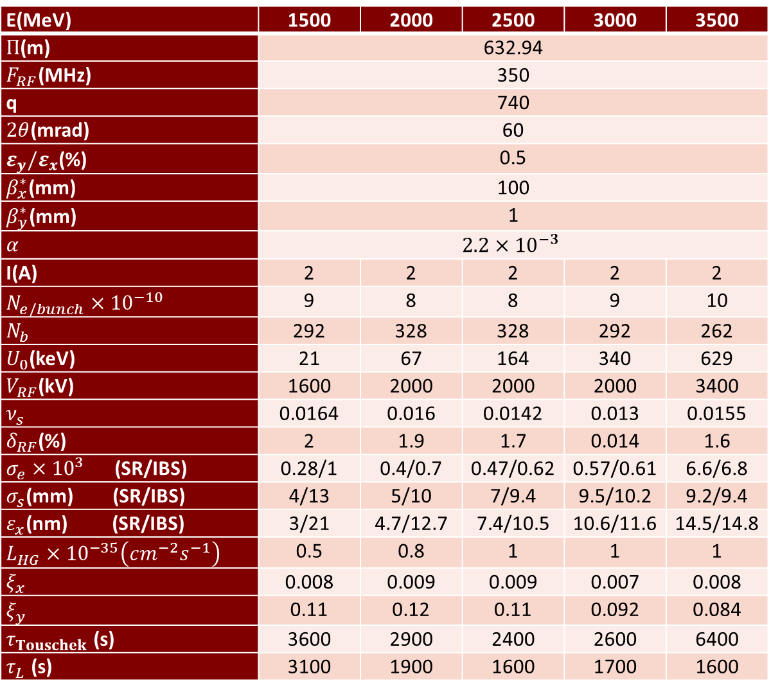
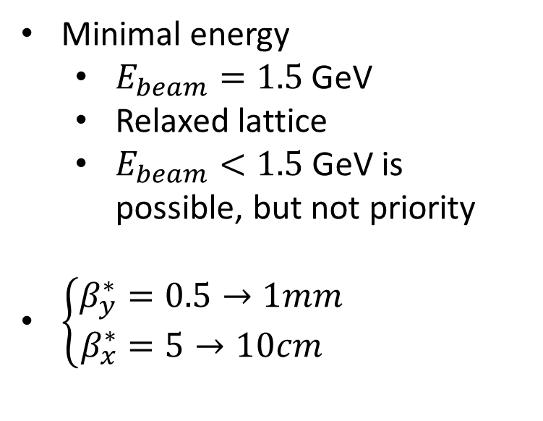
Parameters 2021
E(MeV) | 1500 | 2000 | 2500 | 3000 | 3500
$Π$(m) | 632.94
$F_{RF}$(MHz) | 350
q | 740
$2θ$(mrad) | 60
$ε_{y}/ε_{x}$(%) | 0.5
$β_{x}^{∗}$(mm) | 100
$β_{y}^{∗}$(mm) | 1
$α$ | $$2.2×{10}^{−3}$$
I(A) | 2 | 2 | 2 | 2 | 2
$N_{e/bunch}×{10}^{−10}$ | 9 | 8 | 8 | 9 | 10
$N_{b}$ | 292 | 328 | 328 | 292 | 262
$U_{0}$(keV) | 21 | 67 | 164 | 340 | 629
$V_{RF}$(kV) | 1600 | 2000 | 2000 | 2000 | 3400
$ν_{s}$ | 0.0164 | 0.016 | 0.0142 | 0.013 | 0.0155
$δ_{RF}$(%) | 2 | 1.9 | 1.7 | 0.014 | 1.6
$σ_{e}×{10}^{3}$ (SR/IBS) | 0.28/1 | 0.4/0.7 | 0.47/0.62 | 0.57/0.61 | 6.6/6.8
$σ_{s}$(mm) (SR/IBS) | 4/13 | 5/10 | 7/9.4 | 9.5/10.2 | 9.2/9.4
$ε_{x}$(nm) (SR/IBS) | 3/21 | 4.7/12.7 | 7.4/10.5 | 10.6/11.6 | 14.5/14.8
$L_{HG}×{10}^{−35}\left(cm^{−2}s^{−1}\right)$ | 0.5 | 0.8 | 1 | 1 | 1
$ξ_{x}$ | 0.008 | 0.009 | 0.009 | 0.007 | 0.008
$ξ_{y}$ | 0.11 | 0.12 | 0.11 | 0.092 | 0.084
$τ_{Touschek}$ (s) | 3600 | 2900 | 2400 | 2600 | 6400
$τ_{L}$ (s) | 3100 | 1900 | 1600 | 1700 | 1600
Minimal energy
  $E_{beam}=1.5$ GeV
  Relaxed lattice
  $E_{beam}<1.5$ GeV is possible, but not priority
$\left\{\begin{aligned}β_{y}^{∗}&=0.5→1mm \\ β_{x}^{∗}&=5→10cm\end{aligned}\right.$

Slide 5
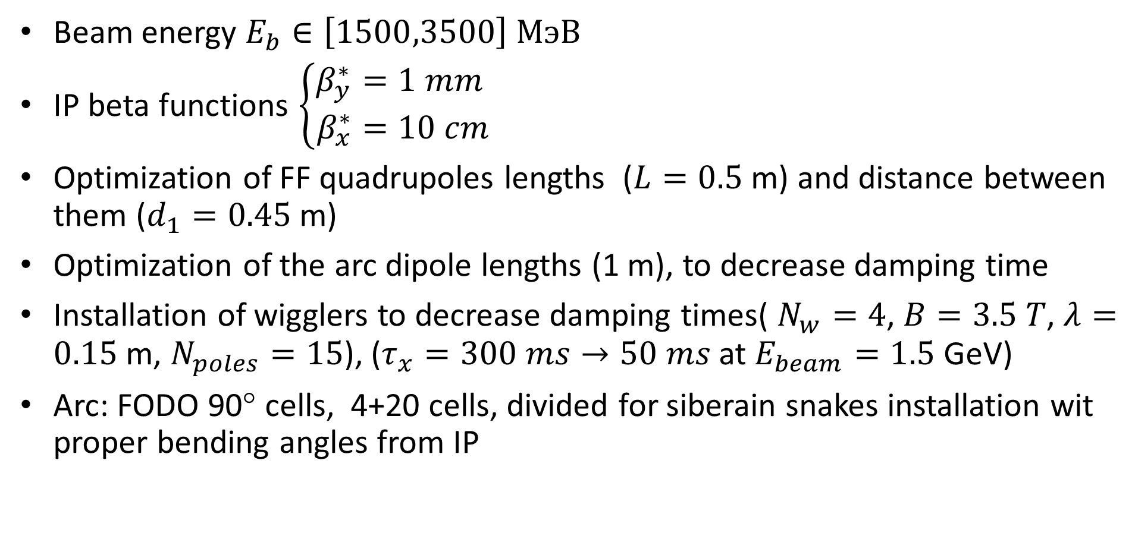
Comments for parameters 2021
Beam energy $E_{b}∈\left[1500,3500\right] МэВ$
IP beta functions $\left\{\begin{aligned}β_{y}^{∗}&=1 mm \\ β_{x}^{∗}&=10 cm\end{aligned}\right.$
Optimization of FF quadrupoles lengths ($L=0.5$ m) and distance between them ($d_{1}=0.45$ m)
Optimization of the arc dipole lengths (1 m), to decrease damping time
Installation of wigglers to decrease damping times( $N_{w}=4$, $B=3.5 T$, $λ=0.15$ m, $N_{poles}=15$), ($τ_{x}=300 ms→50 ms$ at $E_{beam}=1.5$ GeV)
Arc: FODO 90° cells, 4+20 cells, divided for siberain snakes installation wit proper bending angles from IP

Slide 6
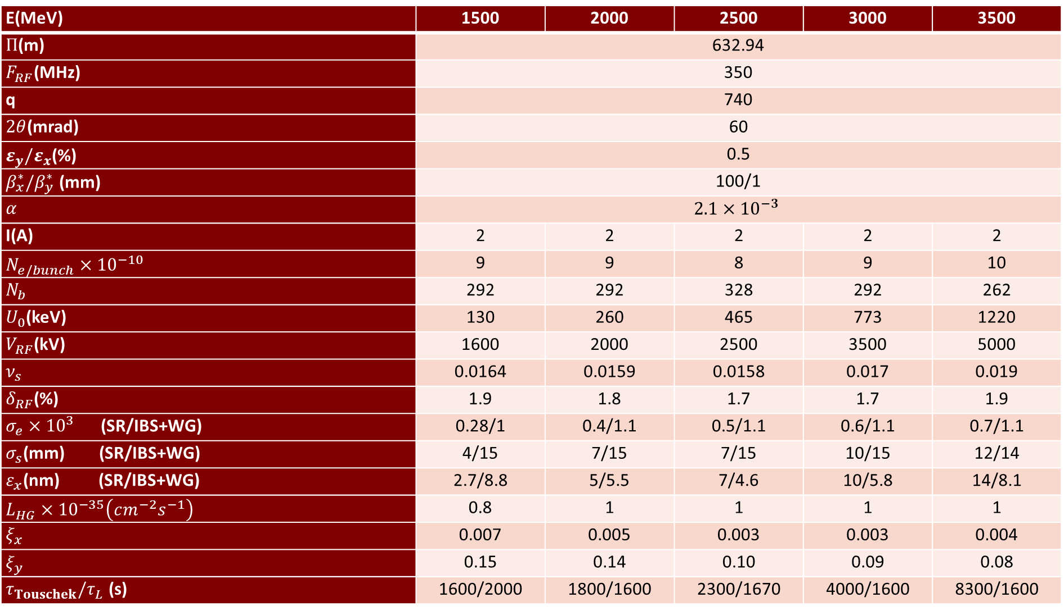
E(MeV) | 1500 | 2000 | 2500 | 3000 | 3500
$Π$(m) | 632.94
$F_{RF}$(MHz) | 350
q | 740
$2θ$(mrad) | 60
$ε_{y}/ε_{x}$(%) | 0.5
$β_{x}^{∗}/β_{y}^{∗}$ (mm) | 100/1
$α$ | $$2.1×{10}^{−3}$$
I(A) | 2 | 2 | 2 | 2 | 2
$N_{e/bunch}×{10}^{−10}$ | 9 | 9 | 8 | 9 | 10
$N_{b}$ | 292 | 292 | 328 | 292 | 262
$U_{0}$(keV) | 130 | 260 | 465 | 773 | 1220
$V_{RF}$(kV) | 1600 | 2000 | 2500 | 3500 | 5000
$ν_{s}$ | 0.0164 | 0.0159 | 0.0158 | 0.017 | 0.019
$δ_{RF}$(%) | 1.9 | 1.8 | 1.7 | 1.7 | 1.9
$σ_{e}×{10}^{3}$ (SR/IBS+WG) | 0.28/1 | 0.4/1.1 | 0.5/1.1 | 0.6/1.1 | 0.7/1.1
$σ_{s}$(mm) (SR/IBS+WG) | 4/15 | 7/15 | 7/15 | 10/15 | 12/14
$ε_{x}$(nm) (SR/IBS+WG) | 2.7/8.8 | 5/5.5 | 7/4.6 | 10/5.8 | 14/8.1
$L_{HG}×{10}^{−35}\left(cm^{−2}s^{−1}\right)$ | 0.8 | 1 | 1 | 1 | 1
$ξ_{x}$ | 0.007 | 0.005 | 0.003 | 0.003 | 0.004
$ξ_{y}$ | 0.15 | 0.14 | 0.10 | 0.09 | 0.08
$τ_{Touschek}/τ_{L}$ (s) | 1600/2000 | 1800/1600 | 2300/1670 | 4000/1600 | 8300/1600
Notes:
54_1

Slide 7
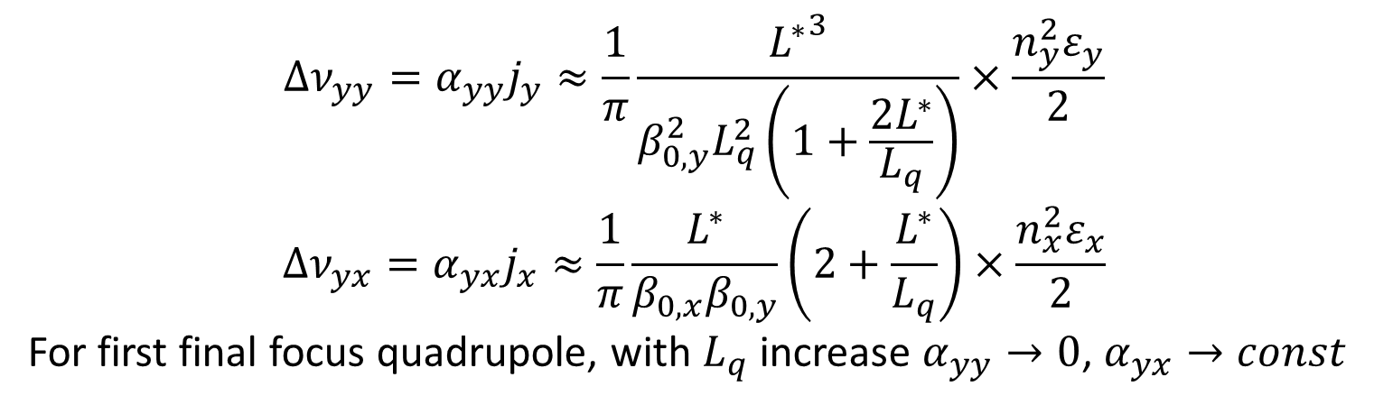
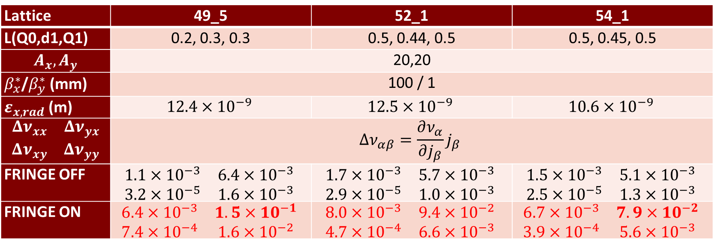
2021: Optimization of the final doublet
$$Δν_{yy}=α_{yy}j_{y}≈\frac{1}{π}\frac{{L^{∗}}^{3}}{{β_{0,y}^{2}L}_{q}^{2}\left(1+\frac{2L^{∗}}{L_{q}}\right)}×\frac{n_{y}^{2}ε_{y}}{2}$$
$$Δν_{yx}=α_{yx}j_{x}≈\frac{1}{π}\frac{L^{∗}}{β_{0,x}β_{0,y}}\left(2+\frac{L^{∗}}{L_{q}}\right)×\frac{n_{x}^{2}ε_{x}}{2}$$
For first final focus quadrupole, with $L_{q}$ increase $α_{yy}→0$, $α_{yx}→const$
IP
L*
d1
Q0
Q1
Lattice | 49_5 | 52_1 | 54_1
L(Q0,d1,Q1) | 0.2, 0.3, 0.3 | 0.5, 0.44, 0.5 | 0.5, 0.45, 0.5
$$A_{x}, A_{y}$$ | 20,20
$β_{x}^{∗}$/$β_{y}^{∗}$(mm) | 100 / 1
$ε_{x, rad}$(m) | $$12.4×{10}^{−9}$$ | $$12.5×{10}^{−9}$$ | $$10.6×{10}^{−9}$$
$$\begin{matrix}Δν_{xx} & Δν_{yx} \\ Δν_{xy} & Δν_{yy}\end{matrix}$$ | $$Δν_{αβ}=\frac{∂ν_{α}}{∂j_{β}}j_{β}$$
FRINGE OFF | $$\begin{matrix}1.1×{10}^{−3} & 6.4×{10}^{−3} \\ 3.2×{10}^{−5} & 1.6×{10}^{−3}\end{matrix}$$ | $$\begin{matrix}1.7×{10}^{−3} & 5.7×{10}^{−3} \\ 2.9×{10}^{−5} & 1.0×{10}^{−3}\end{matrix}$$ | $$\begin{matrix}1.5×{10}^{−3} & 5.1×{10}^{−3} \\ 2.5×{10}^{−5} & 1.3×{10}^{−3}\end{matrix}$$
FRINGE ON | $$\begin{matrix}6.4×{10}^{−3} & 1.5×{10}^{−1} \\ 7.4×{10}^{−4} & 1.6×{10}^{−2}\end{matrix}$$ | $$\begin{matrix}8.0×{10}^{−3} & 9.4×{10}^{−2} \\ 4.7×{10}^{−4} & 6.6×{10}^{−3}\end{matrix}$$ | $$\begin{matrix}6.7×{10}^{−3} & 7.9×{10}^{−2} \\ 3.9×{10}^{−4} & 5.6×{10}^{−3}\end{matrix}$$
Notes:
call,file="../2020.10.11-22.59.05_sextupole_chrom-5.str";

Slide 8
2021: Final Focus trajectories

Slide 9
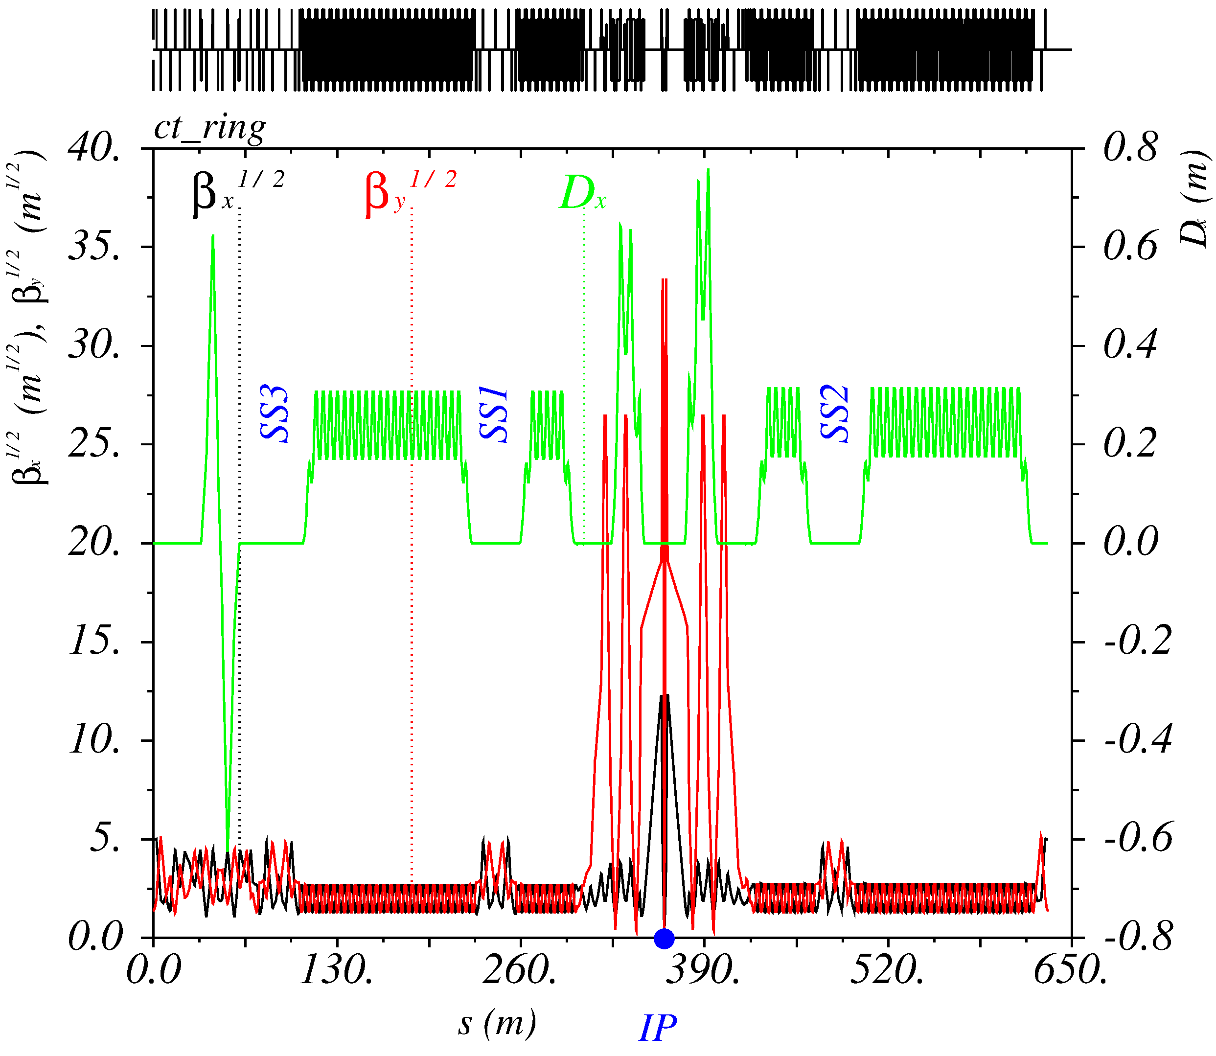
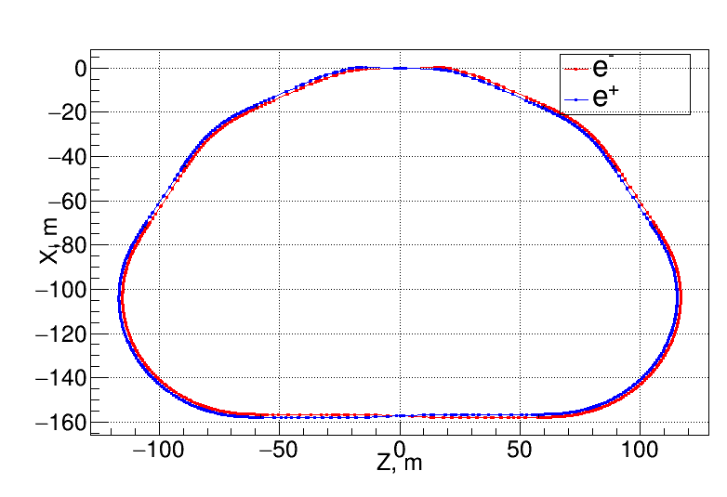
Lattice and layout 2021
IP
Interaction Region
SS
SS
SS
Xing
Inj
Notes:
54_1

Slide 10
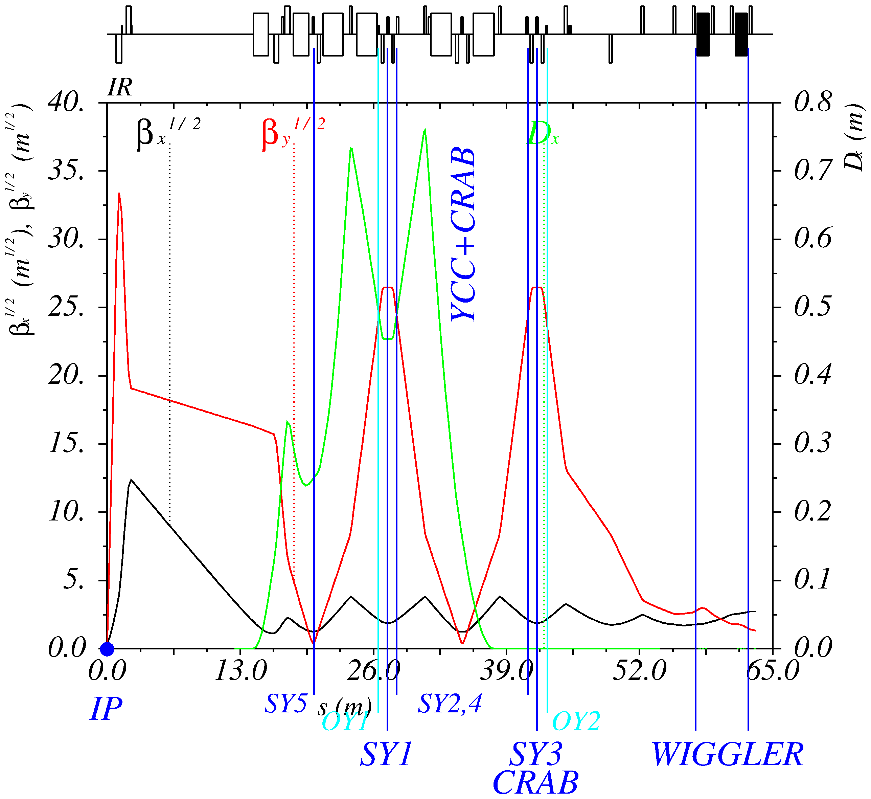
Interaction region

Slide 11
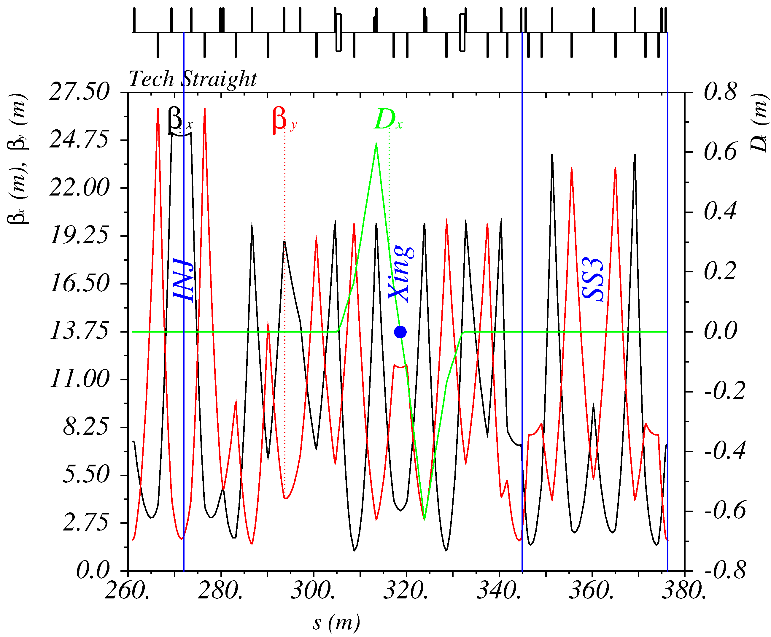
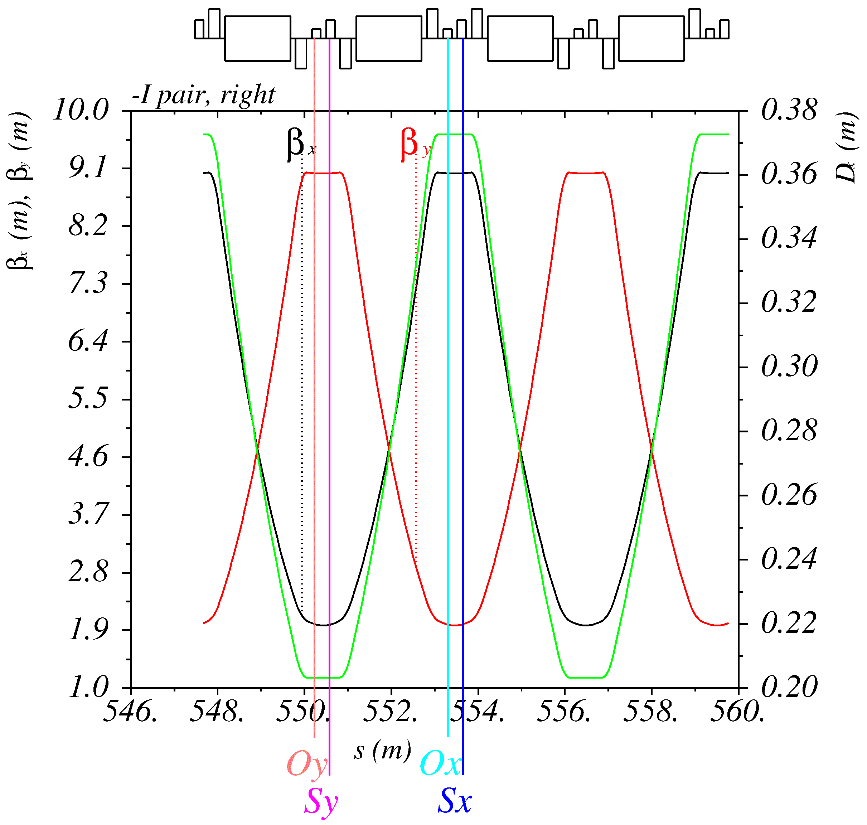
Straight and Arc sections
Straight
Arc: FODO 90° cells

Slide 12
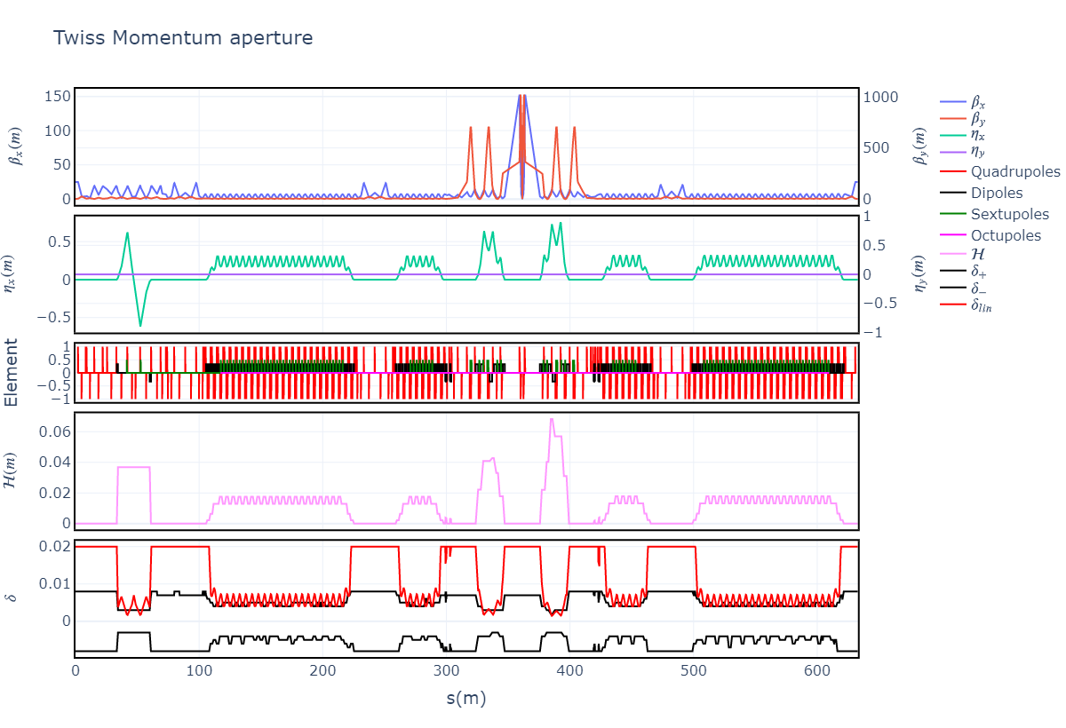
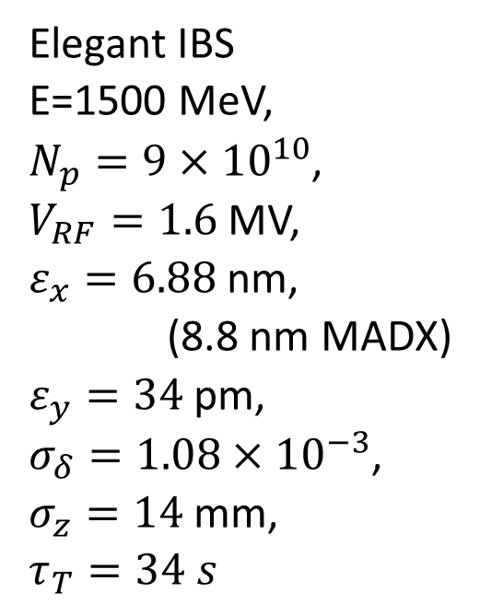
Momentum aperture with Elegant
Elegant IBS
E=1500 MeV,
$N_{p}=9×{10}^{10}$,
$V_{RF}=1.6$ MV,
$ε_{x}=6.88$ nm,
(8.8 nm MADX)
$ε_{y}=34$ pm,
$σ_{δ}=1.08×{10}^{−3}$,
$σ_{z}=14$ mm,
$τ_{T}=34 s$
Notes:
2021.06.17-13.08.03_sextupole_chrom-14.str

Slide 13
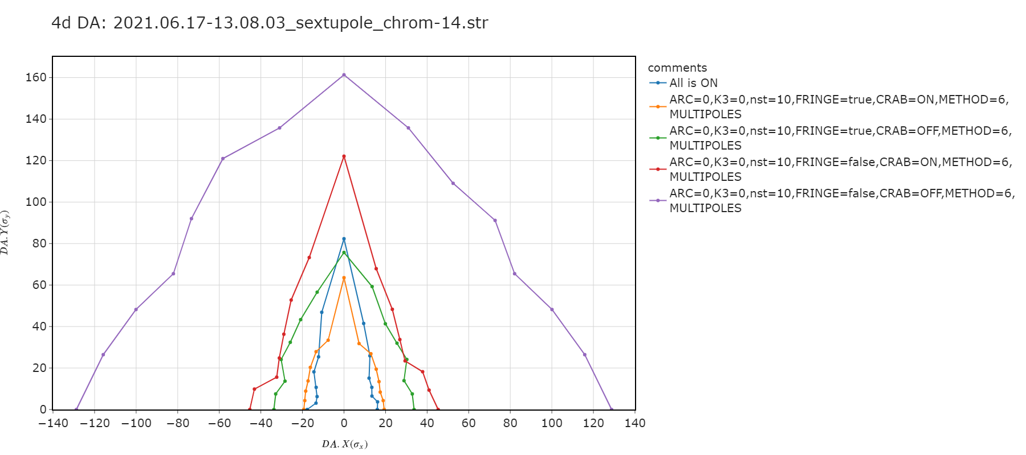
Study of 4d DA degradation
Notes:
Interference CRAB with kinematic and fringes

Slide 14
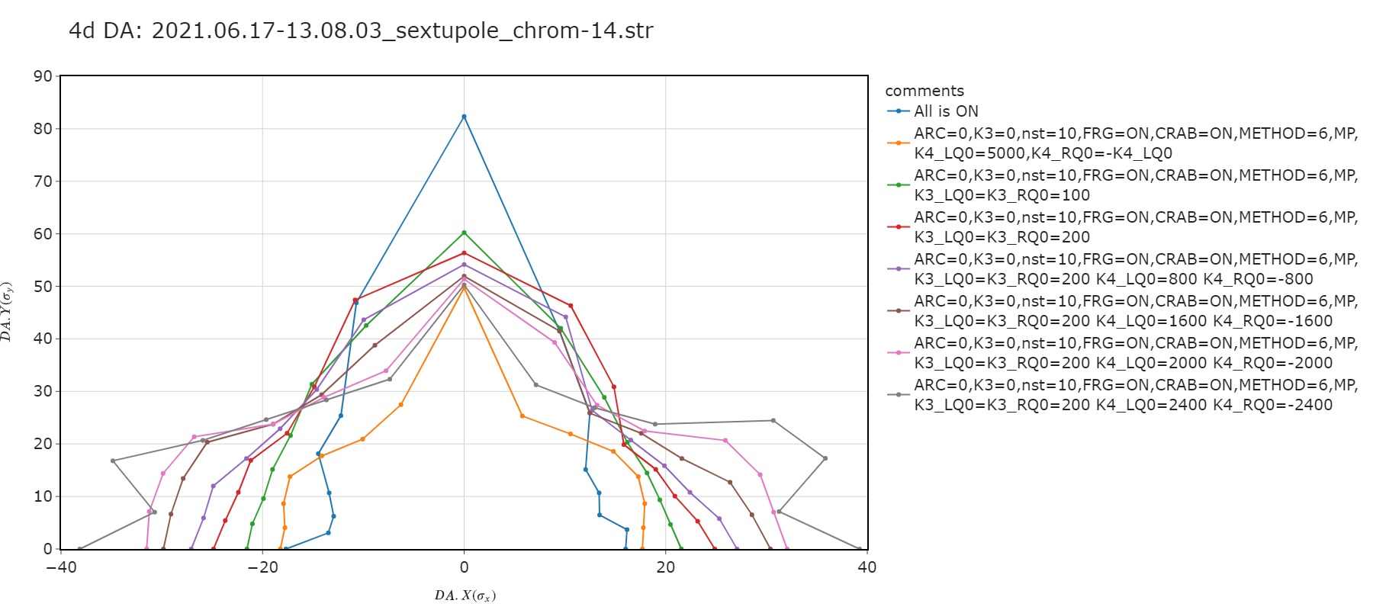
4d DA recovery by multipoles in FF quadrupoles
Notes:
Multipoles in FF quadrupoles

Slide 15
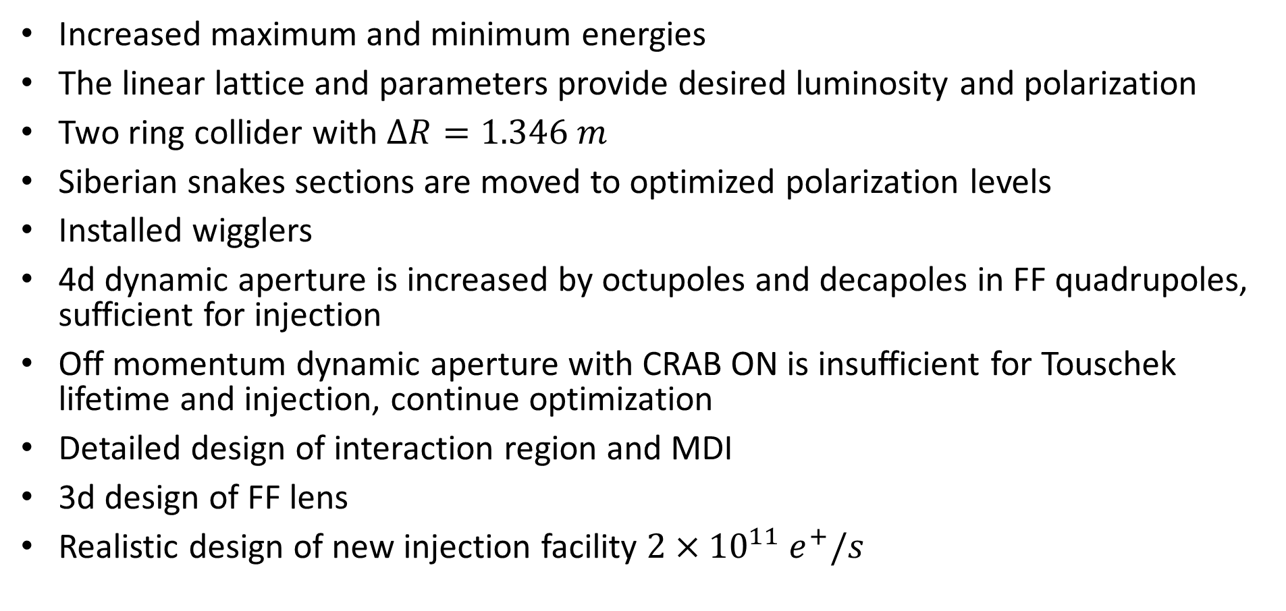
Conclusion
Increased maximum and minimum energies
The linear lattice and parameters provide desired luminosity and polarization
Two ring collider with $ΔR=1.346 m$
Siberian snakes sections are moved to optimized polarization levels
Installed wigglers
4d dynamic aperture is increased by octupoles and decapoles in FF quadrupoles, sufficient for injection
Off momentum dynamic aperture with CRAB ON is insufficient for Touschek lifetime and injection, continue optimization
Detailed design of interaction region and MDI
3d design of FF lens
Realistic design of new injection facility $2×{10}^{11} e^{+}/s$

Slide 16
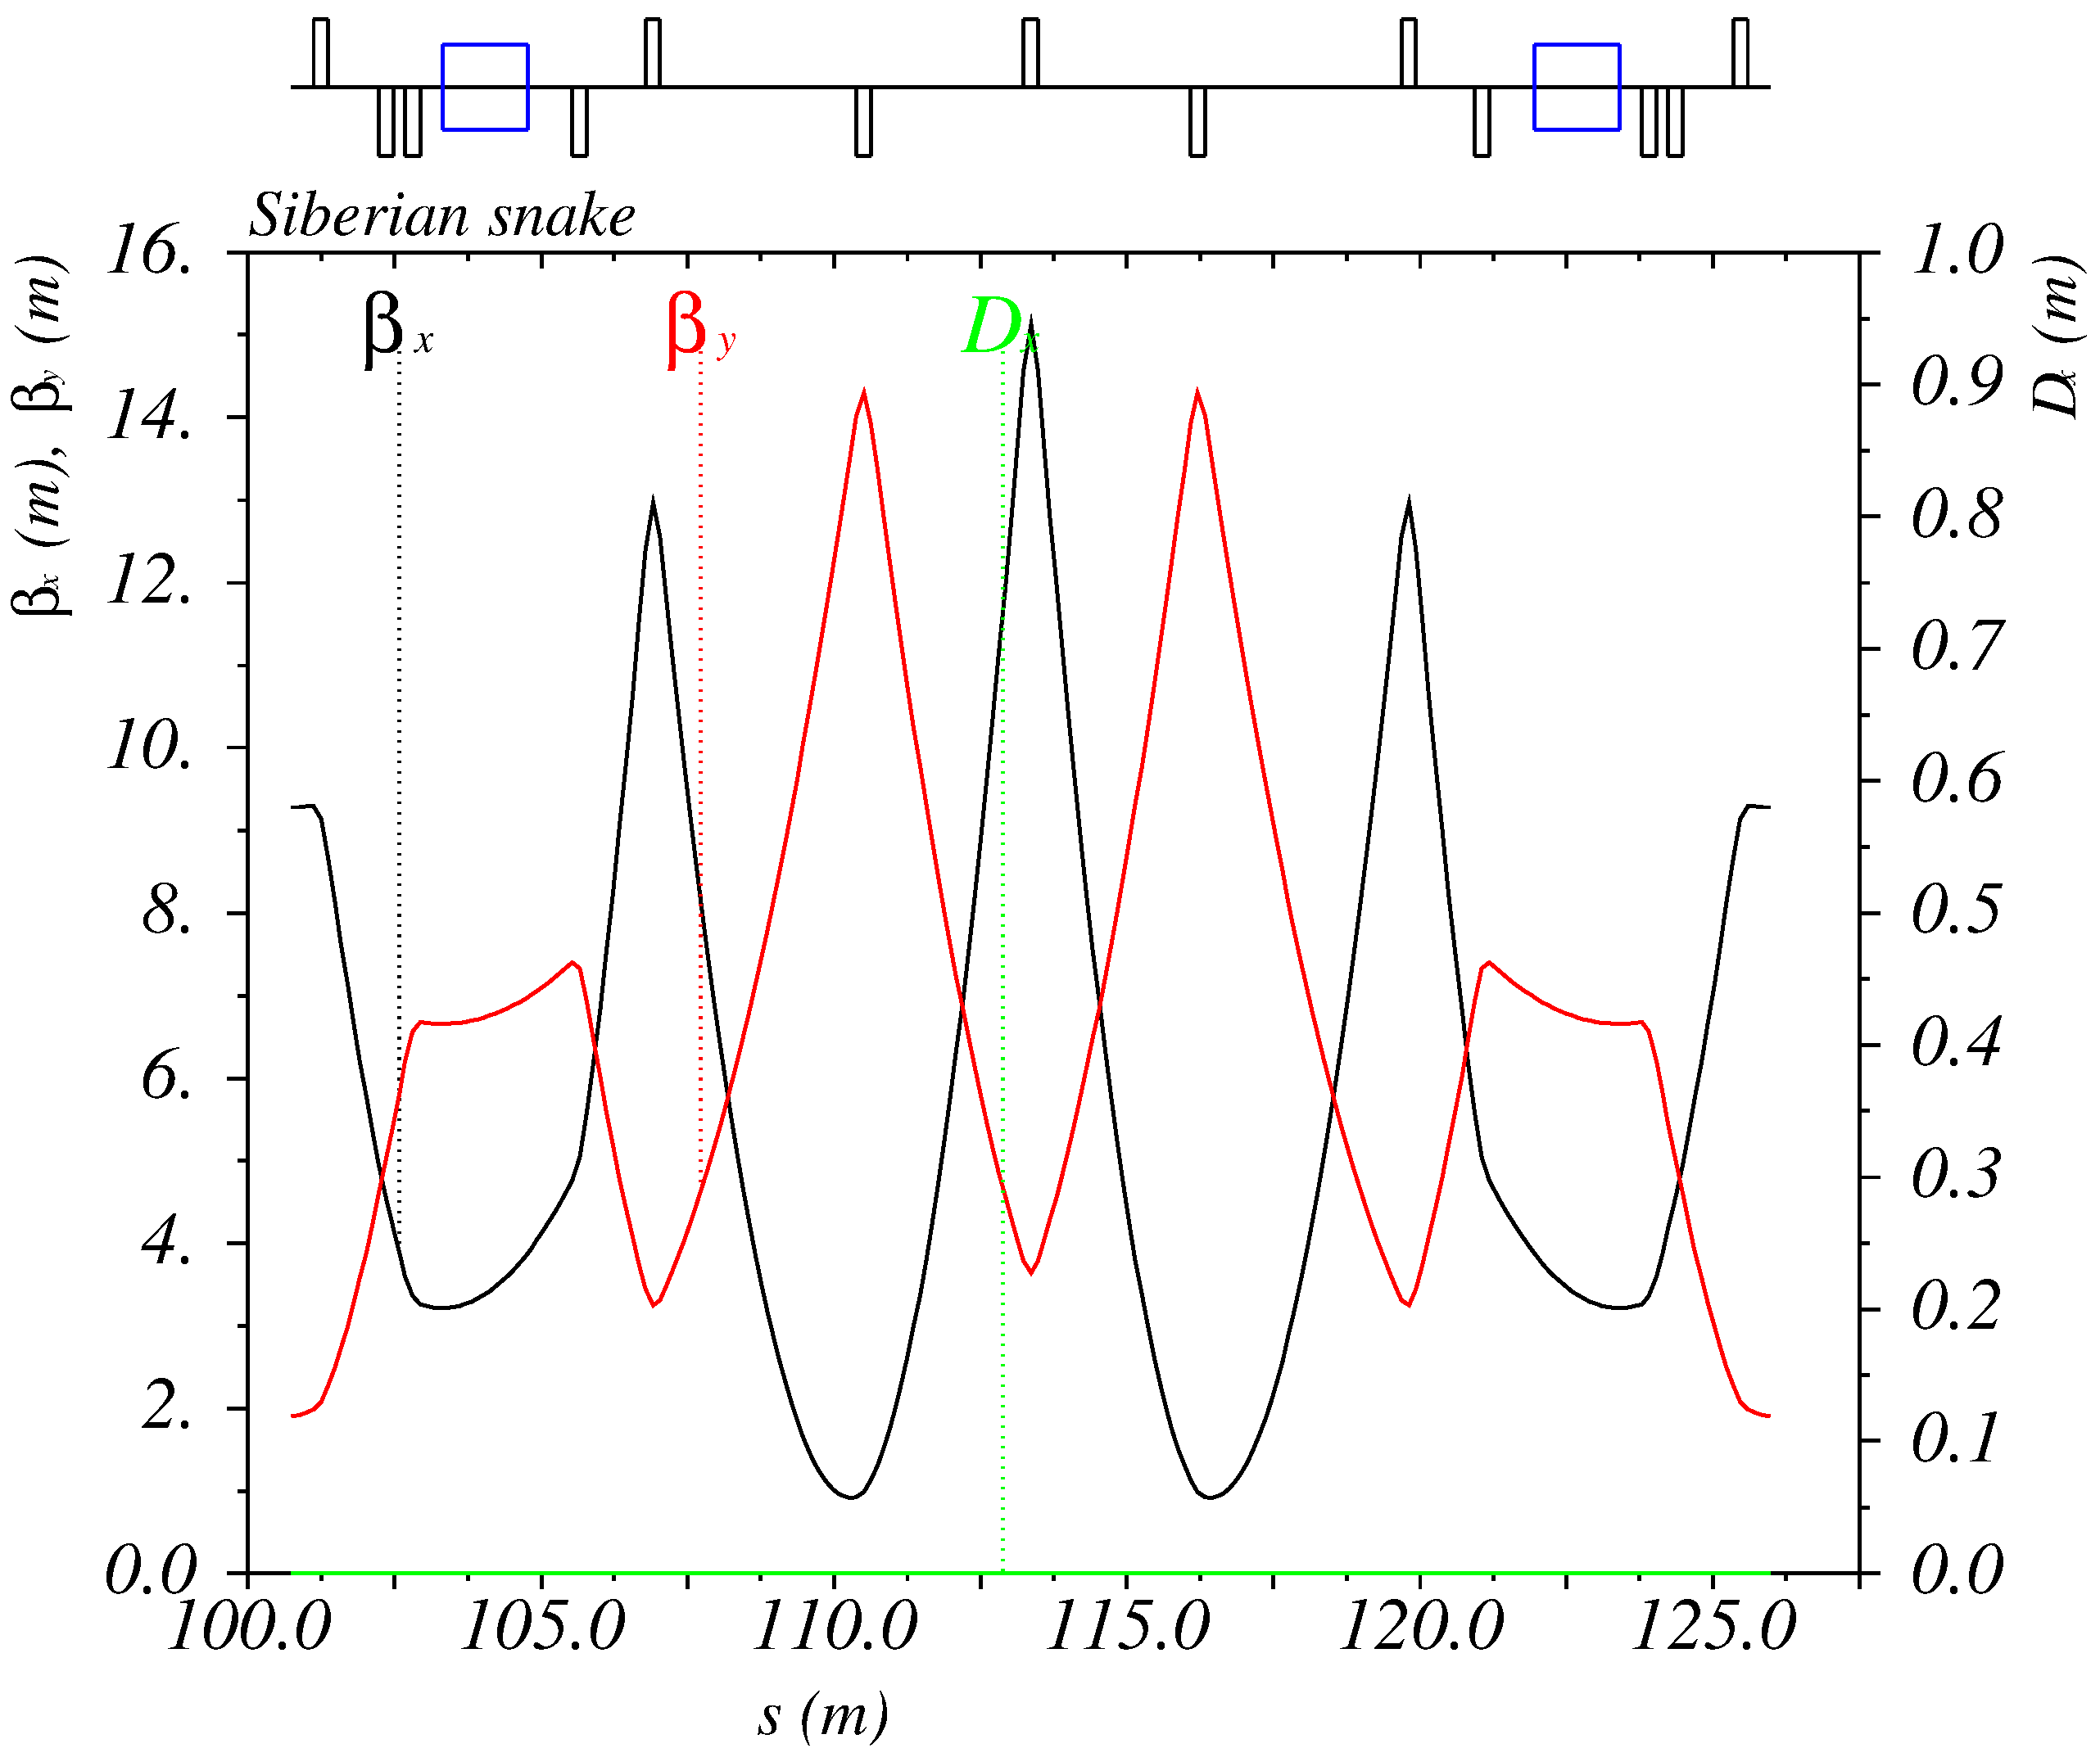
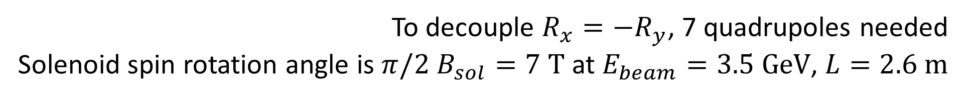
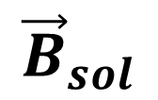
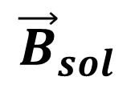
Siberian Snake
The goal is to provide longitudinal polarization at IP
$${\vec{B}}_{sol}$$
$${\vec{B}}_{sol}$$
120°
IP
SS2
SS1
120°
120°
SS3
To decouple $R_{x}=−R_{y}$, 7 quadrupoles needed
Solenoid spin rotation angle is $π/2$ $B_{sol}=7 \text{T}$ at $E_{beam}=3.5 \text{GeV}$, $L=2.6 \text{m}$

Slide 17
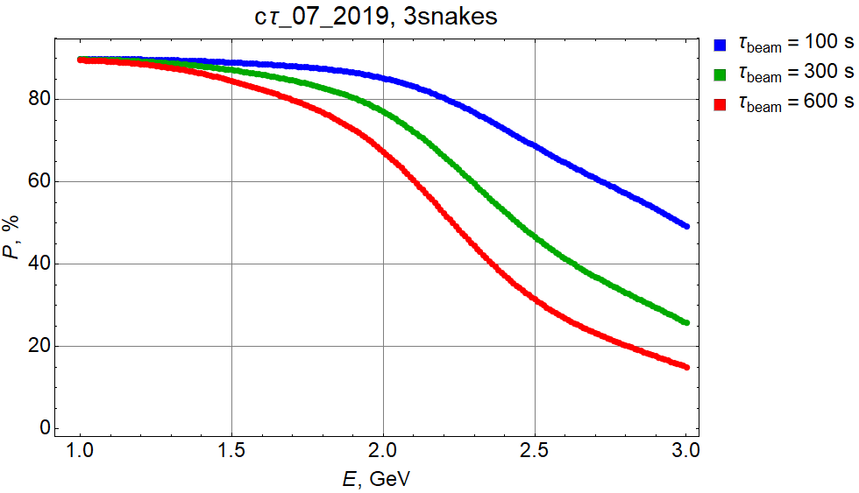
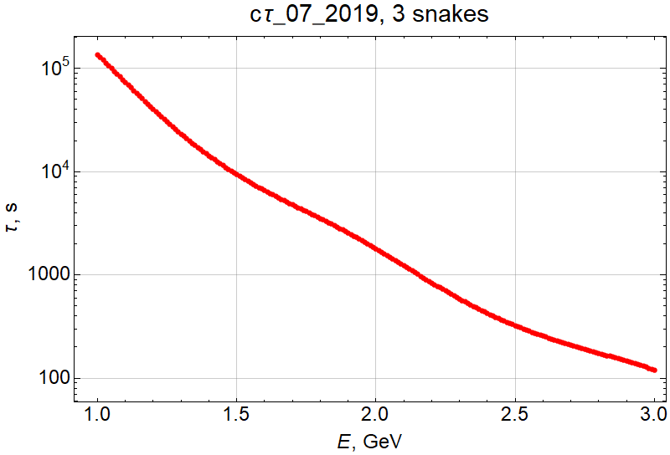
Longitudinal Polarization (number of snakes)
Particle replenishing time

Slide 18
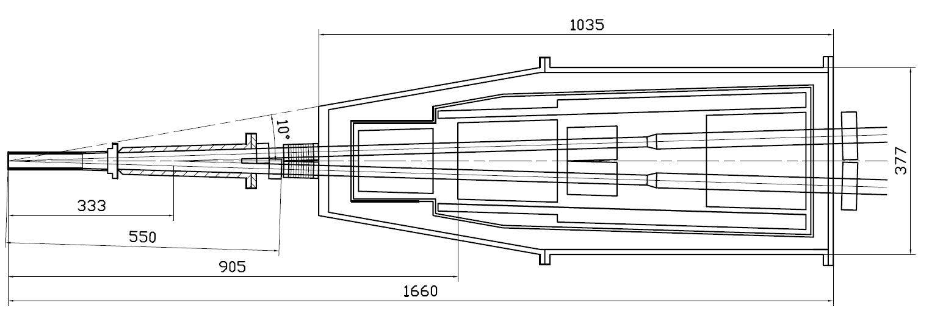
Machine-detector interface
Compensating solenoid
Gradients for 3 GeV
Be-tube ±150 mm,
∅30 mm, cooled
QD0, 200 mm
–100 Т/m
QF1, 200 mm
70 Т/m
Corr. coils
Screening solenoid
BPMs
Y-chamber,
cooled
BPMs
e+
IP
∅ 417
e-
L* =
FF vacuum chamber
Cryostate with FF magnets

Slide 19
Machine-detector interface

