Slide 1
Task 5.1 Internationalization of SCT
This project has received funding from the European Union’s Horizon 2020 research and innovation programme under grant agreement No. 871072.
Vitaly Vorobyev
4th general WP5 meeting
July 8th, 2021

Slide 2
Seminars and conferences
ctd.inp.nsk.su/wiki/index.php/SCT_talks
Conference contributions
Seminars
9 events since March 2021!

Slide 3
Steps towards formal collaboration
This slide was shown at the CHARM 2020 conference
(2021.06.01)
Time
Today
2021
2022
Funding for the SCT project
SCT working groups
Simplified formal collaboration around the SCT experiment
The SCT Collaboration
Conceptual design
R&D for detector
Detector software
…
Basic decisions regarding the SCT detector and planning the experiment
Rules for the full SCT collaboration
Design, construction, and conduct the SCT experiment

Slide 4
Why formal collaboration is needed (right now)?
Institutional board is the body to advice core decisions about the SCT detector and experiment priorities
Explicit discussion in the community
Clear procedures
An intermediate step between an informal community and a large formal collaboration (that must be launched when decision on the project implementation is made)
Simplified collaboration elaborates rules for the full collaboration
We promised to launch formal collaboration in the Cremlinplus application…

Slide 5
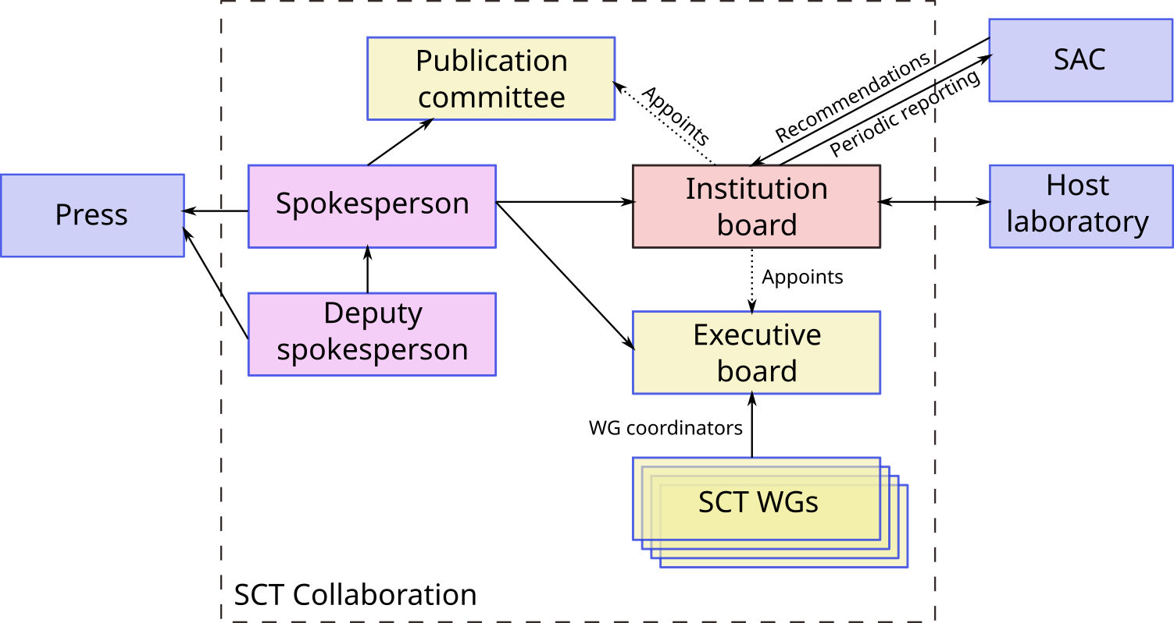
Collaboration rules
https://www.overleaf.com/read/mdscggxzrggq
Full collaboration
https://www.overleaf.com/read/wfcxdndxyjbm
Minimal collaboration
Inspired by LHCb and Belle II
Russian + International

Slide 6
Potential founding partners
Russian organizations
BINP
LPI, Moscow
Novosibirsk State University
Moscow State University
…
European organizations
INFN institutes
Giessen University
GSI
Chinese organizations
IHEP, Beijing
USTC, Hefei

Slide 7
How to proceed
Each organization submits letter of intent to join the SCT proto collaboration to the coordinator (a template is needed)
Each letter is signed by director of the organization
No obligations to participate in formal collaboration after decision on the project implementation is made
No promises of in-kind contribution and/or money invesment
BINP is the coordinator (not the host laboratory!)
Proto collaboration is SCT location-agnostic
The collaboration kick-off meeting and 1st Institutional board meeting in 2021

Slide 8
Risks
Uncertain situation with the project implementation continues for a long time
Institutional board will become artificial body
Inspiration will be lost
It will be much harder to launch formal collaboration 2nd time
Legal issues
Intellectual property rights
Exhausting details negotiation process
…

