Slide 1
Injection facility for SCT-Factory
Alexey Petrenko, BINP
2021 workshop on future Super c-τ factories, Nov. 17, 2021, Novosibirsk.

Slide 2
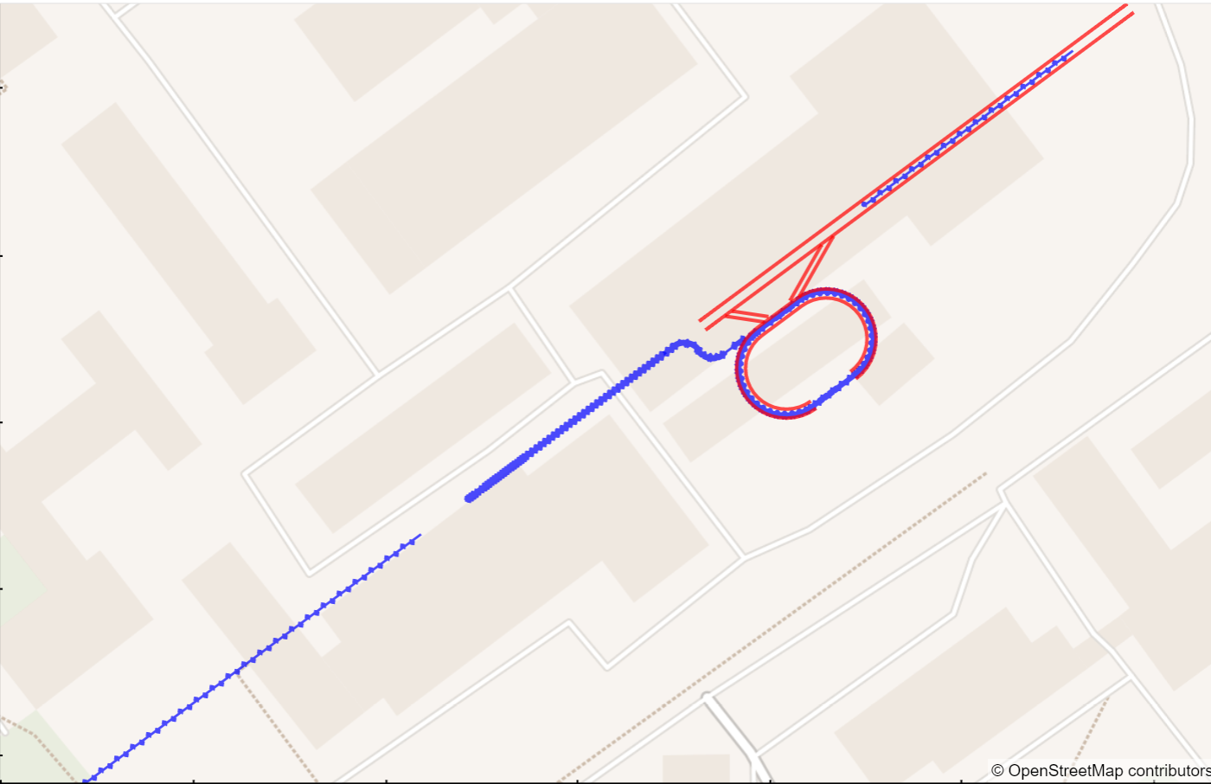
Old injector layout for the 3 GeV BINP-based facility:
With 4.8 nC (3e10 e-), 2.5 GeV electron beam on target we get 5 nC e+ after the solenoid at 200 MeV, 3.5 nC before the damping ring and 3.0 nC e+ captured by the damping ring:
1.5 GeV e-/e+ linac
1.5 GeV e- bypass
1.5 GeV e+
3 nC, (2·10¹⁰)
Two options to produce
2·10¹¹ e+ / sec:
10 Hz operation with
5 nC e- bunch
20 Hz operation with
2.5 nC e- bunch
+ an additional 1.5-2x frequency increase required for e- production
5 nC, 200 MeV e+
5 nC, 2.5 GeV e-
on e+ production target
2020 Joint Workshop on Future charm-tau Factory
2

Slide 3
New injector layout for the 3.5 GeV facility:
The goal is to be able to work at 50 Hz, although 20 Hz is probably enough.
With 3 nC of 3.5 GeV electrons per bunch on target we should capture at least 1.5 nC (10¹⁰) positrons per bunch, i.e. 10¹⁰ e+/bunch at 50 Hz or 5·10¹¹ e+/sec – good safety margin (2·10¹¹ e+/sec is required by the collider).
3

Slide 4
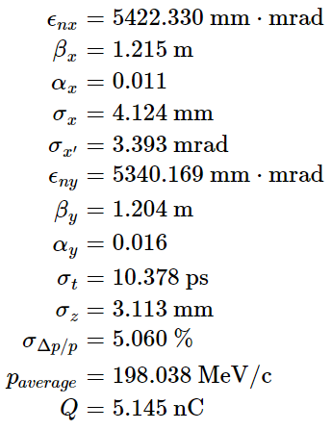
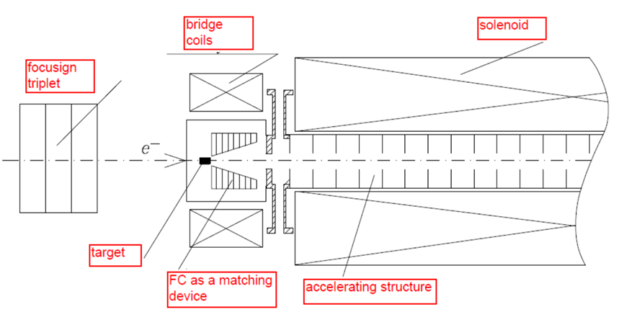
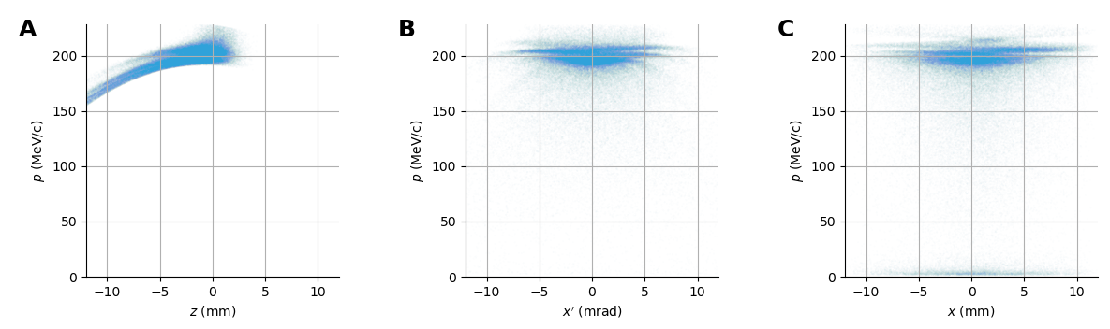
Positron production system
Old simulation for 5 nC 2.5 GeV e- bunch on target.
2.5 GeV
Positron distribution after the solenoid (Pavel Martyshkin):
http://www.inp.nsk.su/~petrenko/c-tau/Injector/p-linac/Martyshkin/
4

Slide 5
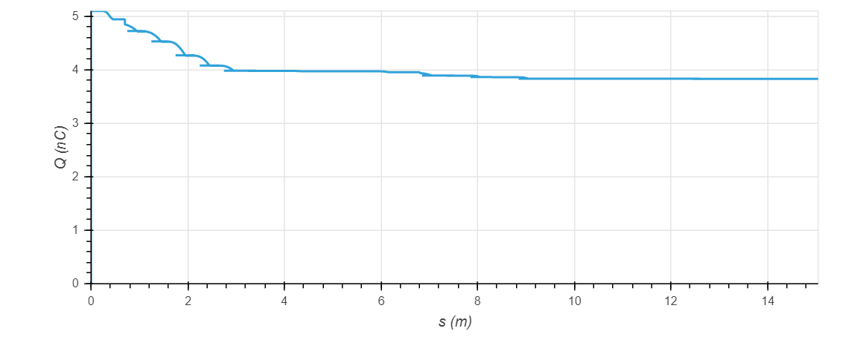
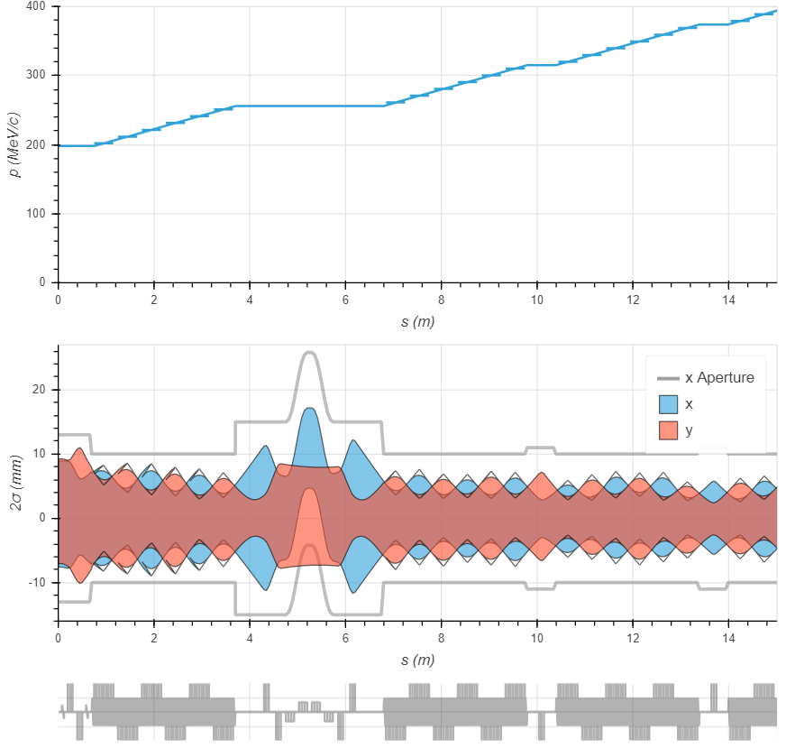
Losses during transition to quadrupole focusing:
Old simulation for 5 nC 2.5 GeV e- bunch on target.
5

Slide 6
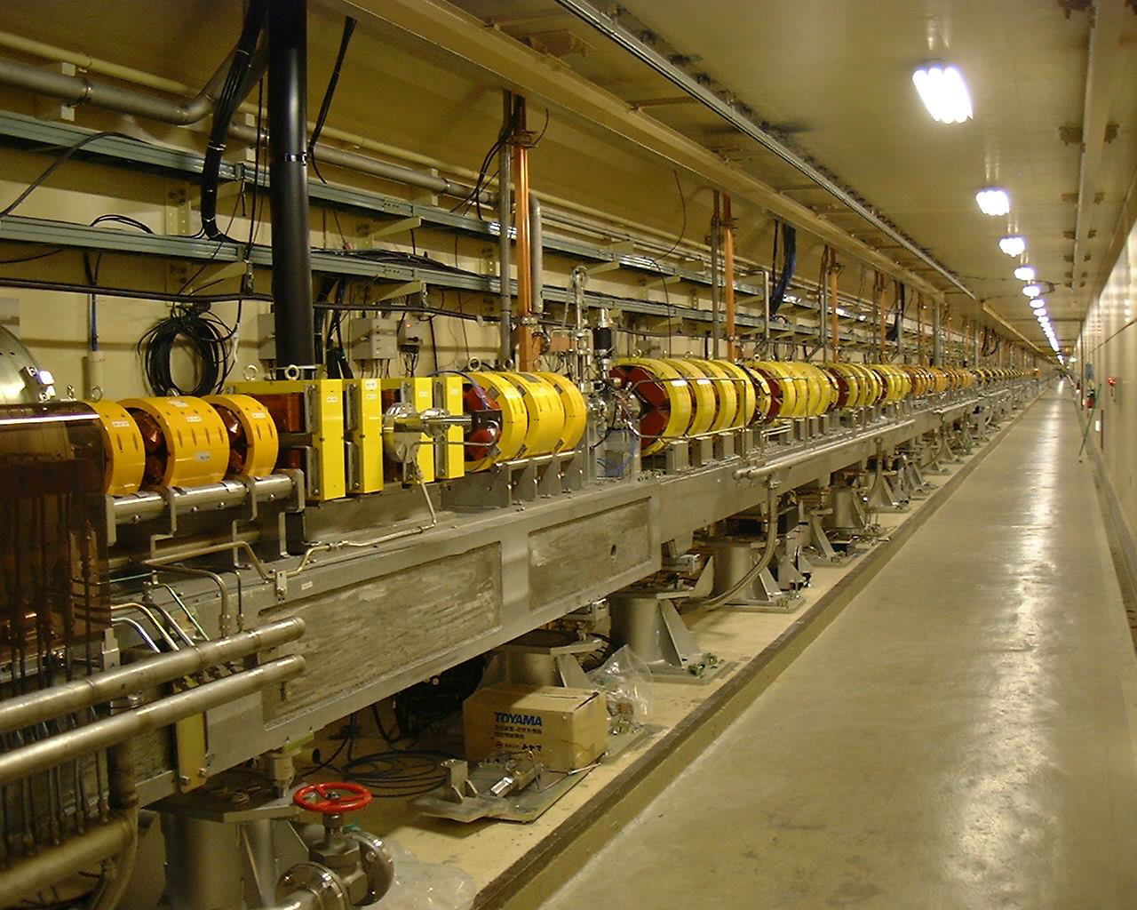
Similar system at KEK
From Pavel Martyshkin’s presentation
6

Slide 7
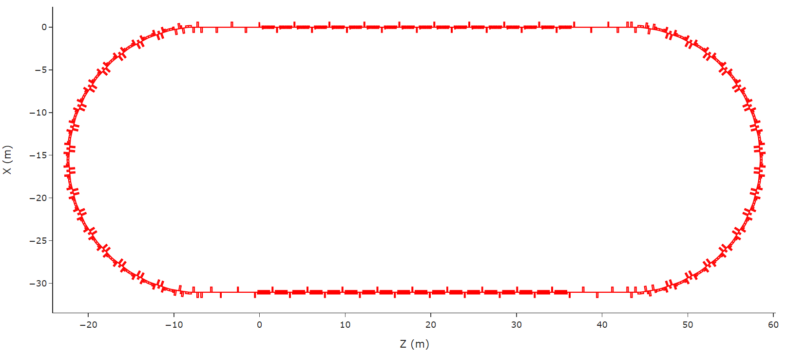
1.5 GeV damping ring (scaled down CLIC Pre-Damping Ring)
Wigglers
Damping times: τ_{δ} = 2.3 ms, τ_{x,y} = 4.7 ms.
Energy loss per turn = 430 keV (1-2 MV RF required)
With 1.5 MV RF the 3 nC bunch will have σ_{z} = 7 mm, ε_{x,y} = 3 nm.
TME cells
Wigglers
This seems to be enough for 50 Hz operation even in a single bunch regime. The ring could be downsized if we assume multiple bunches stored for more than one cycle.
7

Slide 8
Conclusion
New e+/e- injector design is proposed for the 3.5 GeV SCT-factory with fully independent electron and positron linacs (total energy of linacs is 10.5 GeV).
The 50 Hz operation with 3 nC e- bunches on target certainly meets the collider requirement of 2·10¹¹ e+/sec.
8

Slide 9
Backup slides:

Slide 10
Transition to quadrupole focusing
Particle tracking of the full distribution:
10

Slide 11
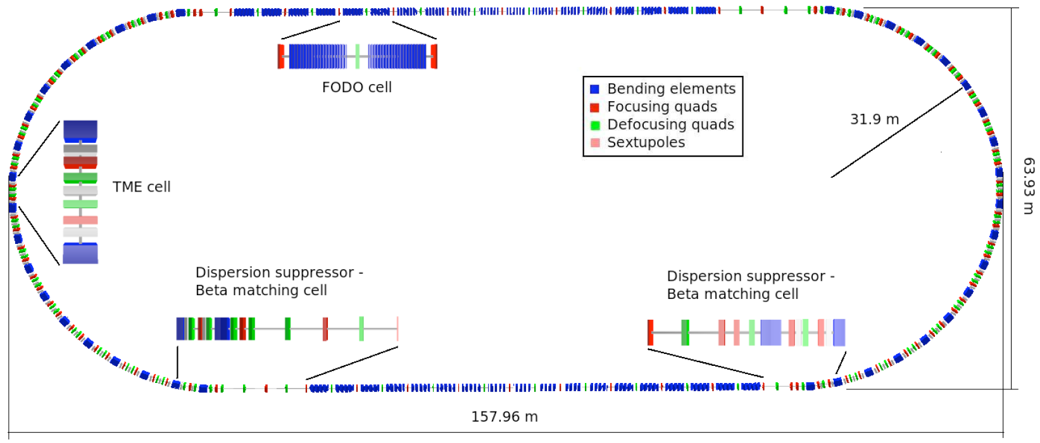
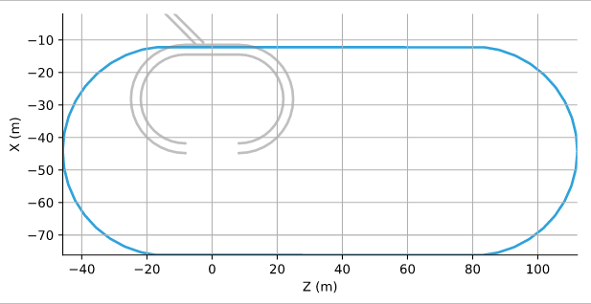
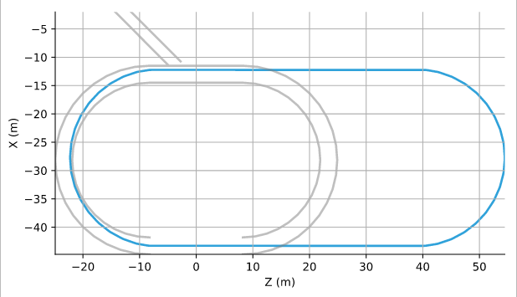
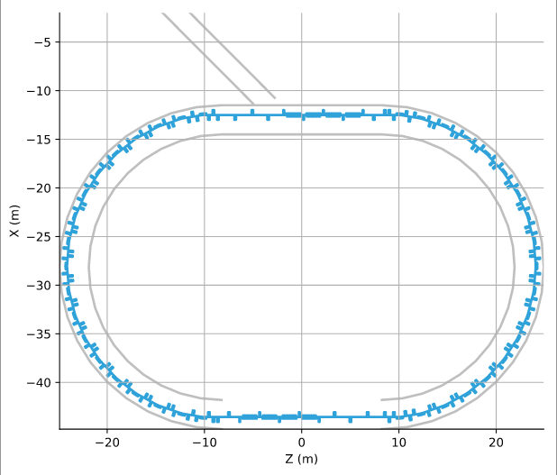
Scaling down CLIC Pre-Damping Ring
Designed for 2.8 GeV
http://project-clic-cdr.web.cern.ch/project-CLIC-CDR/Drafts/Yannis_DR.pdf
Similar magnetic field but with 1.5 GeV e+ now:
Proportionally scale all elements
Existing tunnel
Remove several FODO-periods.
11

Slide 12
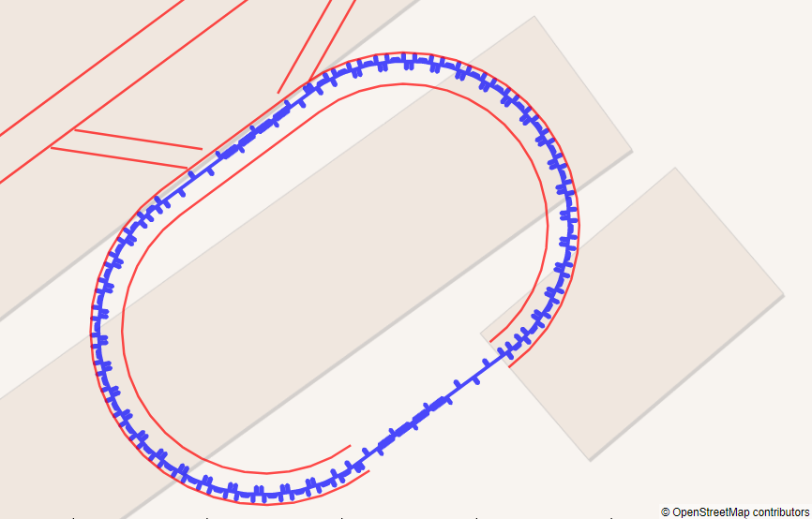
Damping ring (scaled down CLIC Pre-Damping Ring)
Red line marks existing tunnel
Wigglers
TME cells
TME cells
Wigglers
Damping times: τ_{x} = 7.2 ms, τ_{s} = 3.5 ms
Equilibrium emittance: ε_{x} = 6.3 nm (including IBS)
http://www.inp.nsk.su/~petrenko/c-tau/Injector/damping_ring/Twiss.html
12

Slide 13
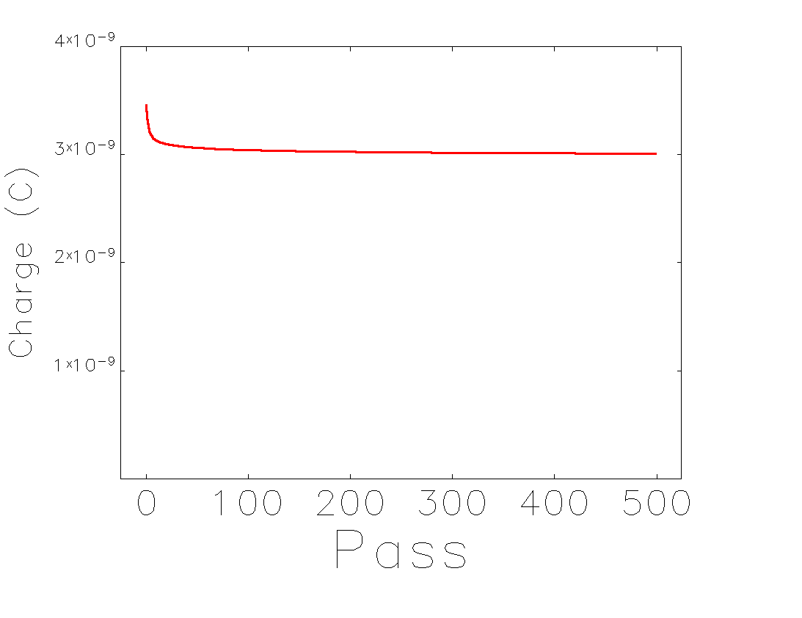
Positron bunch capture into the damping ring
Surprisingly the capture is reasonably good even into completely non-optimized optics.
(+ to be checked with realistic field errors)
Turn
13

