Slide 1
A DIRC-like Time-of-Flight Detector for the STCF Experiment
Ming Shao
On behalf of STCF DTOF group
University of Science and Technology of China
State Key Laboratory of Particle Detection and Electronics
Workshop on Future Super c-τ Factories 2021

Slide 2
Outline
The DTOF detector in STCF experiment
  Introduction
  Conceptual design
  PID Performance
  Optimization
  Cosmic-ray test
Summary

Slide 3
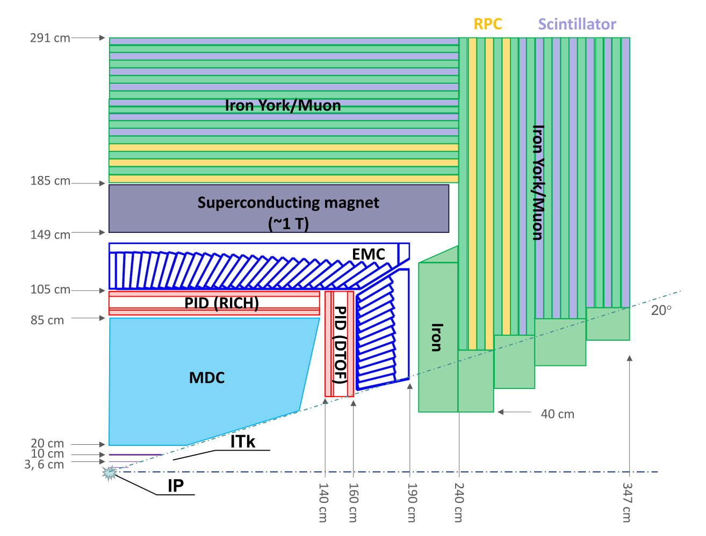
STCF Experiment
Inner Tracker
~0.15%X₀ / layer
σ_{xy}~50-100 um
Main Tracker
σ_{xy}<~130 um
σ_{p}/p ~ 0.5% @ 1 GeV
dE/dx~6%
PID
π/K (K/p) 3-4σ separation
Momentum 2GeV/c
EMC
Energy range: 0.02-3GeV
Resolution σ_{E} (%)@1GeV
barrel: 2.5%
endcap: 4%
MUD
Low momentum ~0.5GeV
π suppression >30

Slide 4
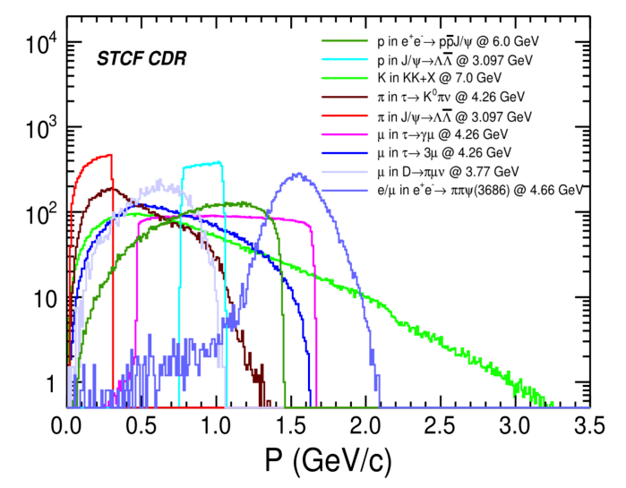
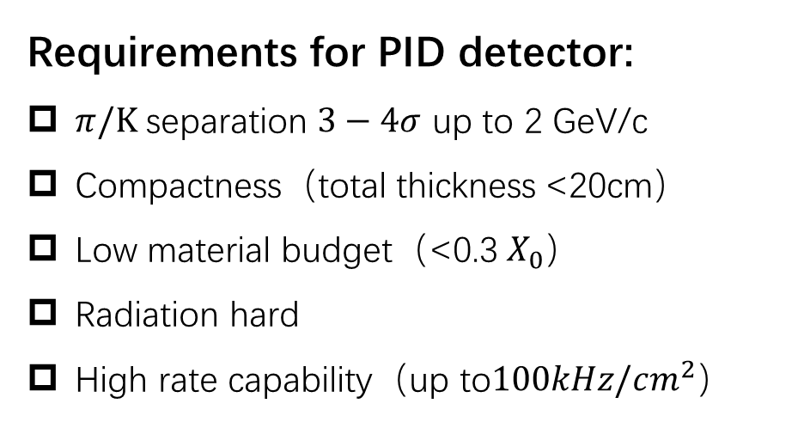
PID Requirements at STCF
Requirements for PID detector:
$π/Κ$ separation $3−4σ$ up to 2 GeV/c
Compactness（total thickness <20cm）
Low material budget（<0.3 $X_{0}$）
Radiation hard
High rate capability（$\text{up} \text{to}100kHz/cm^{2}$）
Technology Choices:
dE/dx at low momentum (<0.8GeV/c)
TOF or Cherenkov detector? (0.8-2GeV/c)
Momentum range of final-state particles for STCF benchmark physics process
Options for STCF PID:
RICH (barrel); DIRC or DIRC-like (endcap)

Slide 5
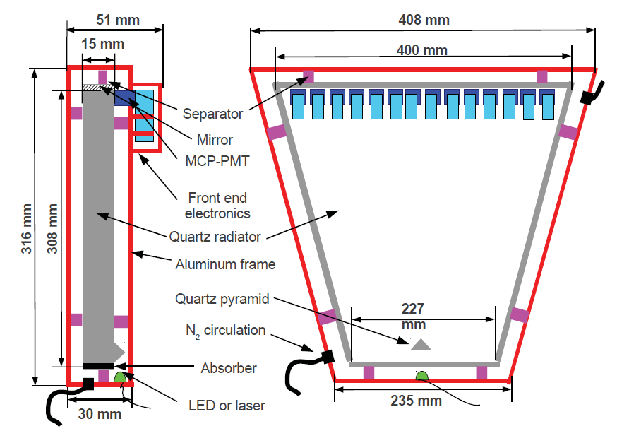
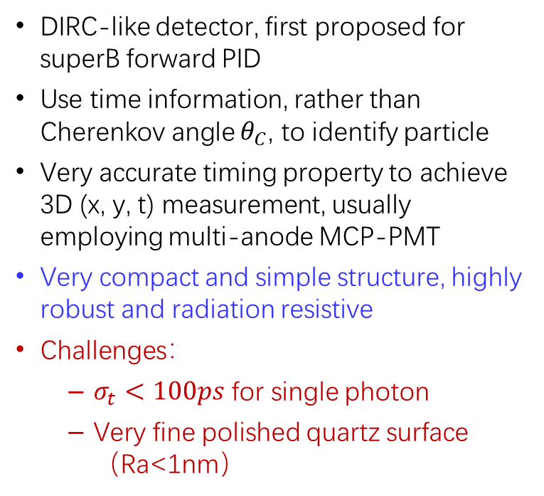
DIRC-like Timing Detector
DIRC – Detection of Internal Reflected Cherenkov Light
DIRC-like detector, first proposed for superB forward PID
Use time information, rather than Cherenkov angle $θ_{C}$, to identify particle
Very accurate timing property to achieve 3D (x, y, t) measurement, usually employing multi-anode MCP-PMT
Very compact and simple structure, highly robust and radiation resistive
Challenges：
  $σ_{t}<100ps$ for single photon
  Very fine polished quartz surface（Ra<1nm）
DIRC @ Babar achieved ~3𝜎 𝜋/𝐾 separation @4𝐺𝑒𝑉/𝑐
FTOF at superB:
Forward Time-of-Flight
Baseline technology for STCF endcap PID detector

Slide 6
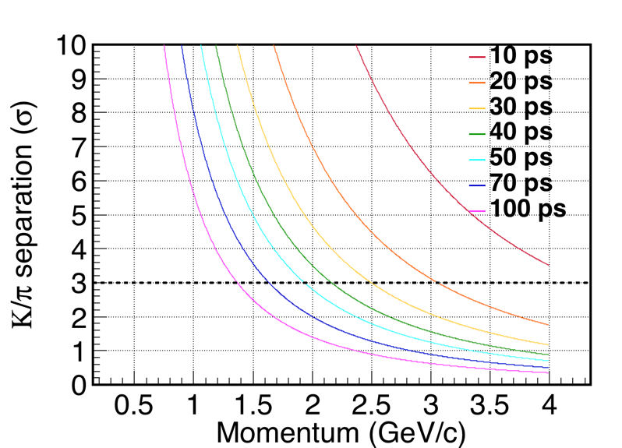
Expected PID with DTOF
PID capability calculated by TOF information only (a naïve estimation)
Flight path ~ 1.5 m
Total time resolution below 50 ps to achieve K/pi separation better than 3 sigma.
The event start time (T0) may contribute ~ 40 ps, so an intrinsic DTOF time resolution of <30ps is needed

Slide 7
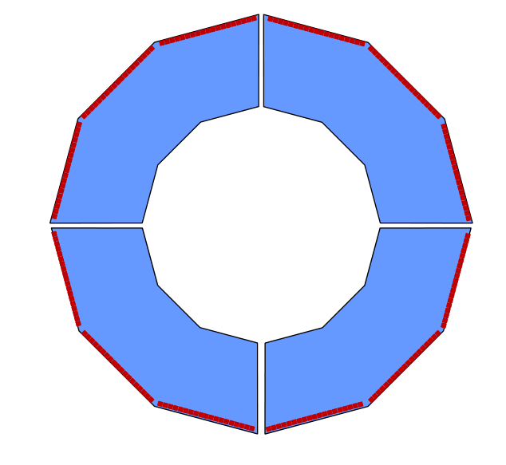
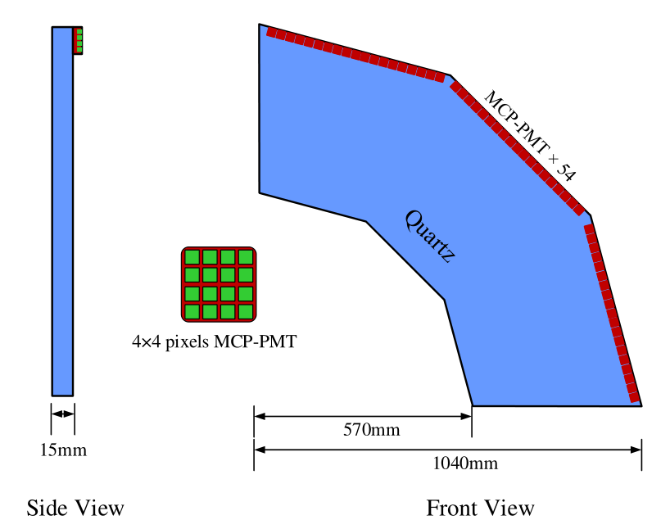
DTOF Design
DIRC-like +TOF =DTOF
Two discs, each consisting of 4 fan-shaped sectors
Polar angle coverage：22.1°-36.6°
Quartz radiator
Radius 570mm to 1040 mm
Thickness 15mm
Each sector readout by 54 multi-anode MCP-PMTs
Each MCP-PMT contains 4*4 readout pads (5.5mm * 5.5mm)
Combination of DIRC and TOF technologies
Simple, compact, fast and precision
Suitable for STCF（<2GeV）

Slide 8
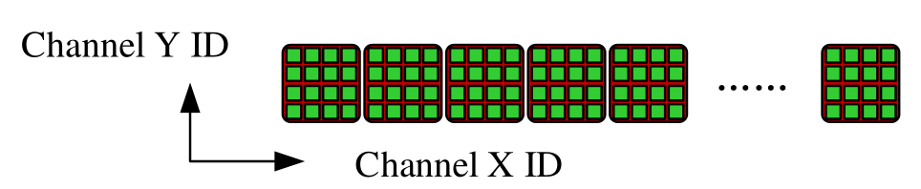
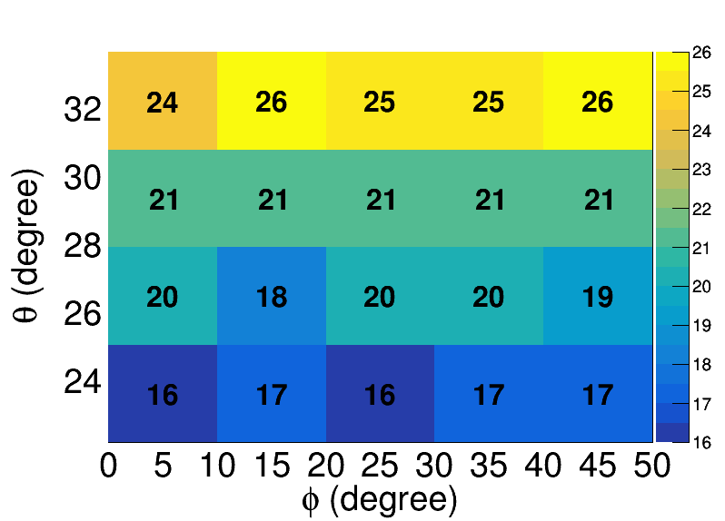
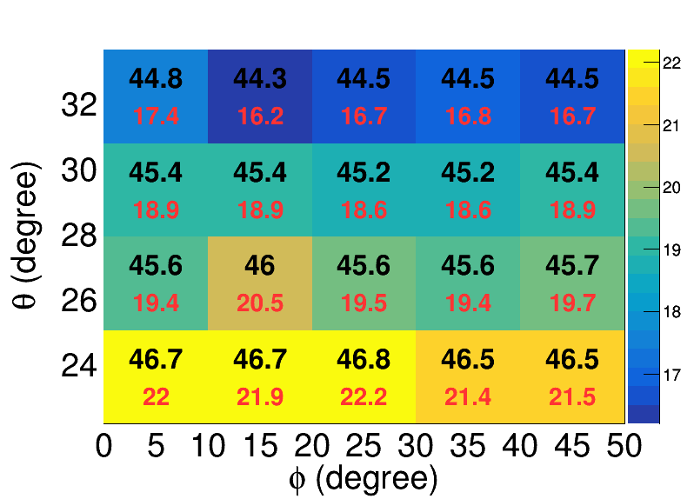
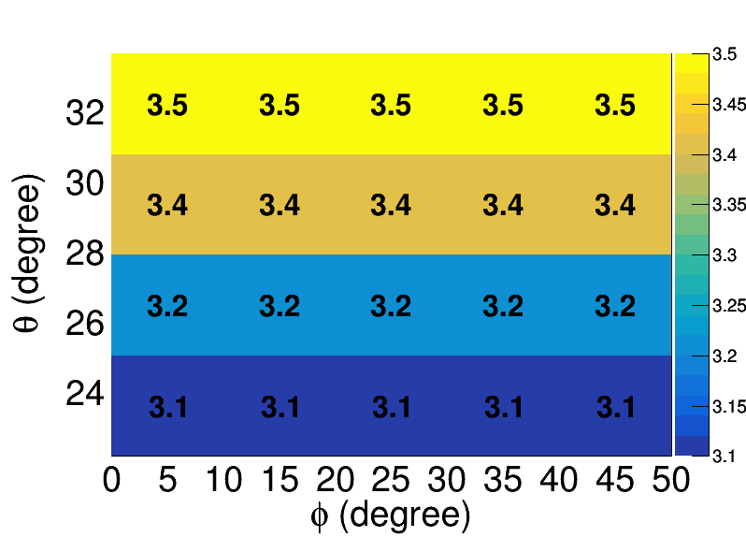
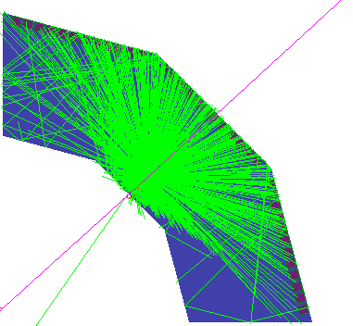
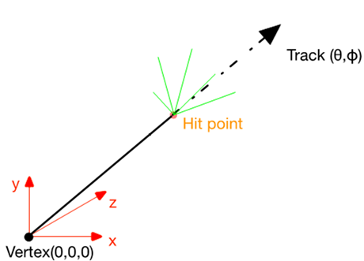
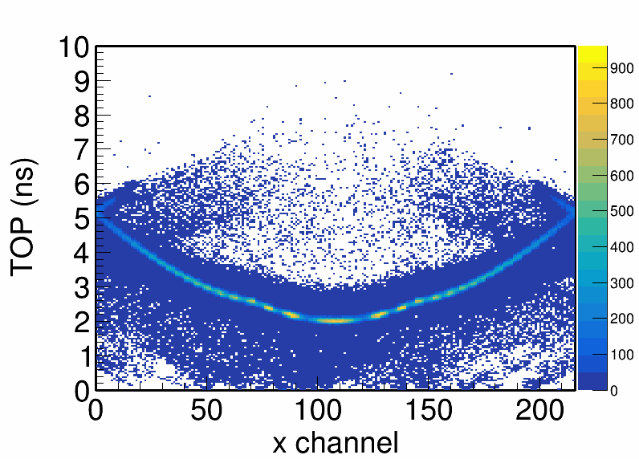

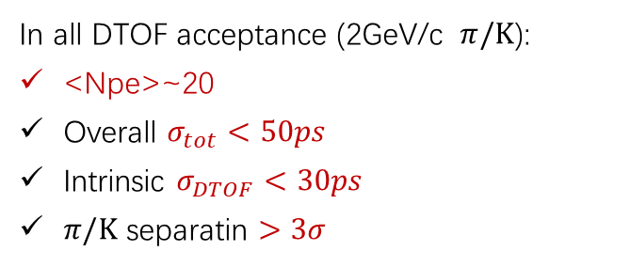


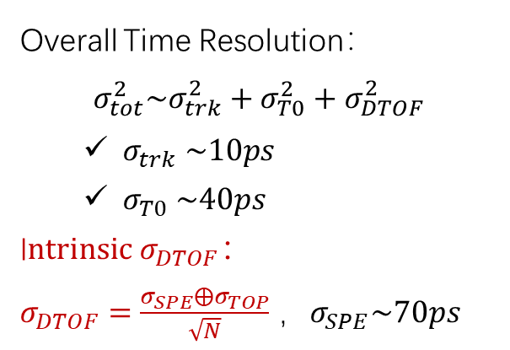
DTOF in Geant4 Simulation
$$4×54\left(X\right)×4\left(Y\right)=864 channel$$
𝜋
pion
($σ_{tot}$, $σ_{DTOF}$, ps)
DTOF <Npe>@2GeV/c
Time resolution @2GeV/c
$π/Κ$ separation @2GeV/c
Overall Time Resolution：
$$σ_{tot}^{2}\sim σ_{trk}^{2}+σ_{T0}^{2}+σ_{DTOF}^{2}$$
  $σ_{trk} \sim 10ps$
  $σ_{T0} \sim 40ps$
I$ntrinsic σ_{DTOF}：$
$σ_{DTOF}=\frac{σ_{SPE}{⨁σ}_{TOP}}{\sqrt{N}}$ ，$σ_{SPE}\sim 70ps$
In all DTOF acceptance (2GeV/c $π/Κ$):
<Npe>~20
Overall $σ_{tot}<50ps$
Intrinsic $σ_{DTOF}<30ps$
$π/Κ$ separatin $>3σ$
Time (ns)
Time – position hit pattern
$σ_{TOP}$: uncertainty of reconstructed time of propagation (TOP) in the radiator

Slide 9
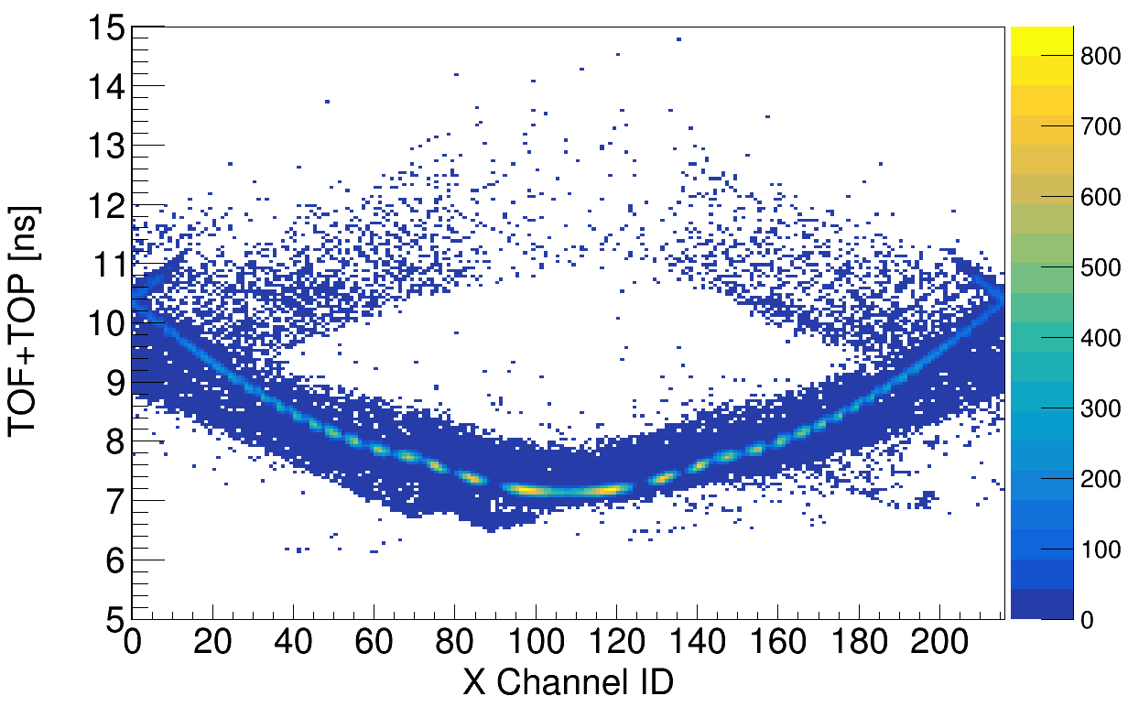
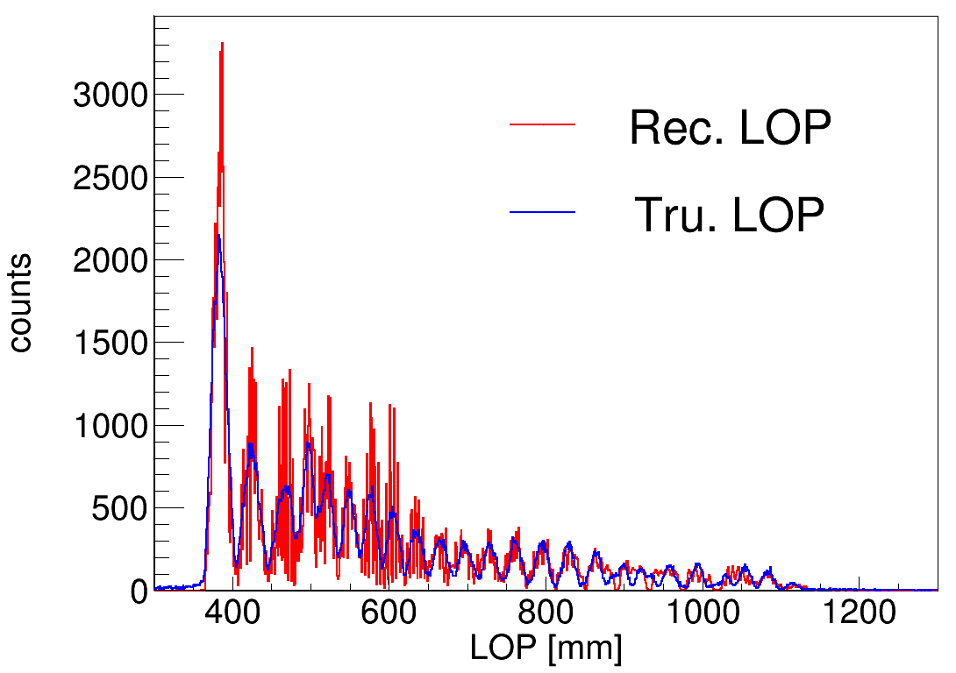
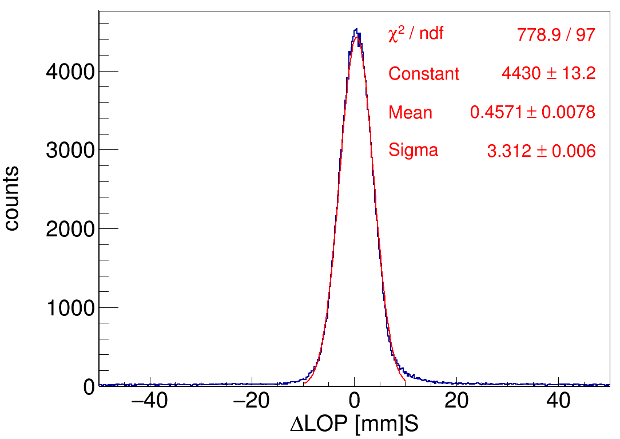
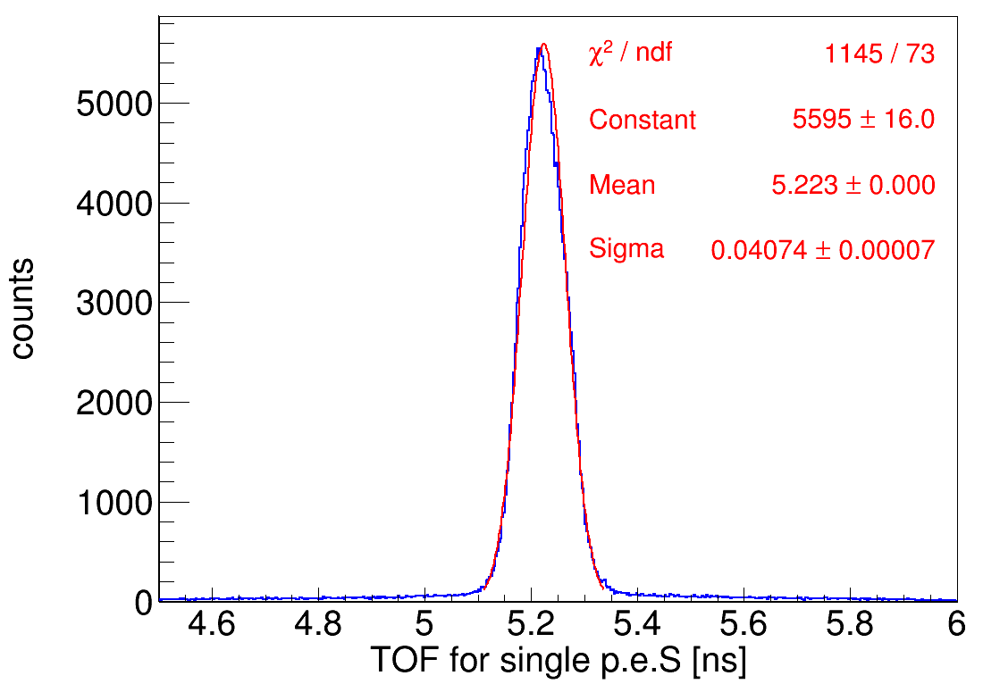
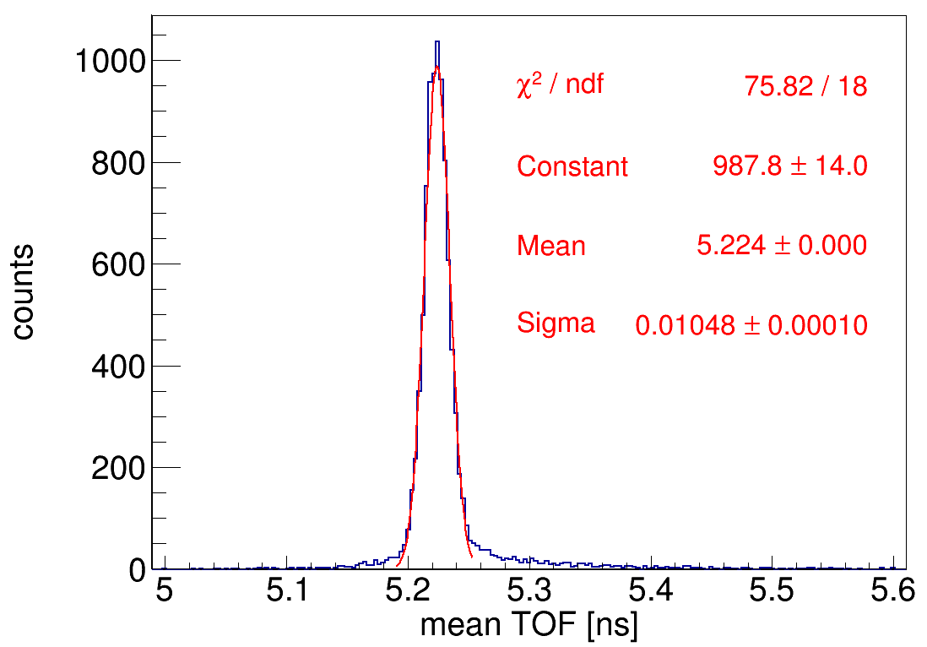
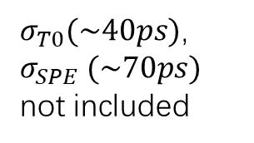
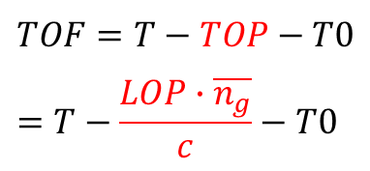
TOF Reconstruction
Length of propagation (LOP) in the radiator
$$TOF=T−TOP−T0=T−\frac{LOP∙\overline{n_{g}}}{c}−T0$$
$σ_{T0}(\sim 40ps)$, $σ_{SPE} (\sim 70ps)$ not included

Slide 10
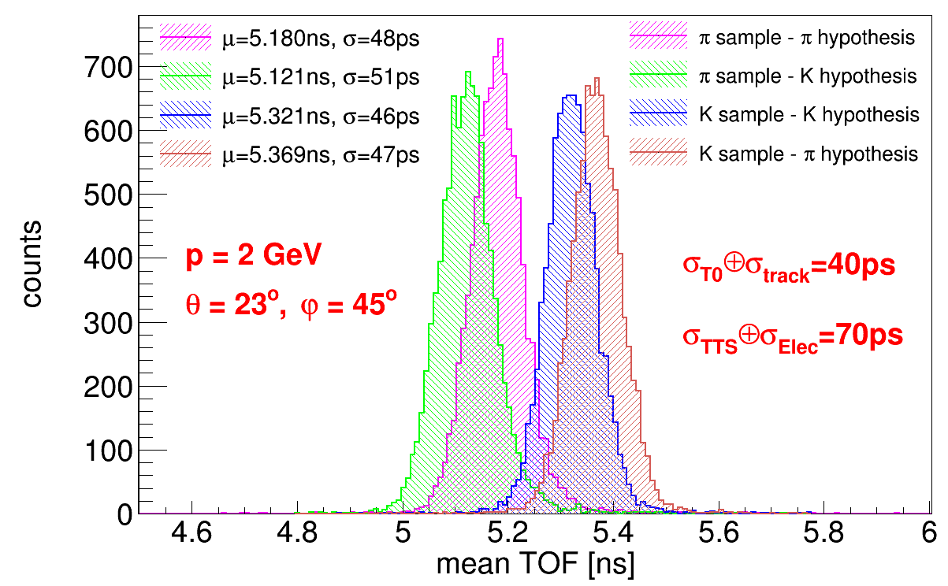
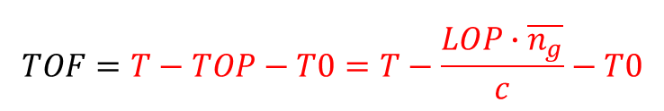
π/K separation
$$TOF=T−TOP−T0=T−\frac{LOP∙\overline{n_{g}}}{c}−T0$$
2
1
3
4
peak2 and peak3：3.0σ
peak1 and peak3：4.1σ
peak2 and peak4：4.0σ

Slide 11
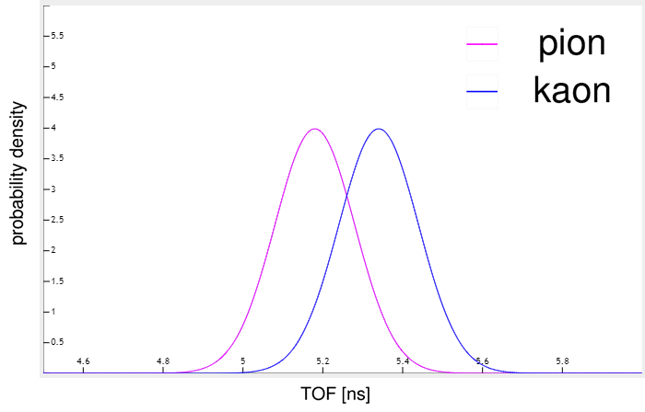
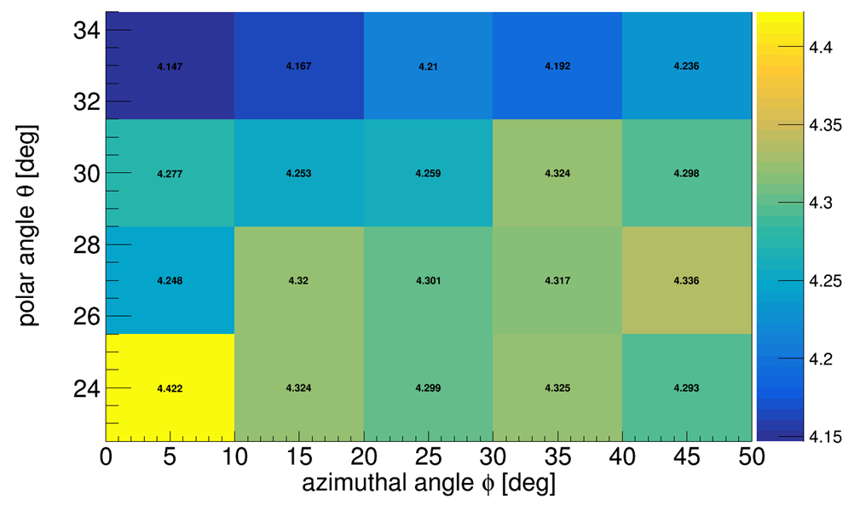
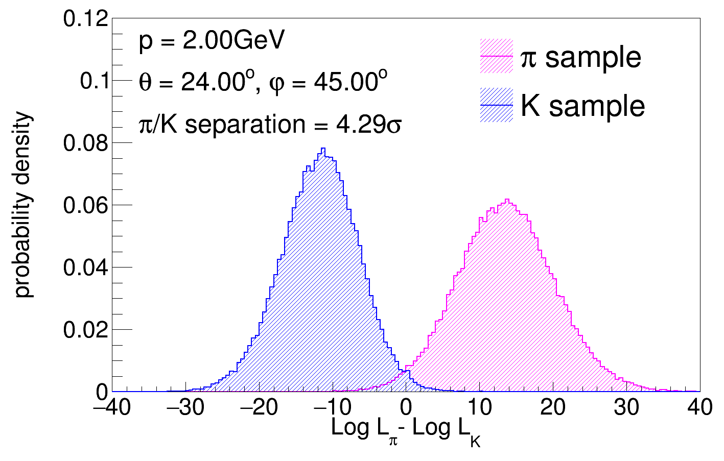
π/K separation
Likelihood method :
π/K separation at p = 2 GeV/c

Slide 12
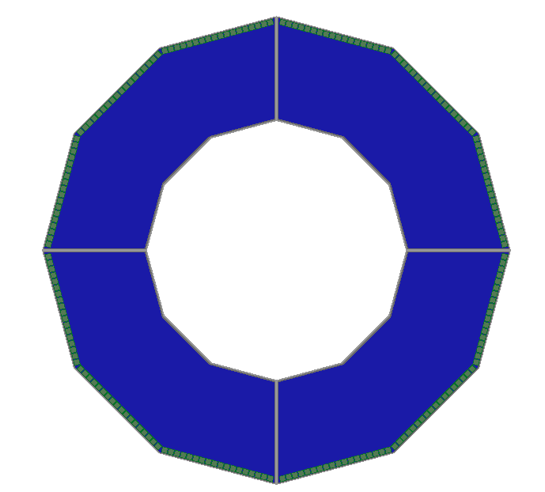
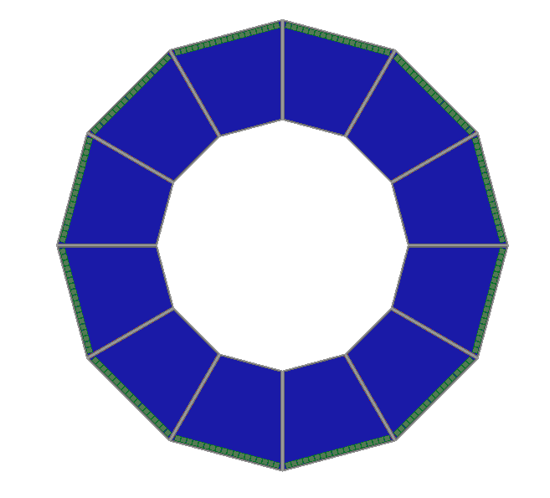
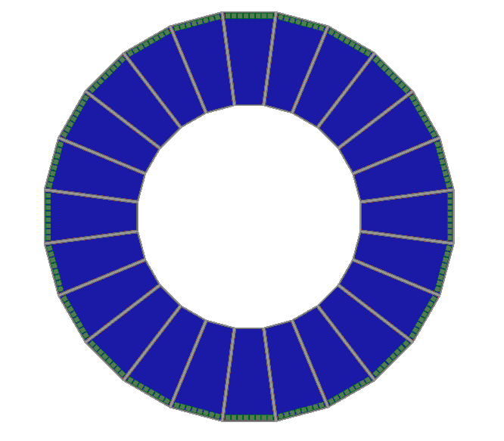
Optimization of DTOF Shape
Design-A
4 sectors per disc
18×3 MCP-PMTs per sector
Design-B
12 sectors per disc
18 MCP-PMTs per sector
Design-C
24 sectors per disc
8 MCP-PMTs per sector

Slide 13
DTOF Design with Mirror
Design-α
No mirror, absorber
Design-β
Mirror on top surface
Design-γ
Mirror with 45°chamfer

Slide 14
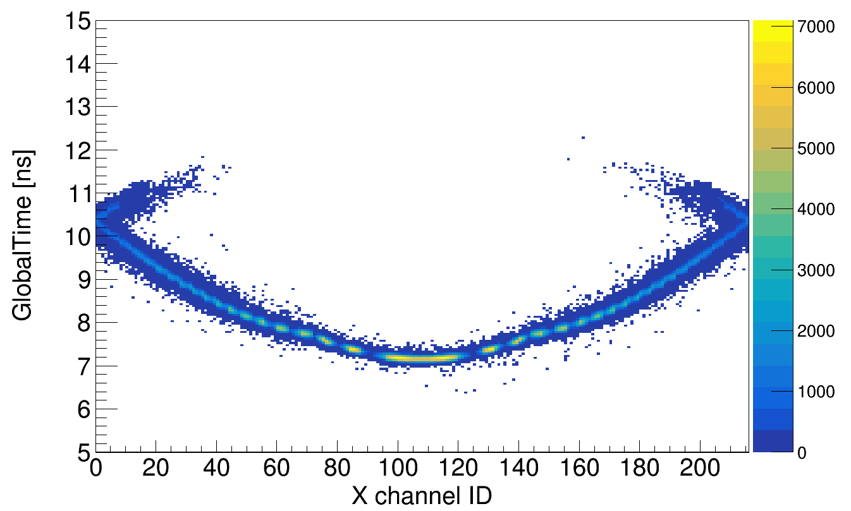
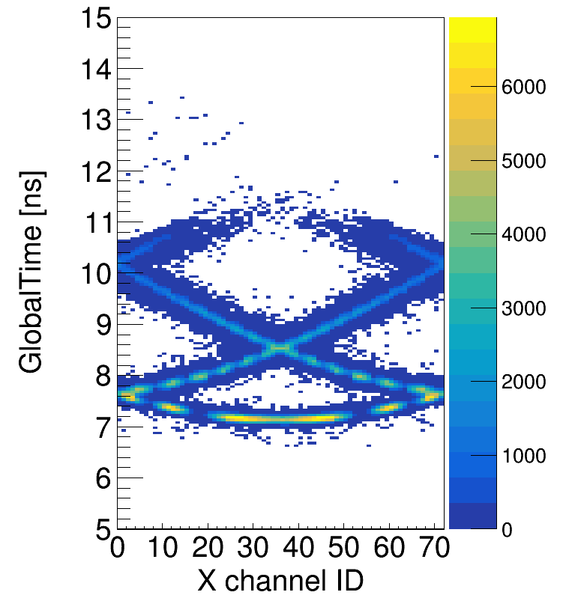
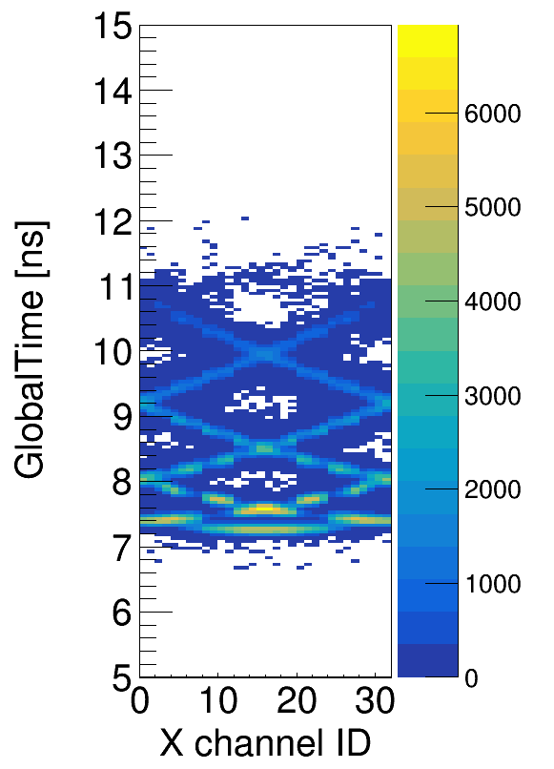
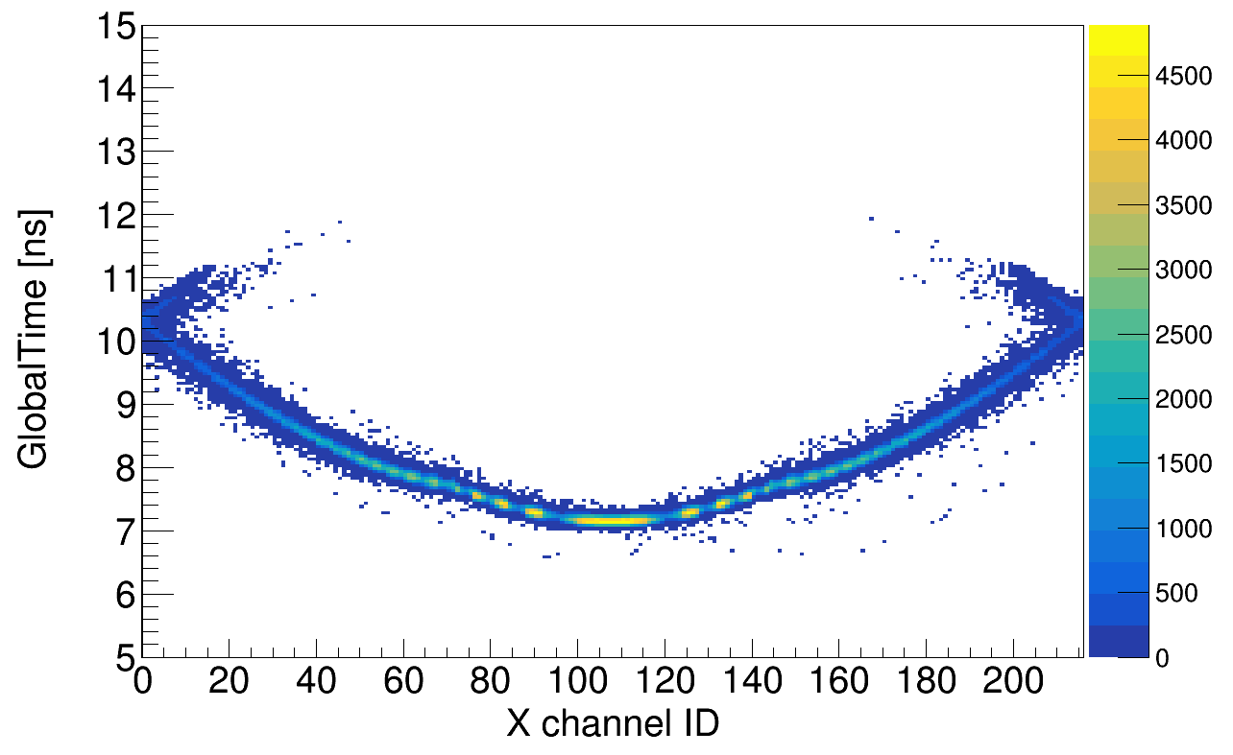
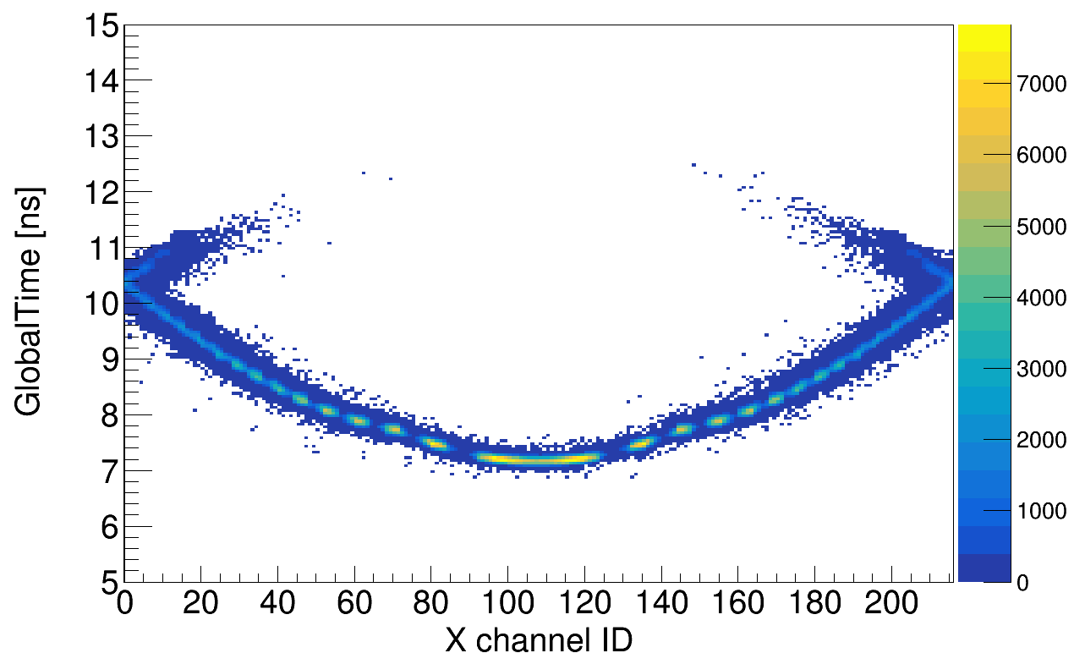
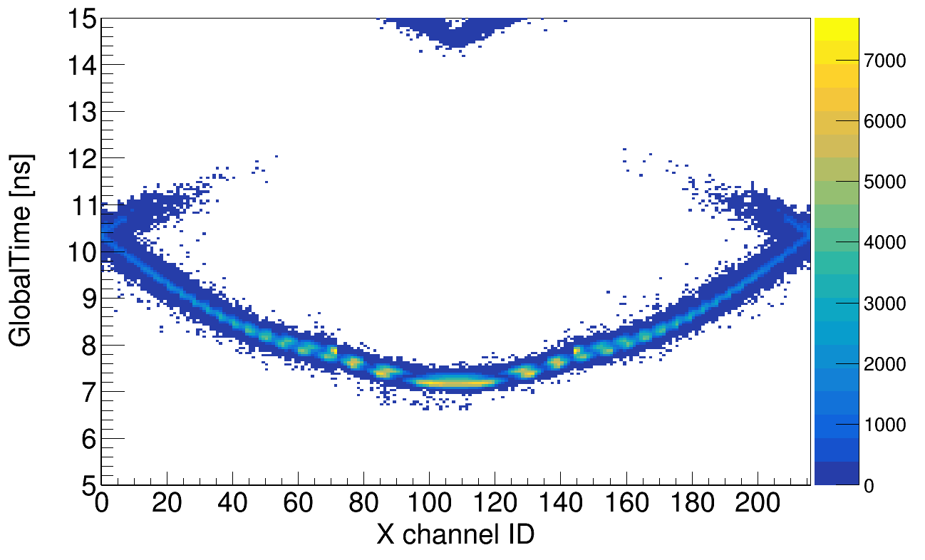
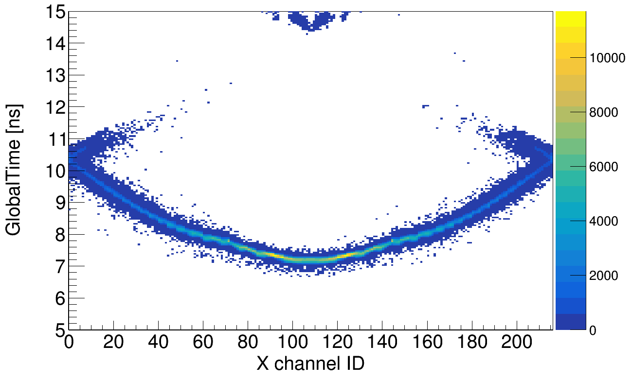
Comparison – Shape/Mirror/Thickness
Aα15
Bα15
Cα15
θ=24°, φ=45°, p=2GeV,
pion
Aα10
Aα15
Aα20
Aα15
Aβ15
Aγ15

Slide 15
Summary of DTOF Geometry Optimization
Performance of DTOF with different configurations
Thickness of radiator
Shape of radiator
Configuration/Geometry ID | 0 | 1 | 2 | 3 | 4 | 5 | 6
Radiator shapes (sector number) | 4 | 12 | 24 | 4 | 4 | 4 | 4
Radiator thickness (mm) | 15 | 15 | 15 | 10 | 20 | 15 | 15
Outer side surface | A | A | A | A | A | M | 45° M
Inner side surface | A | A | A | A | A | A | A
Lateral side surface | M | M | M | M | M | M | M
Number of photoelectron for pions (except background) | 21.8 | 21.9 | 17.0 | 15.5 | 25.7 | 33.2 | 38.7
Accumulated charge density on MCP-PMT anode (C/cm²) | 10.8 | 10.5 | 9.6 | 8.8 | 11.8 | 17.0 | 25.6
π/K separation power | 4.17σ | 4.08σ | 3.66σ | 3.99σ | 4.27σ | 4.26σ | 4.19σ
Including of mirror
Optimized DTOF structure

Slide 16
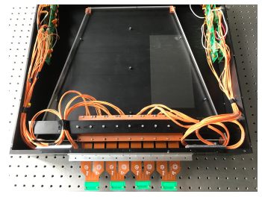
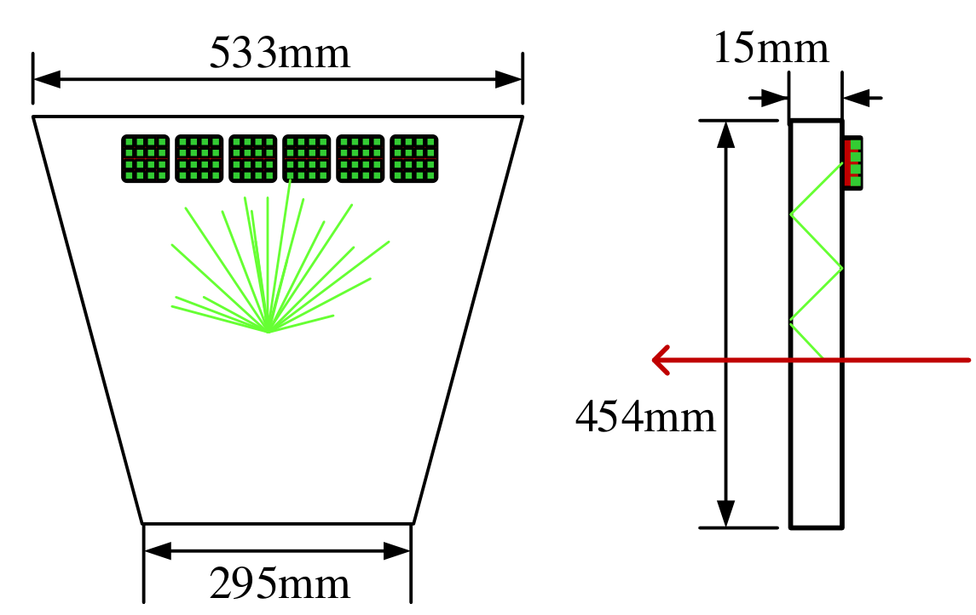
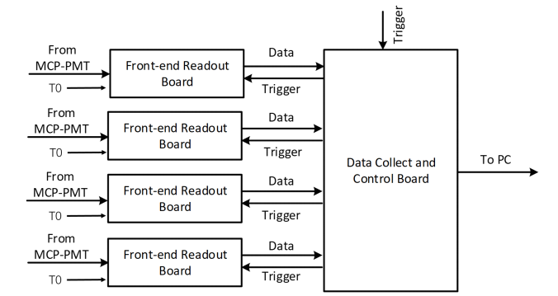
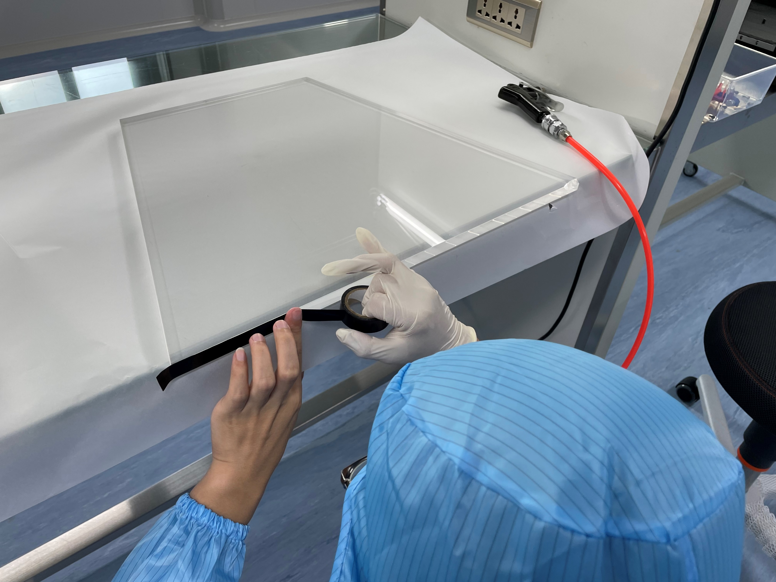
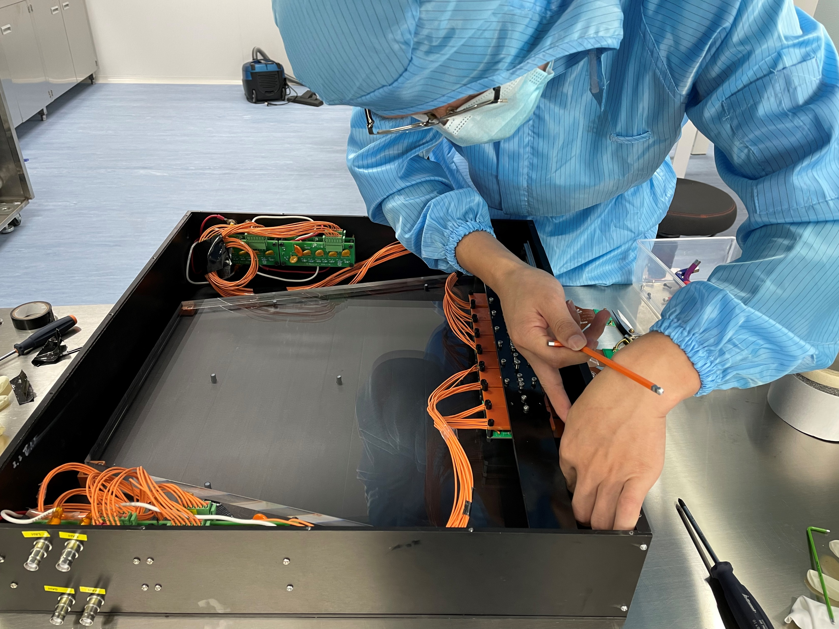
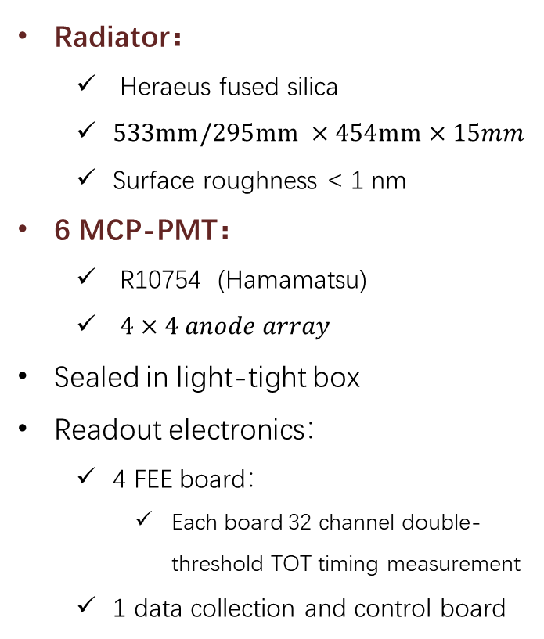
DTOF Prototype – 1/3 sector
Radiator：
  Heraeus fused silica
  $533mm/295mm ×454mm×15mm$
  Surface roughness < 1 nm
6 MCP-PMT：
  R10754 (Hamamatsu)
  $4×4 anode array$
Sealed in light-tight box
Readout electronics：
  4 FEE board：
    Each board 32 channel double-threshold TOT timing measurement
  1 data collection and control board
Cosmic Ray
DTOF prototype assembly in clean room
Readout electronics

Slide 17
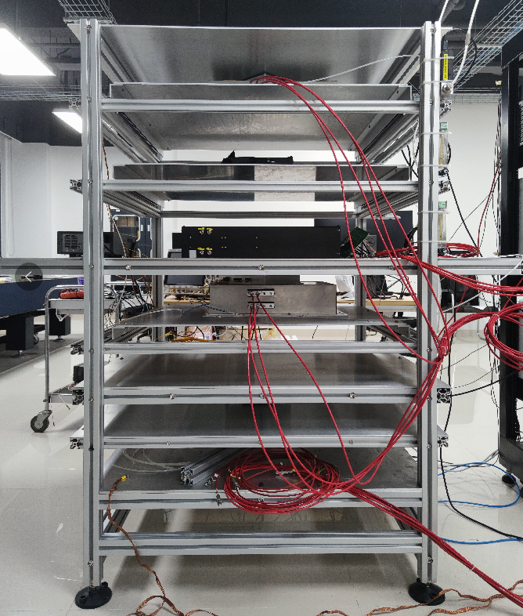
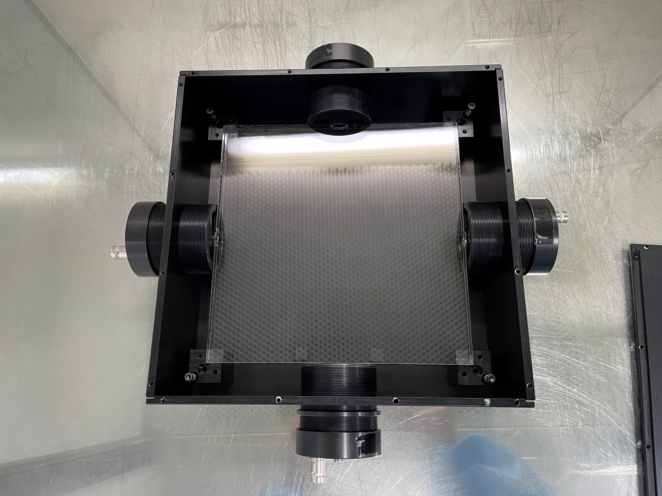
Cosmic-ray Test Stand
Trigger
Schematic diagram of the cosmic-ray test setup
2*MicroMegas
T0
DTOF
2*MicroMegas
Trigger
Reference Time Detector (T0):
Similar to DTOF, a square quartz plate coupled with 4 MCP-PMT (single anode, R3809)
~200cm

Slide 18
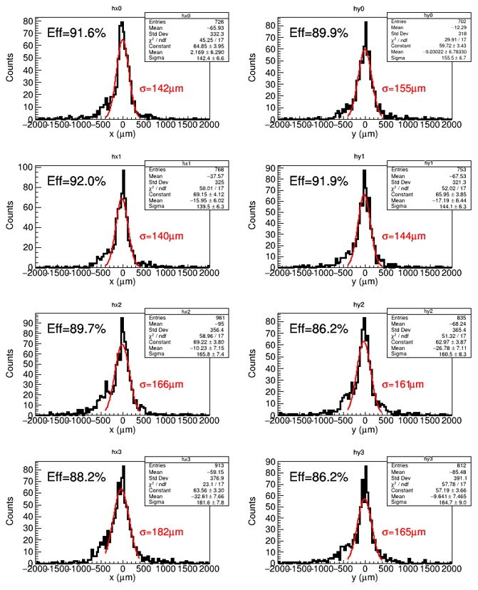
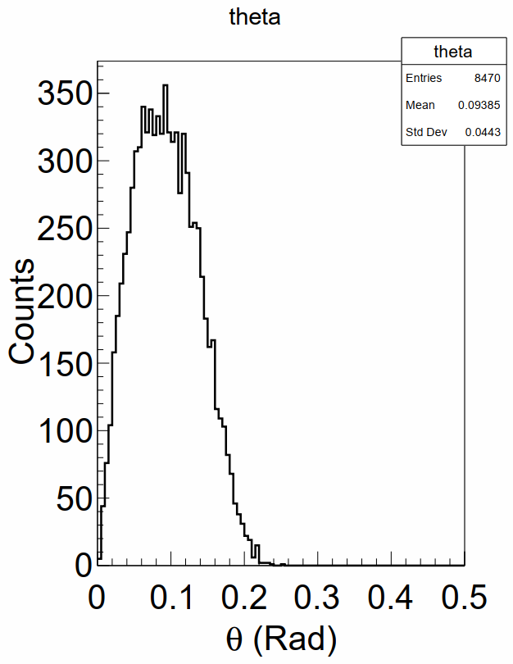
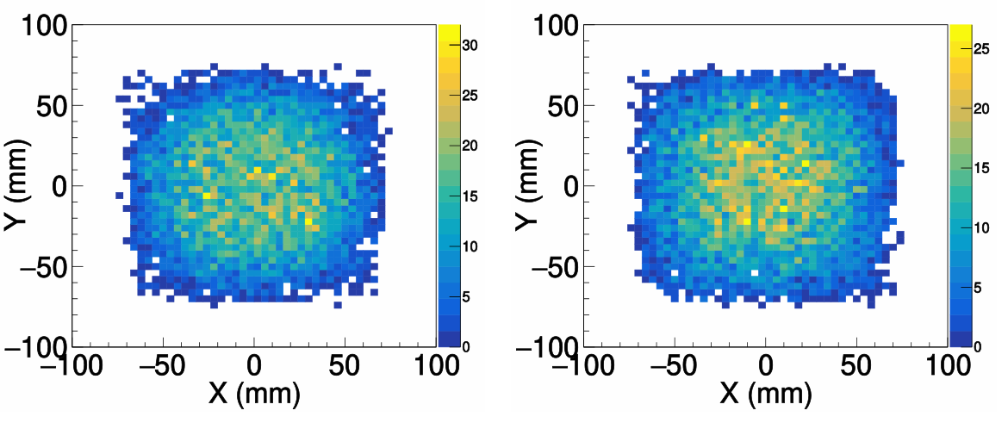

Tracker Performance
Cosmic-ray (CR) track reconstruction：
4 layers of MicroMegas ($150mm×150mm$)
0.4mm strip pitch (in total 384 X + 384 Y strips), 6-in-1 encoding readout (128 readout channel)
Processing: filter → decoding → alignment → reconstruction
  Spatial resolution <200um, efficiency ~90%
  Angular resolution <1mrad
Spatial Resolution and efficiency of 4 layers of Micromegas
CR direction
CR hits on T0
CR hits on DTOF

Slide 19












T0 Performance
$TOP$
reconstructed
$\frac{1}{2}\left(T0_{i}−T0_{j}\right)$ (raw)
$$\frac{1}{2}\left(T0_{i}−T0_{j}\right)$$
T0 efficiency ~37%（8%@Npe≥2）
When $Npe≥2$,
  $σ_{T0}=\frac{1}{2}\left(T0_{i,cor}−T0_{j,cor}\right)$= 24ps
$TOT$ corrected
$$\frac{1}{2}\left(T0_{i,cor}−T0_{j,cor}\right)$$
$ΔT0_{i}−TOT_{i}$ correlation
Photons from background electrons

Slide 20









DTOF Performance
$RecTOP=RecLOP/v_{g}$
FT = DT – T0
DT = T - TOP
$$σ_{FT}=\sqrt{σ_{DT}^{2}+σ_{T0}^{2}}$$
No Reflected
（R=0）
R=1
R=2
$σ_{FT}$ (SPE)
<Npe> ~ 9
DT-T0 correlation increase with R
  Correlation negligible with R=0
R=1
R=0
 | <Npe> | $$σ_{T0}$$ | $$σ_{FT}$$ | $$σ_{DT}$$
MC | 12 | 23ps | 35ps@N=12 | 24ps@N=12
Exp. | 9 | 24ps | 35ps@N=9 | 26ps@N=9
R=2
DTOF intrinsic time resolution achieved <30ps@Npe≥9

Slide 21
Summary
We illustrate the design of DTOF detector for the future STCF program.
The simulation tools are extensively used to study various aspects of the DTOF:
  Detector geometry and optimization
  Background effect
  PID algorithm and expected performance
A 1/3-size DTOF prototype was constructed and tested with cosmic-ray
  DTOF intrinsic time resolution reaches <30ps@Npe=9
Thank you !

Slide 22
BACKUP SLIDES

Slide 23
PID Requirements
Particle Identification (PID) of charged particles： π/K (K/p) 3-4σ separation, up to p= 2GeV/c

Slide 24

Reconstruction Algorithm
$cos\left(\overline{θ_{c}}\right)=\frac{1}{n_{p}β}=\frac{\vec{v_{t}}∙\vec{v_{p}}}{\left|\vec{v_{t}}\right|∙\left|\vec{v_{p}}\right|}$
  $\vec{v_{t}}=\left(a,b,c\right)，\left|\vec{v_{t}}\right|=1$
  $\vec{v_{p}}=\left(∆x,∆y,∆z\right)$
$σ_{∆x}=\frac{pitch X}{\sqrt{12}},σ_{∆y}=\frac{pitch Y}{\sqrt{12}}$
$LOP=H∙\sqrt{\frac{{∆x}^{2}+{∆y}^{2}+{∆z}^{2}}{{∆y}^{2}}}$
$TOF=T−TOP−T0=T−\frac{LOP∙\overline{n_{g}}}{c}−T0$
H
Y
Y
T
Z
X

Slide 25





Reconstruction Algorithm (cnt.)
$m_{c}=cos\left(\overline{θ_{c}}\right)=\frac{1}{n_{p}β}=\frac{\vec{v_{t}}∙\vec{v_{p}}}{\left|\vec{v_{t}}\right|∙\left|\vec{v_{p}}\right|}$，$\vec{v_{t}}=\left(a,b,c\right)$，$\vec{v_{p}}=\left(∆x,∆y,∆z\right)$
$\left({c^{2}−m}_{c}^{2}\right){∆z}^{2}+2c\left(a ∆x+b ∆y\right)∆z+{\left(a ∆x+b ∆y\right)}^{2}−m_{c}^{2}\left({∆x}^{2}+{∆y}^{2}\right)=0$
Solve: $∆z=\frac{−B±\sqrt{B^{2}−4AC}}{2A}$
  $A=\left({c^{2}−m}_{c}^{2}\right)$，$B=2c\left(a ∆x+b ∆y\right)$
  ${C=\left(a ∆x+b ∆y\right)}^{2}−m_{c}^{2}\left({∆x}^{2}+{∆y}^{2}\right)$
  $∆=B^{2}−4AC≥0 \& a ∆x+b ∆y+c ∆z>0$
  $∆z=min\left\{\left|{∆z}_{1}\right|,\left|{∆z}_{2}\right|\right\}$
Total reflection criteria: $\frac{{∆x}^{2}+{∆y}^{2}}{{∆x}^{2}+{∆y}^{2}+{∆z}^{2}}≥\frac{1}{n_{p}^{2}}$
$∆$x
$$∆y$$
$$θ_{c}$$
$$∆z$$
Y
Z
X

Slide 26



DTOF Simulation with Background
θ=24°, φ=45°, p=2GeV, pion
Assume PMT gain~10⁶，10 years’ operation （50% duty time）
Background，12p.e. in 100ns ➔ 12C/cm² accumulated anode charge
Signal，22p.e.@400K ➔ 0.8C/cm² accumulated anode charge

Slide 27





Likelihood Method with Background
Contribution from Npe is included in the likelihood
$ℒ_{h}=p_{h}\left(N_{p.e.}\right)\prod_{i=0}^{N_{p.e.}}{f_{h}\left({TOF}_{i}\right)}$
$f_{h}\left(t\right)=\left\{\begin{aligned}gauss+0.05, signal and bkg \\ 0.05, bkg\end{aligned}\right.$
$p_{h}\left(N_{p.e.}\right)=crystalball$
$ℒ_{h}=\prod_{i=0}^{N_{p.e.}}{f_{h}\left({TOF}_{i}\right)}$
$f_{h}\left(t\right)=gauss+0.05$
TOF distribution, gaussian fit
Np.e. distribution (bkg), crystalball fit
Np.e. distribution (signal+bkg), crystalball fit

Slide 28



π/K Separation with Background
No background
Simulated background
Simulated background*3
Without background，4.30 σ
With background，4.27 σ
With 3-time background，4.26 σ
Conclusion: PID capability not affected by background hits

Slide 29



T0 Npe
DTOF Npe
Energy of background electrons

