Slide 1

The LHCb Calorimeter System:
Design, Performance and Upgrade
INSTR – 2017
Instrumentation for Colliding Beam Physics
February 27 – March 03 2017, Novosibirsk
Yu. Guz (IHEP Protvino)
on behalf of the LHCb collaboration

Slide 2
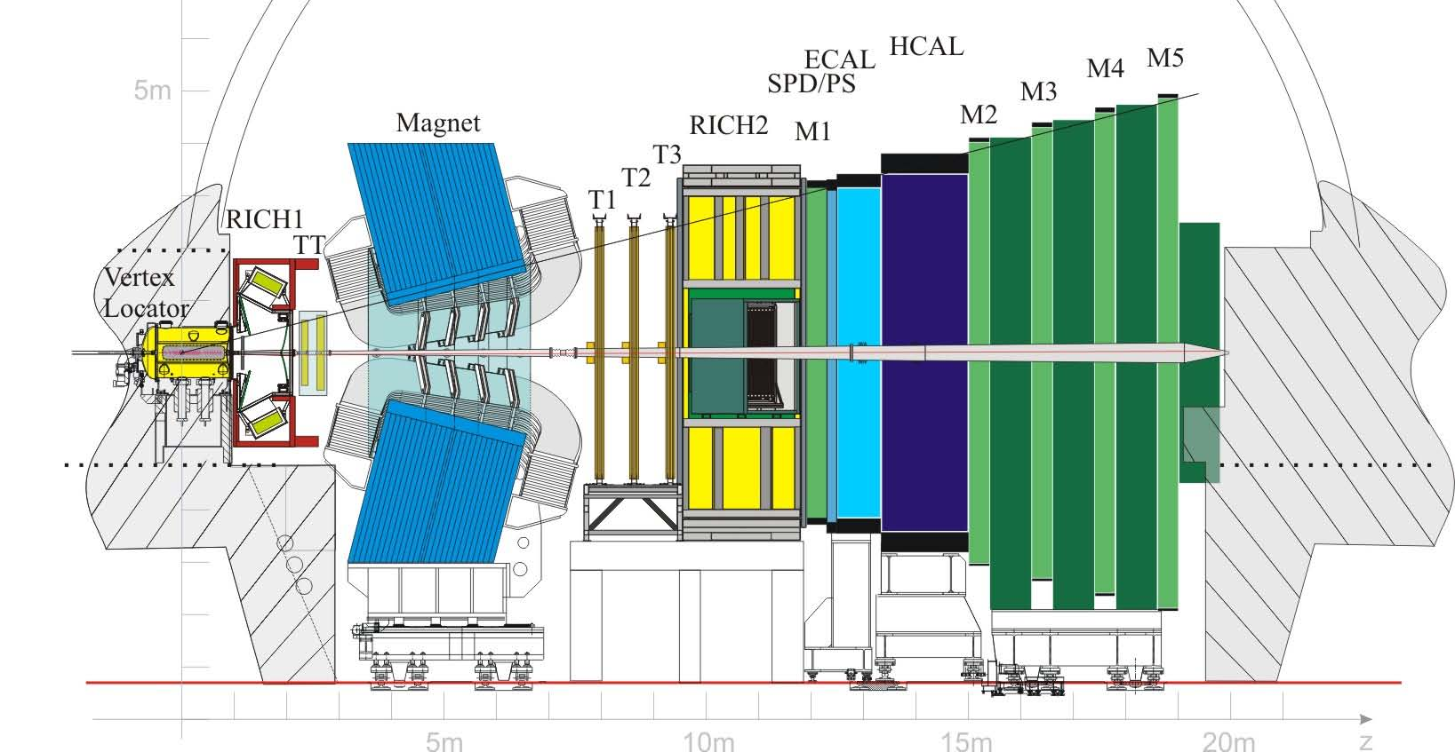
The LHCb detector
2008 JINST 3 S08005
Main subdetectors:
Vertex Locator (VeLo): a silicon strip detector surrounding the IP
warm magnet, ~4 Tm;
tracker stations (inner: silicon; outer: straw)
two RICH detectors
electromagnetic calorimeter with preshower
hadron calorimeter
muon identification system

Slide 3
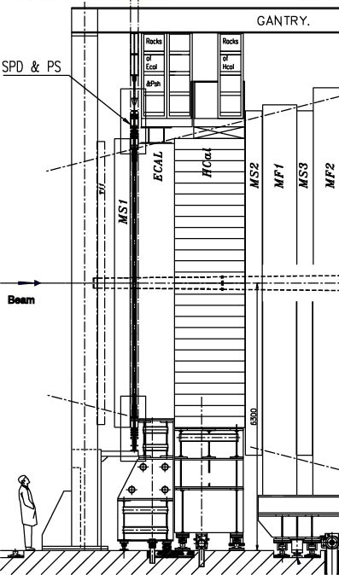
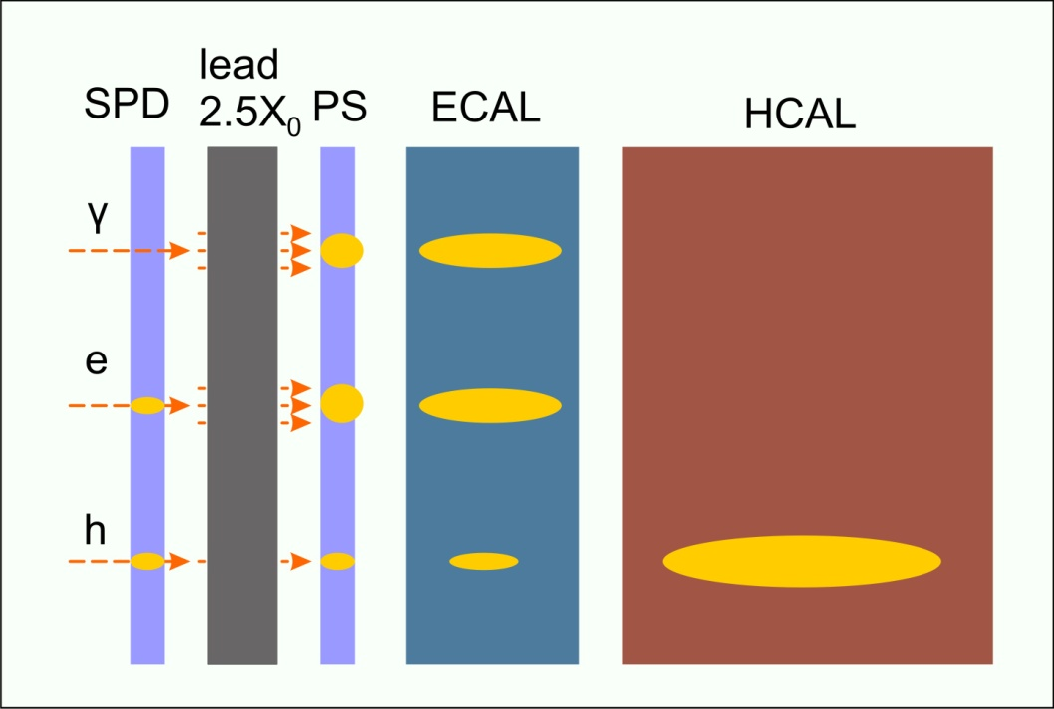
The LHCb Calorimetry System
  solid angle coverage
  300x250 mrad
  distance from IP: ~12.5 m
  four subdetectors:
  SPD,PS,ECAL,HCAL
  based on scint./WLS
  technique, light readout
  with PMT
  provides:
    L0 trigger on high p_{T} e±, π⁰, γ, hadron
    precise energy measurement of e± and γ
    particle identification: e±/γ/hadron; contributes to Muon ID (HCAL).
beam
ECAL
PS/SPD
HCAL
MUON SYSTEM

Slide 4
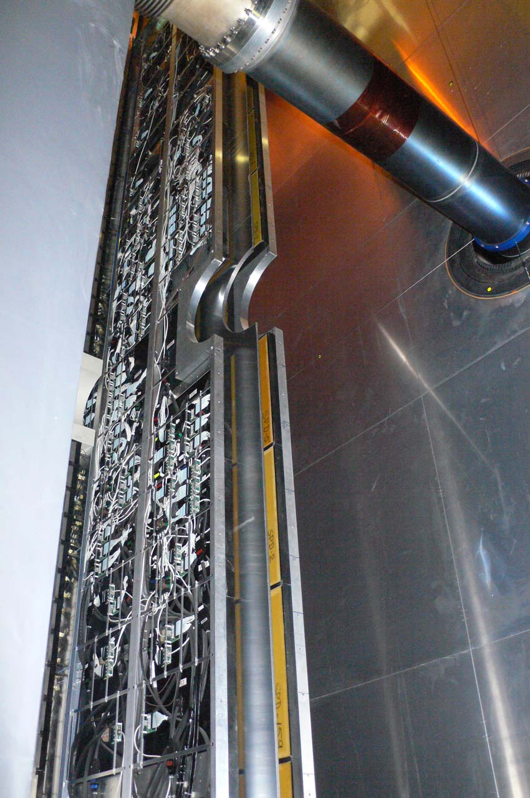
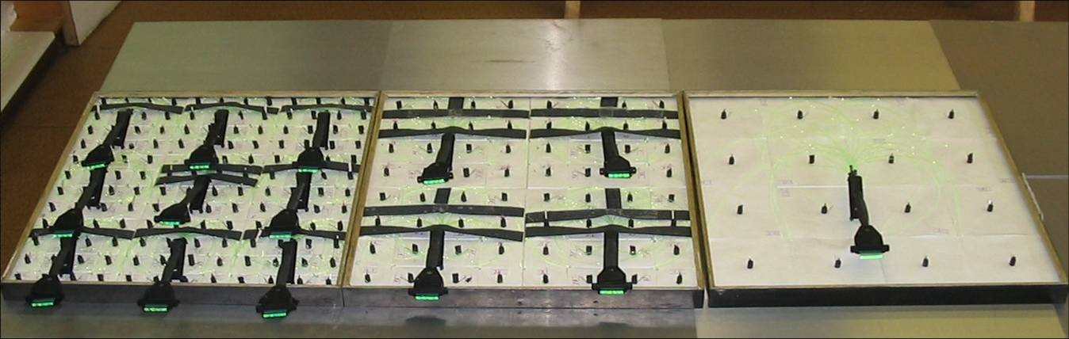
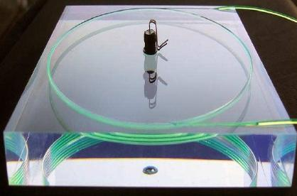
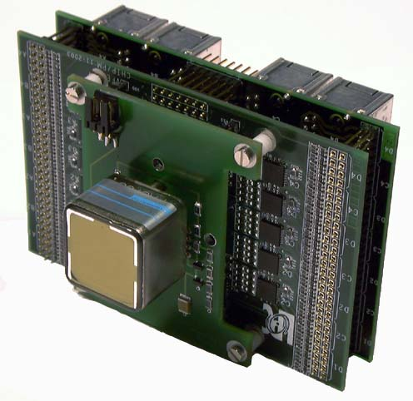
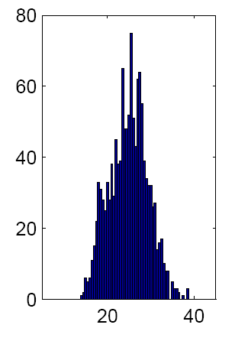
PS / SPD
Preshower detector: two planes of scintillator tiles, with 1.5 cm thick lead plane between them. Size and segmentation: matches ECAL.
The scintillator tiles are 15 mm thick. The light is captured and re-emitted by WLS fiber (3.5 loops) glued in a deep groove machined at the surface of the tile. Light readout: multi-anode PMT.
Inner
144 tiles 4x4 cm²
Middle
64 tiles 6x6 cm²
Outer
16 tiles 12x12 cm²
LED
SPD
# cells
Lead
PS
64-ch
MAPMT
VFE board
Nphe/MIP
The scintillation light is captured by WLS fibers glued into the tiles, and transported via clear fibers to 64-channel HAMAMATSU multi-anode PMT R7600-00-M64MOD.
Both PS and SPD are equipped with LED monitoring system
The light yield of all 12032 cells measured on cosmics at production: ~ 25+-12 ph.el. / MIP
HV setting: uniform, ~700-800 V

Slide 5
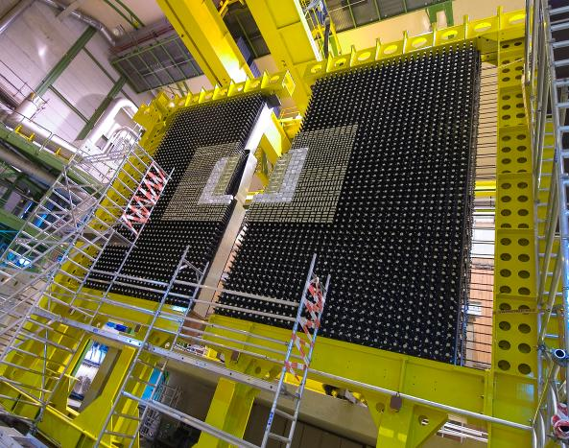
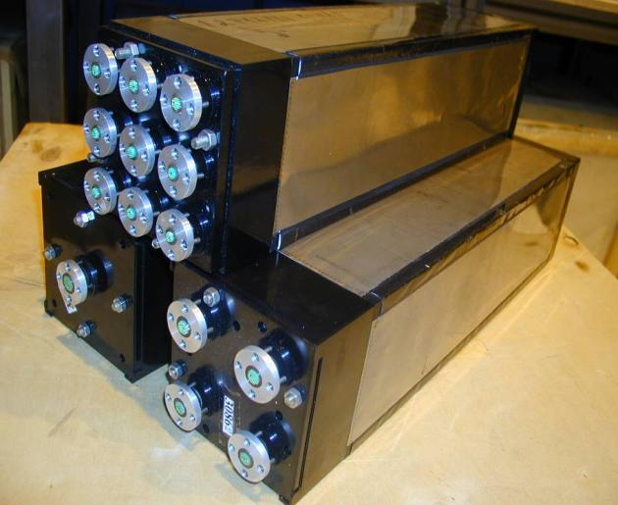
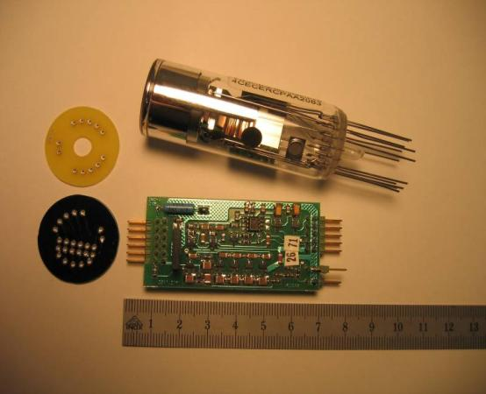
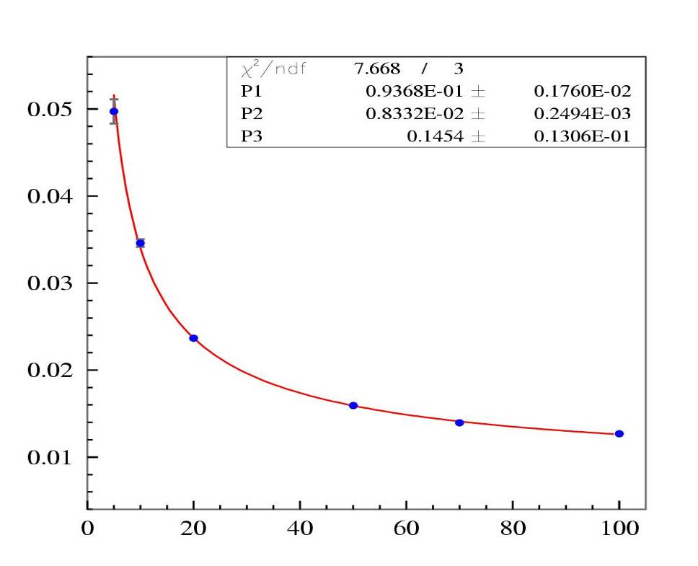
ECAL
Inner
9 cells
Middle
4 cells
Outer
1 cell
PMT
CW base
Shashlik technology
4 mm thick scintillator tiles and 2 mm thick lead plates, ~25 X₀ (1.1 λ_{I}); Moliere radius ~ 36 mm;
modules 121.2 x 121.2 mm², 66 Pb +67 scintillator tiles;
Segmentation: 3 zones → 3 module types, Inner (9 cells per module), Middle (4), Outer (1). Total of 3312 modules, 6016 cells, (7.7 x 6.3) m², ~100 tons.
Light readout: PMT R-7899-20, HAMAMATSU. HV supply: individual Cockcroft-Walton circuit at each PMT.
Average performance figures from beam test (there is slight difference between zones):
Light yield: ~ 3000 ph.el. / GeV
Energy resolution:

Slide 6
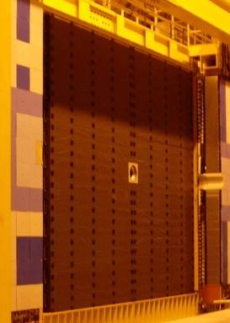
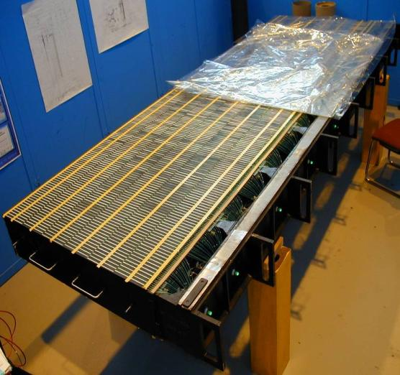
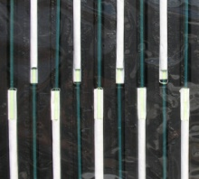
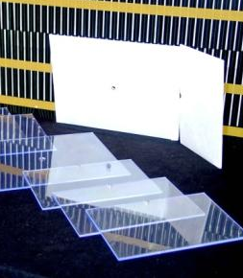
HCAL
spacers
beam
scintillators
row 0
row 1
beam
row 2
row 3
row 4
row 5
master
plate
WLS
fibers
PMT
light
guide
Pipes of the
source movement
system
HCAL module: self-supporting structure containing either 16 outer or 8 outer + 32 inner cells. HCAL consists of 52 modules, 9.5 tons each.
An HCAL module with optics assembled
Tilecal technology (originally developed for ATLAS).
The volume ratio Scint:Fe ~ 3:16.
Instrumented depth: 1.2 m, 6 tile rows, ~5.6λ_{I}
Outer cells: 26x26 cm², Inner : 13x13 cm² (half tiles)
Total of 1488 cells, 2x26 modules, 500 tons
Scintillator, fibers, PMTs, LED system: similar to ECAL
built-in ¹³⁷Cs calibration system
Performance from the beam test:
energy resolution
light yield 105±10 ph.el. / GeV

Slide 7
The LHCb trigger: Run II
  Hardware Level-0 trigger
      SPD multiplicity ← CALORIMETRY
      search for a highest ET object:
          E_{T} (e±/γ) > 2.7 GeV ← CALORIMETRY
          E_{T} (hadr.) > 3.6 GeV ← CALORIMETRY
          p_{T} (μ) > 1.4 GeV/c ← MUON ID system
      up to 1 MHz output, adjustable thresholds
  Software High Level Trigger (HLT)
      ~26000 CPU cores
  Storage rate: 12.5 kHz
L0CALO: 60% of the L0 bandwidth

Slide 8
Calibration and monitoring

Slide 9
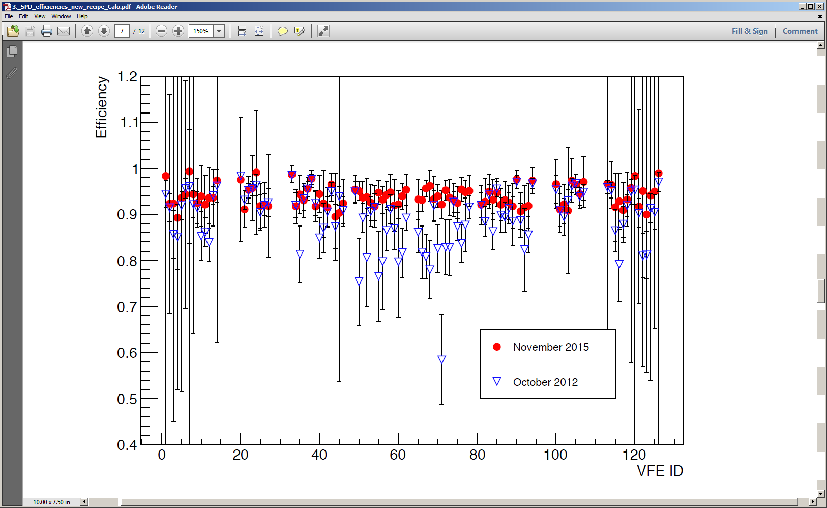
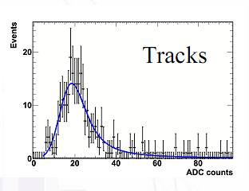
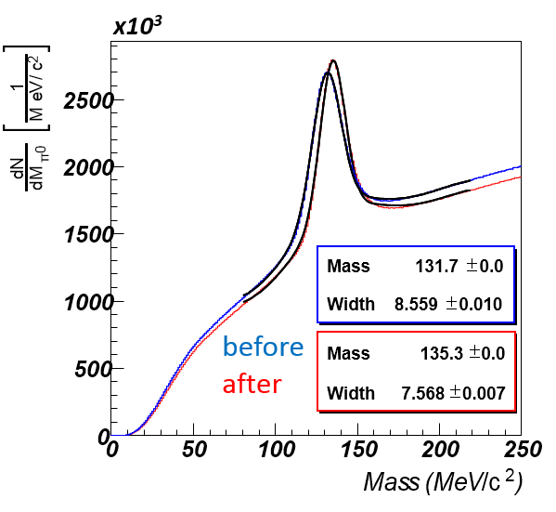
CALO calibration
more details: see talk of D. Pereima, this conference
SPD
The SPD is calibrated on data, via threshold scan with charged tracks. The nominal efficiency is ~95% (threshold ~0.7 MIP).
before calibration
after calibration
The PS signal is digitized by 10-bit ADC. The inter-calibration of cells is based on the position of the signal from charged track.
PS
The ECAL fine calibration on data is based on the π⁰ peak position.
Up to now, was performed offline.
Starting from 2017, the plan is to do it ~ once per month online (special data stream).
ECAL
HCAL: the main tool is embedded ¹³⁷Cs calibration system, calibration out of data taking.

Slide 10
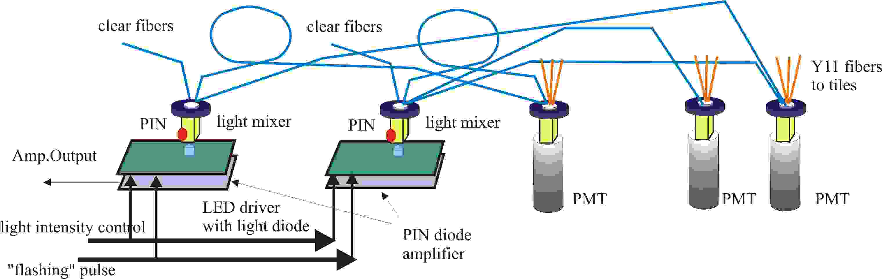
LED monitoring
Each CALO subdetector is equipped with a LED calibration system.
The HCAL and ECAL monitoring systems have similar design
  LED flash magnitudes are monitored by PIN photodiodes
For HCAL and (since 2015) ECAL: “active” monitoring
  to enable it for ECAL, we had to replace LED light distribution fibers to quartz ones, because of radiation
  The goal is to improve L0 operation stability
  HV corrections are calculated from deviation of average LED amplitudes from reference
    from 2016 – in automatic regime (HV correction at the end of each fill)
  This compensates for the ECAL/HCAL PMT gain drift
    for ECAL it also partially compensates for the radiation degradation of light yield
ECAL
HCAL

Slide 11
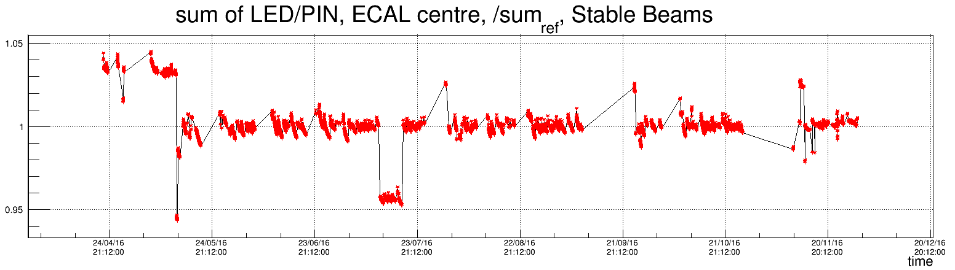
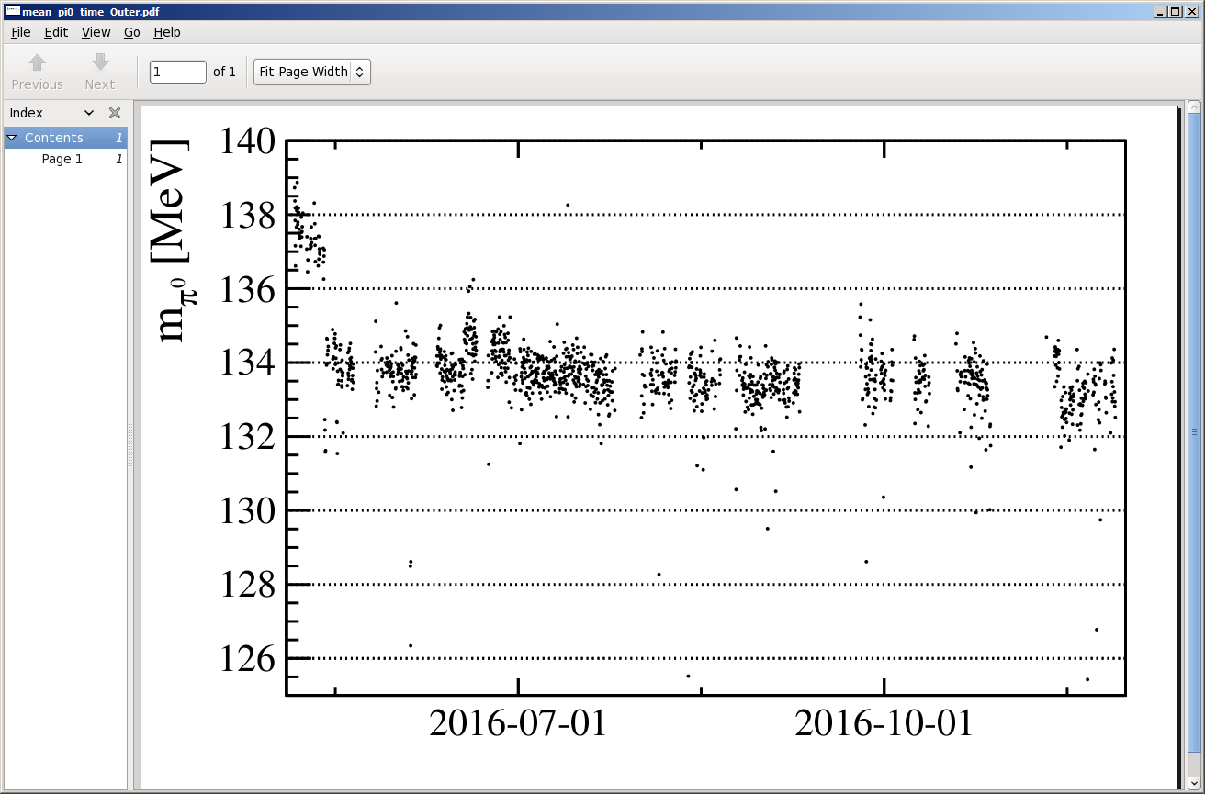
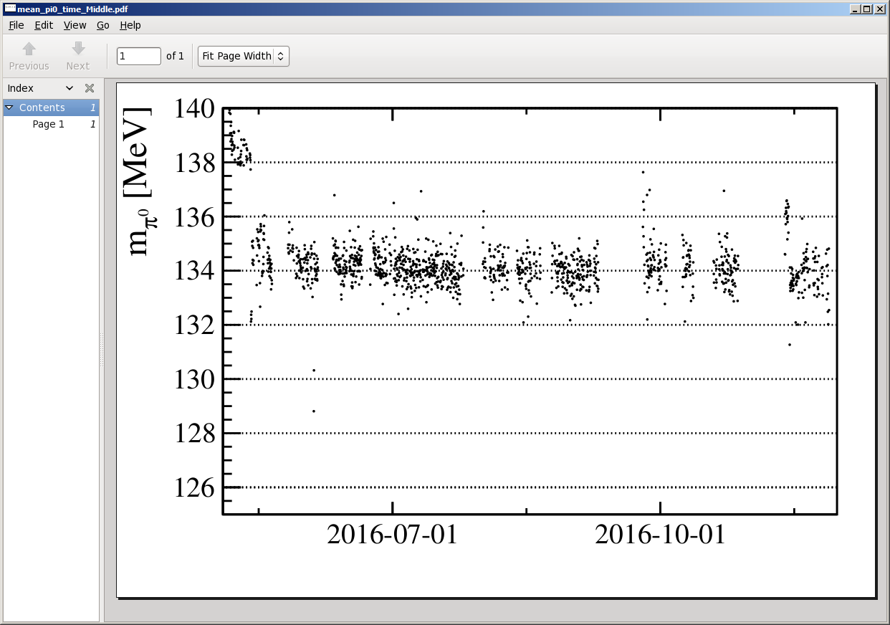
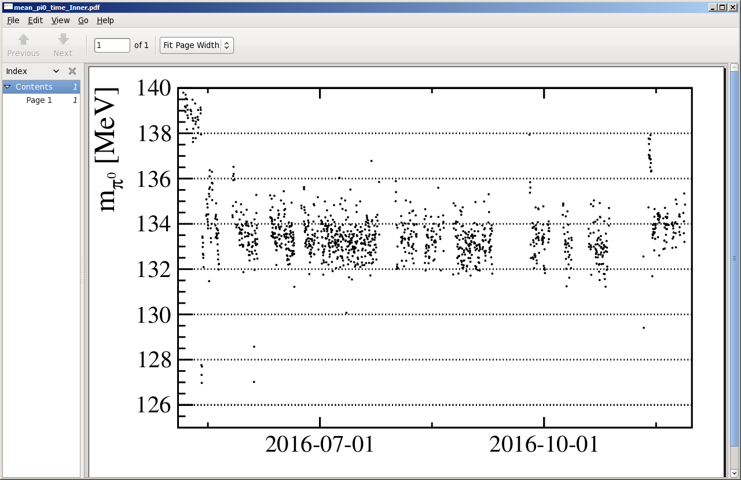
LED monitoring: ECAL in 2016
Active monitoring: HV correction after each LHC fill
Annealing at tech. stops
π⁰ calib
applied
DAQ failure
147 HV updates
Outer
Middle
Inner
“Online” π⁰ mass is ~stable (fraction of MeV degradation).
More stable detector response: stabilizes L0 rate, facilitates offline calibration.

Slide 12
Performance

Slide 13
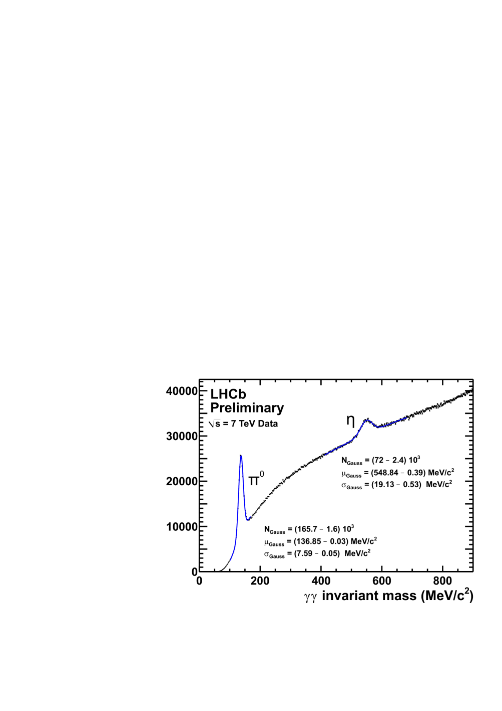
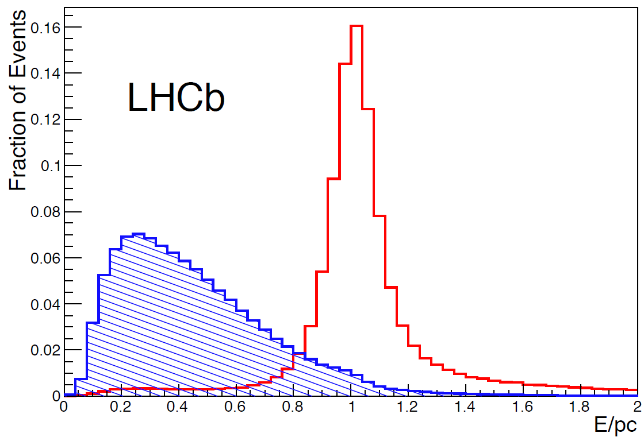
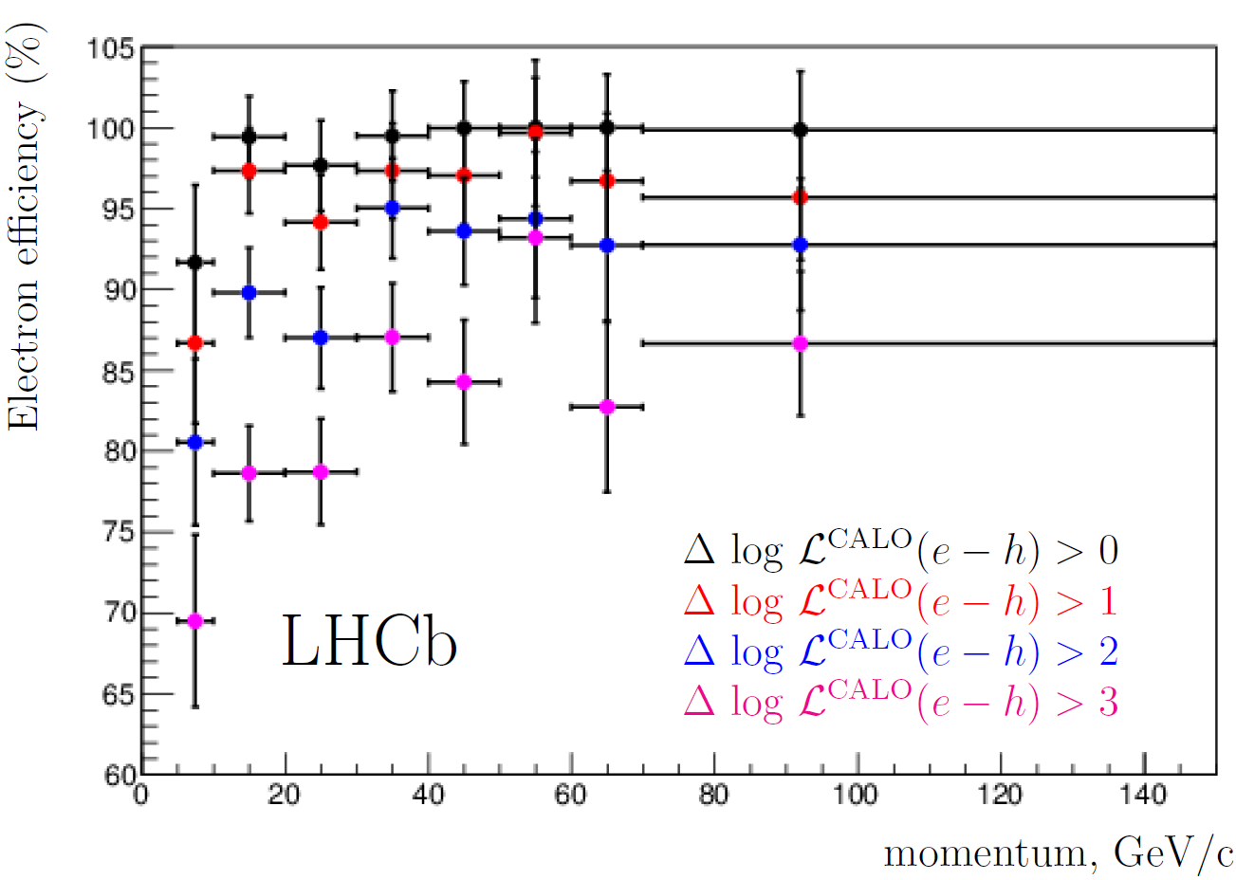
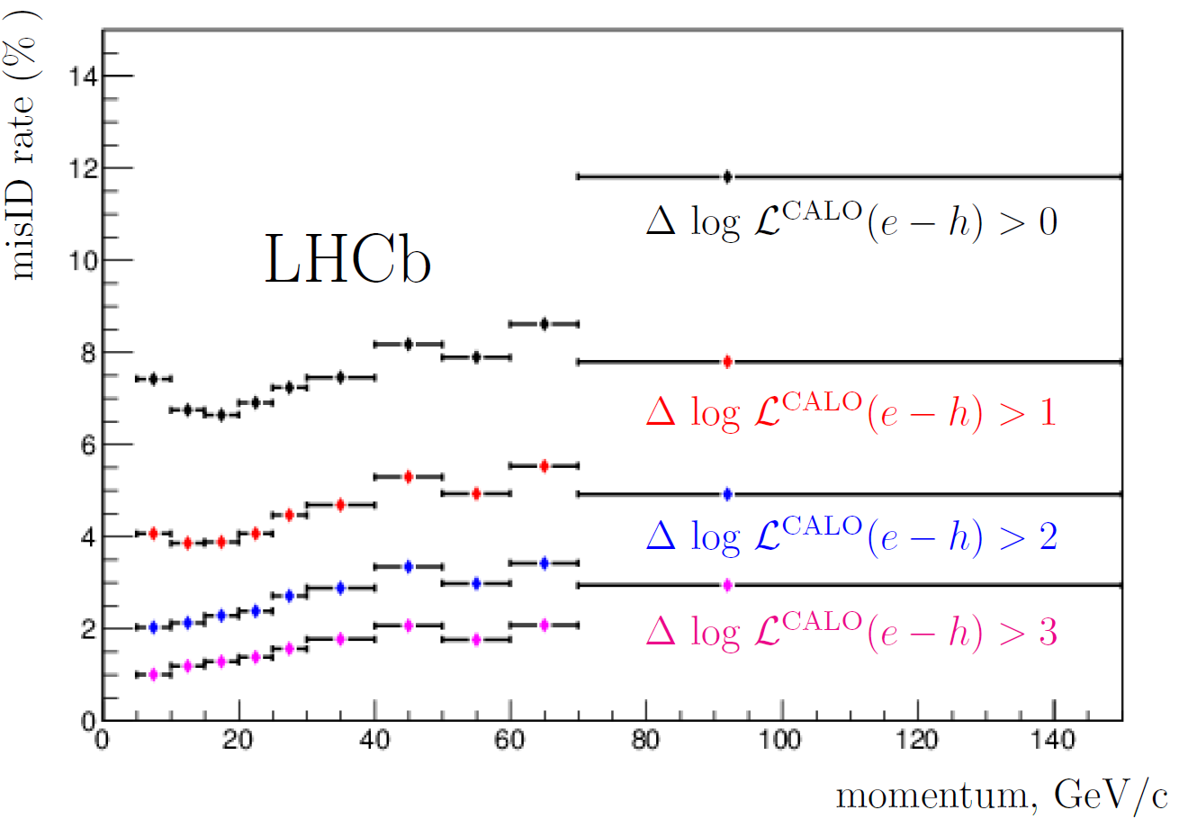
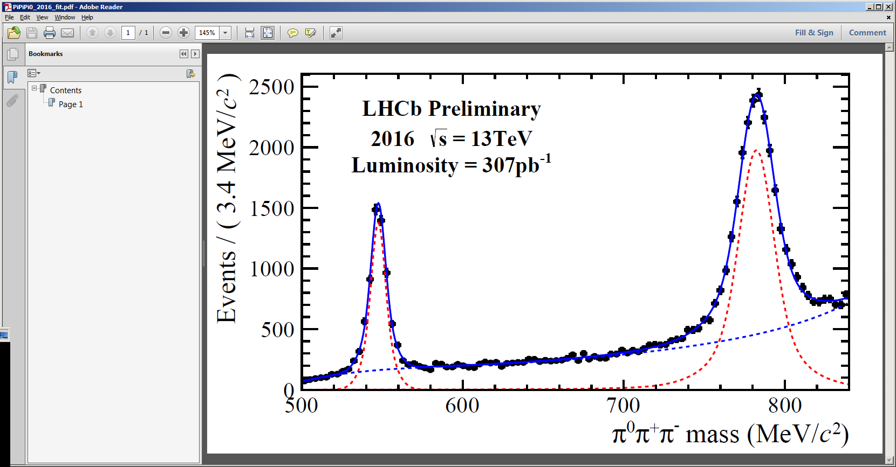
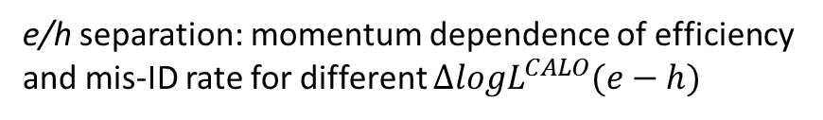
Photon reconstruction, e/h separation
π⁰,η → γγ
Int.J.Mod.Phys. A30 (2015) 1530022
ECAL E/p
electron
hadron
η,ω→π⁺π–π⁰(γγ)
μ=782.389 MeV
σ=11.909 MeV
μ=547.539 MeV
σ=9.902 MeV
e/h separation: momentum dependence of efficiency
and mis-ID rate for different $∆logL^{CALO}(e−h)$
On average: 5% misID rate for 90% efficiency

Slide 14
Ageing effects

Slide 15
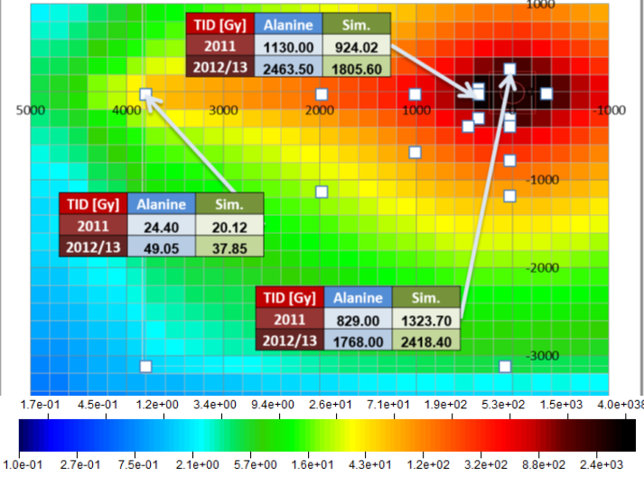
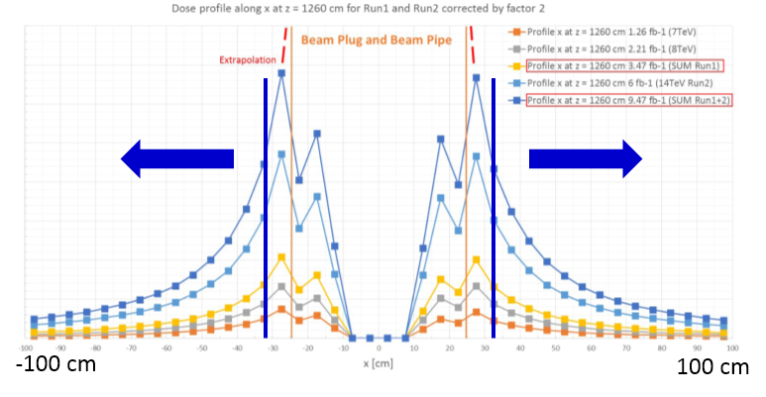
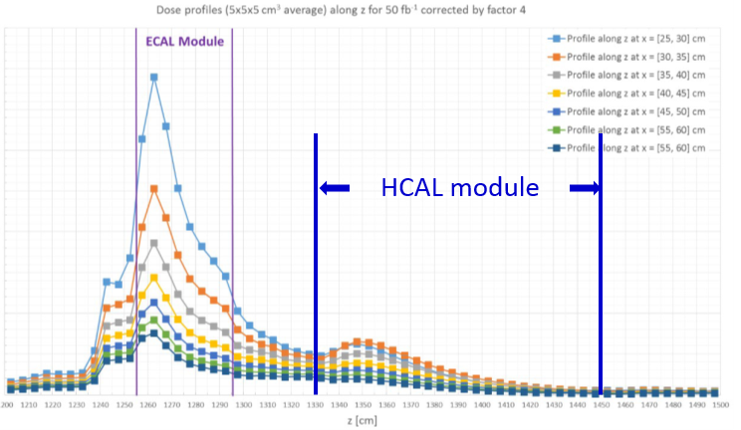
Radiation environment @ CALO
Instrumented
area: |x|>32 cm
Dose profiles at the depth of EM shower max. Rapid decrease with |x|.
(M. Karacson, PhD thesis)
Dose map @ ECAL front, corresponding to the 2012 FLUKA simulation (2.21 fb⁻¹, E_{CM} = 8 TeV)
For E_{CM} = 8 TeV → 14 TeV: factor of ~ 1.7 for same integrated luminosity
For the position of EM shower maximum in ECAL: factor of ~2 wrt ECAL front.
Dose profiles along z at different x positions.
HCAL front: ~0.3 of ECAL front (the CW HV generators are operational till 10-15 kGy)
HCAL back: 0.03 of ECAL front

Slide 16
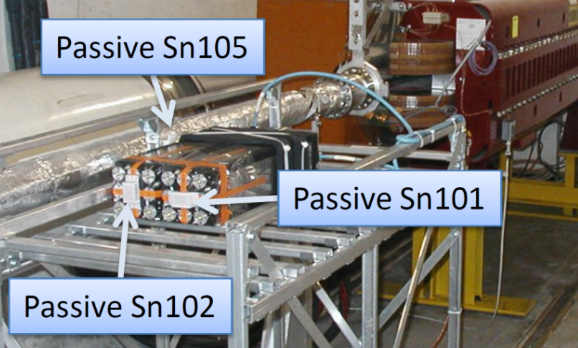
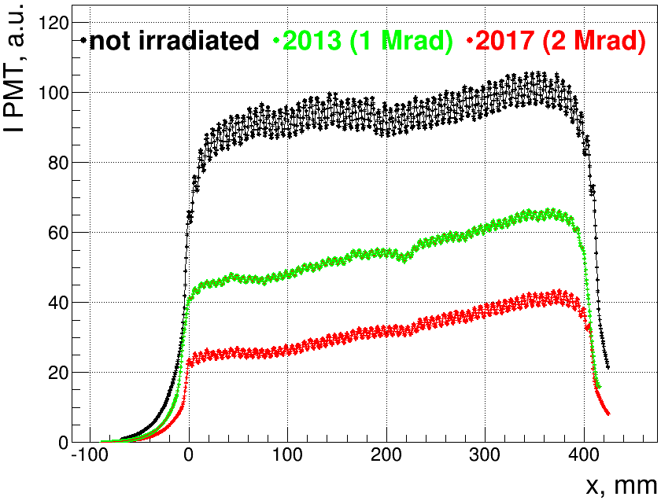
ECAL radiation hardness
Irradiation of Inner modules in the LHC tunnel
Two ECAL modules were installed in 2009 in the LHC tunnel upstream of the LHCb interaction point, close to the beam pipe.
The dose is measured at the module surface
Sizeable uncertainty (~ x1.5 – x2) in obtaining the dose inside the module
The module may be considered operational till ~3-4 Mrad at shower maximum:
10…13 fb⁻¹ @ 14 TeV for the innermost cells (32 cm from the beam)
25…30 fb-1 @ 14 TeV at 48 cm
…

Slide 17
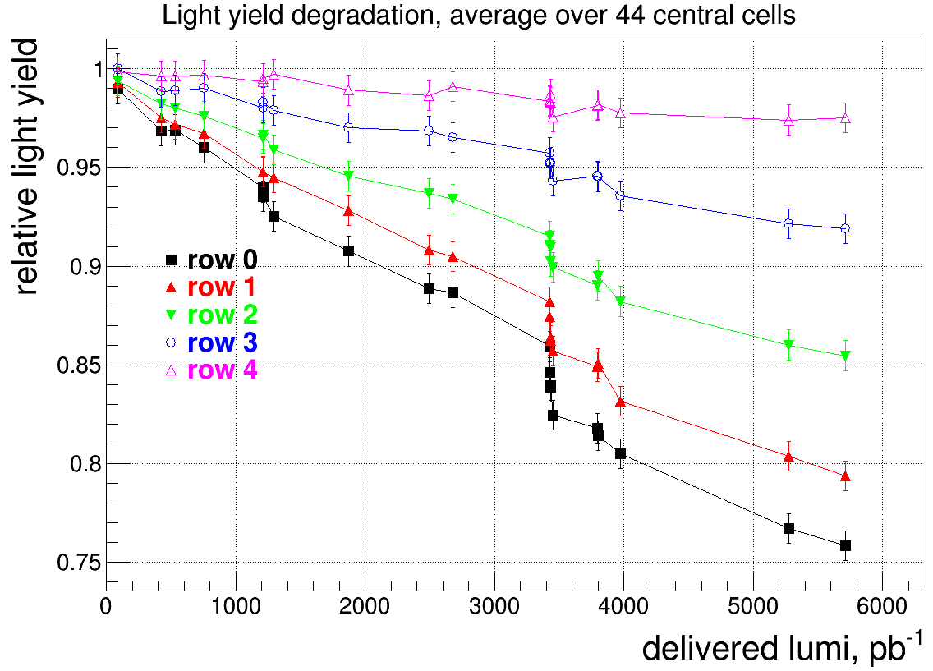
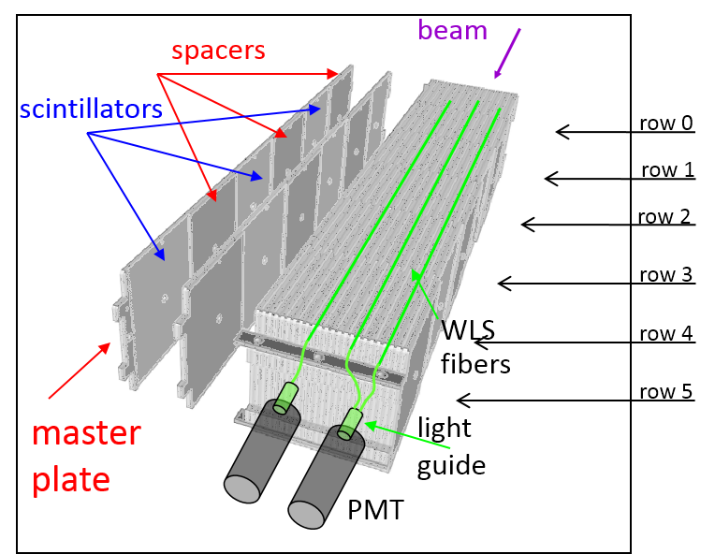
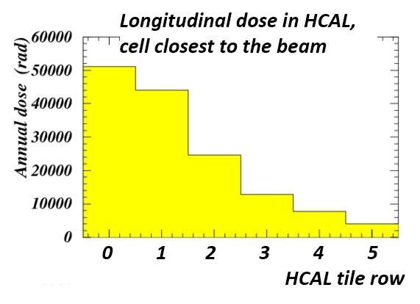
HCAL radiation degradation
The HCAL radiation degradation can be evaluated in situ from the ¹³⁷Cs calibration data.
The hadronic shower maximum lays within the tile row 0 (ECAL is ~1.2 λ_{I}); the dose in the row 5 is much less.
LS1 + beam
commissioning
The light yield degradation in a tile row #i is approximately:

Slide 18
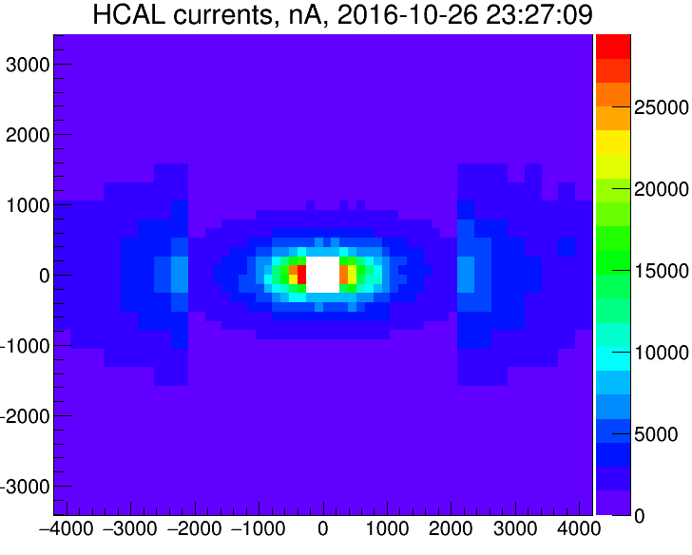
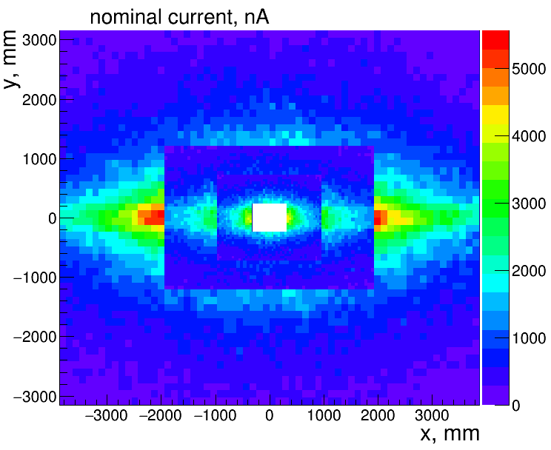
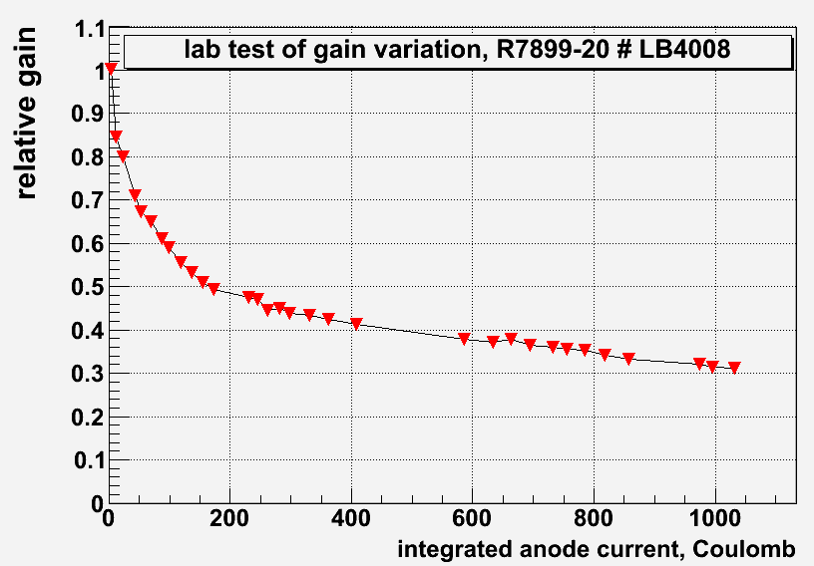
PMT ageing
Significant DC anode current in HCAL and ECAL PMTs occurs during LHC operation
HCAL
ECAL
HCAL: up to 100 C/year
ECAL: up to 30 C/year
Compensated by gradually increasing HV
The dynode system ageing was tested in the lab:

Slide 19
LHCb CALO Upgrade(s)
For the overview of LHCb upgrades:
see talk of M. Williams, this conference

Slide 20
The LHCb trigger: Upgrade
With the present trigger organization, 1 MHz L0 limit saturates the physics processes yield with increasing luminosity (especially L0Hadron).
  Solution for LHCb Upgrade:
  No Level-0 trigger any more!
  Event selection will be based of full event reconstruction
All the Front End electronics should work at 40 MHz. The electronics has to be rebuilt for most subdetectors.
Upgrade I.
Step in luminosity to 2·10³³ cm⁻²s⁻¹

Slide 21
LHCb CALO Upgrade Phase 1
Present ECAL and HCAL will be kept
PS and SPD will be removed: for particle ID in HLT the tracker information will be used
The ECAL and HCAL Frontend electronics will be rebuilt
The ECAL and HCAL PMT gain will be reduced by factor of 5, to reduce PMT degradation
  PMT linearity: OK within required dynamic range
to compensate, increase x5 the FE preamplifier gain
  low noise frontend ASIC (ICECAL)
detector maintenance should follow radiation degradation of detector components:
  regular replacement of PMTs / CW bases of ECAL
  HCAL degradation in the centre will not affect the LHCb performance
  replace damaged ECAL Inner modules at LS3 (~2025)

Slide 22
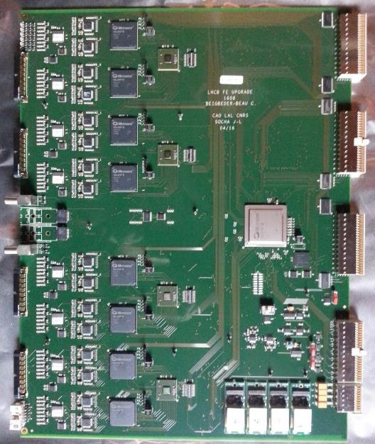
LHCb CALO Upgrade: FEB
main features:
number of channels: 32
input impedance: 50 Ω
integration time: 25 ns
sensitivity: 4 fC / ADC count
dynamic range: 12 bit
dynamic pedestal subtraction
timing: individual per channel
non-linearity: <1%
spill-over: <1%
cross-talk: <0.5%
CALO FEB prototype

Slide 23
LHCb CALO Upgrade Phase 1b and 2
CERN-LHCC-2017-003
Phase 1(b) Upgrade (~2025, LS3):
consolidation and enhancement.
LHCb will continue running at L=2·10³³cm⁻²s⁻¹,
to reach ~50 fb⁻¹.
By LS3 HCAL will not be necessary any more
(no hardware E^{T}_{hadron} selection)
and will be dismounted, in favor of additional muon filter.
ECAL: at L=2·10³³cm⁻²s⁻¹, occupancy is too high not only in the centre
instead of replacing only very central modules, it is suggested to enhance granularity by replacing all modules in the horizontal band
high granularity → small Moliere radius → W based modules in the centre

Slide 24
LHCb CALO Upgrade Phase 1b and 2
CERN-LHCC-2017-003
Phase 2 (~2030):
the goal is a detector which is able to
take data at L=2·10³⁴cm⁻²s⁻¹,
Integrated luminosity ~300 fb⁻¹
ECAL: migration to new technology
sampling calorimetry
high granularity → W based
timing layer (measure time at ~20 ps precision, to distinguish between primary vertices)
  either 4D Si planes embedded to ECAL modules, or a separate subdetector
First new modules can be installed in the ECAL centre during the Phase I(b) Upgrade (LS3)

Slide 25
Conclusions
The Calorimetry system of LHCb is running successfully in 2010-2016, demonstrating very good detector performance.
Upgrade for higher luminosity (2·10³³cm⁻²s⁻¹) is foreseen during LHC LS2.
The Calorimetry system will be subject to the following modifications:
  The Preshower, SPD and lead converter will be removed
  All the Front End electronics of HCAL and ECAL will be rebuilt.
  The gain of all the PMTs will be reduced by factor of 5, with corresponding increase of sensitivity of input amplifiers of Front End Boards
Further LHCb upgrades, Phase 1(b) and 2, are now under consideration, for LHC LS3 and LS4. The final goal is to have a detector running at L=2·10³⁴cm⁻²s⁻¹.
  HCAL will be removed
  ECAL will be rebuilt using a new technology.

Slide 26
Thank you!

Slide 27
backup

Slide 28
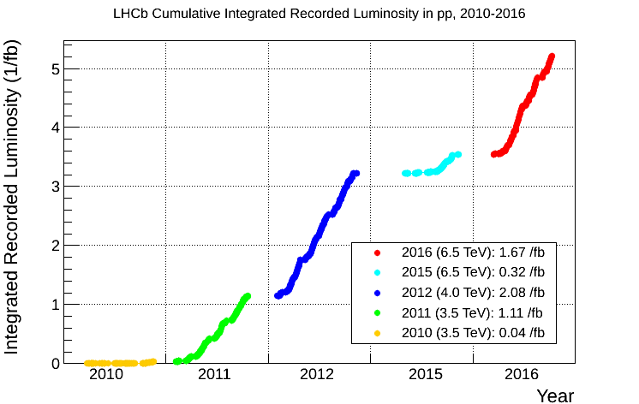
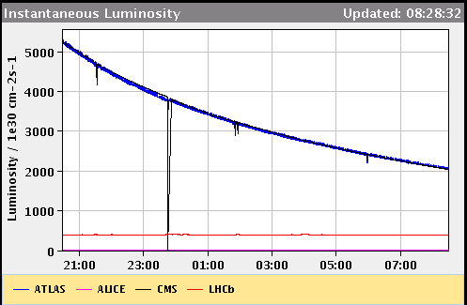
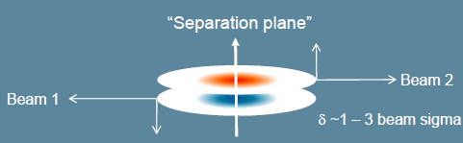
The LHCb operation
luminosity leveling
LHCb is running at a constant luminosity lower than ATLAS and CMS (3.3·10³² cm⁻²s⁻¹ in 2016) using luminosity leveling technique.

Slide 29
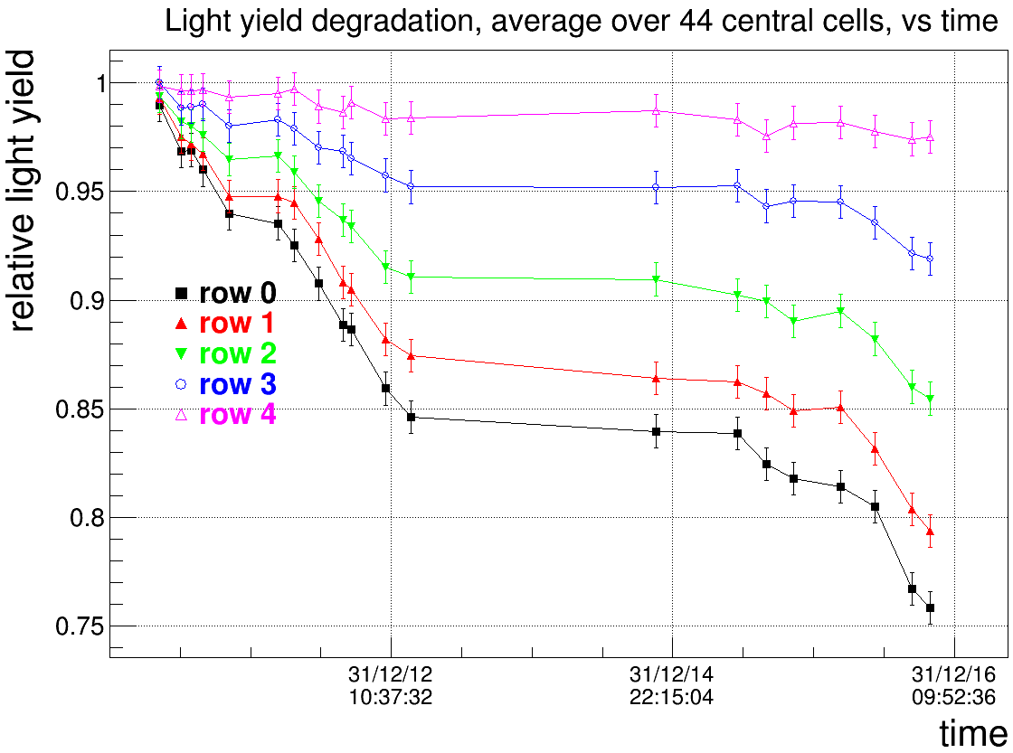
HCAL ageing
Determined from the ¹³⁷Cs calibration data

