Slide 1
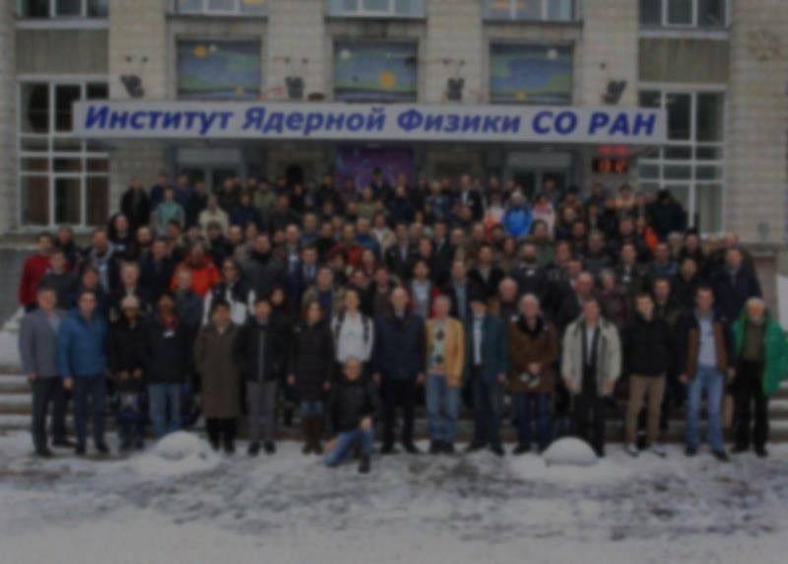
The µ-RWELL
LABORATORI NAZIONALI DI FRASCATI
www.lnf.infn.it
G. Bencivenni¹
R. De Oliveira², P. De Simone¹, G. Felici¹ , M. Gatta¹ G. Morello¹,
A. Ochi³ , M. Poli Lener¹
L. Benussi¹, L. Borgonovi⁴, P. Giacomelli⁴, A. Ranieri⁵,
M. Ressegotti⁶, I. Vai⁶, V. Valentino⁵
Laboratori Nazionali di Frascati - INFN
CERN
Kobe University
INFN Sezione di Bologna
INFN Sezione di Bari
INFN Sezione di Pavia
INSTR-2017 - 2nd March 2017, Novosibirsk

Slide 2
Outline
The architecture & principle of operation
The Low Rate scheme and its performance
  - Technology Transfer of the Low Rate version
The High Rate scheme and its performance
Conclusion

Slide 3
Why a new MPGD
  The R&D on µ-RWELL is mainly motivated by the wish of improving the
  stability under heavy irradiation
  & simplify as much as possible
  construction/assembly procedures
  The original idea was conceived in 2009 @ LNF during the construction of the CGEM , but only in the 2014 we really started a systematic study of this new technology in collaboration with Rui de Oliveira

Slide 4
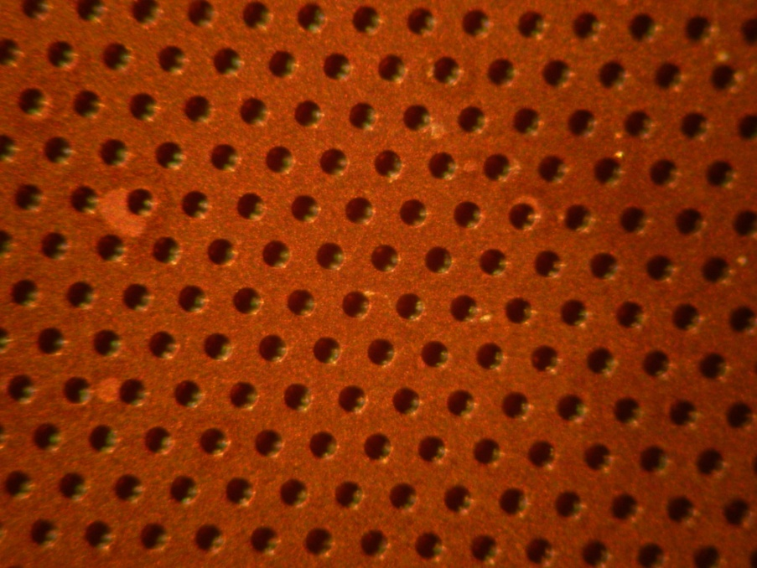
The detector architecture
G. Bencivenni et al., 2015_JINST_10_P02008
The µ-RWELL is composed of only two elements:
the µ-RWELL_PCB and the cathode
The µ-RWELL_PCB, the core of the detector, is realized by coupling:
a “WELL patterned kapton foil” as “amplification stage”
a “resistive layer” for discharge suppression & current evacuation:
  “Single resistive layer” (SL) <<100 kHz/cm²: single resistive layer → surface resistivity ~100 MΩ/☐ (CMS-phase2 upgrade; SHIP)
  “Double resistive layer” (DL) >> 1 MHz/cm²: more sophisticated resistive scheme must be implemented (MPDG_NEXT- LNF) suitable for LHCb-Muon upgrade
a standard readout PCB
Drift cathode PCB
Copper top layer (5µm)
Well pitch: 140 µm
Well diameter: 70-50 µm
Kapton thickness: 50 µm
DLC layer (<0.1 µm)
R ̴100 MΩ/□
1
2
3
Rigid PCB readout
electrode
µ-RWELL PCB
(*) DLC = Diamond Like Carbon
High mechanical & chemical resistant material

Slide 5
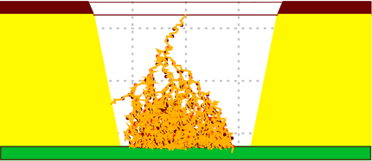
Principle of operation
Applying a suitable voltage between top copper layer and DLC the “WELL” acts as multiplication channel for the ionization.
top copper layer
HV
kapton
The charge induced on the resistive foil is
dispersed with a time constant, τ = ρC ,
determined by
the surface resistivity, ρ
the capacitance per unit area, which depends on the distance between the resistive foil and the pad readout plane, t
the dielectric constant of the insulating medium, ε_{r} [M.S. Dixit et al., NIMA 566 (2006) 281]
resistive stage
ρ
Insulating medium
ε_{r}
t
Pad/strip r/out
Not in scale
The main effect of the introduction of the resistive stage is the suppression of the transition from streamer to spark
As a drawback, the capability to stand high particle fluxes is reduced, but an appropriate grounding of the resistive layer with a suitable pitch solves this problem (see High Rate scheme)

Slide 6
Main detector features
The µ-RWELL is a single-amplification stage, intrinsically spark protected MPGD characterized by:
simple assembly procedure:
  only two components → µ-RWELL_PCB + cathode
  no critical & time consuming assembly steps:
    no gluing
    no stretching (→ no stiff & large frames needed)
    easy handling
  suitable for large area with PCB splicing technique w/small dead zone
cost effective:
  1 PCB r/o, 1 µ-RWELL foil, 1 DLC, 1 cathode and very low man-power
easy to operate:
  very simple HV supply → only 2 independent HV channels or a trivial passive divider (while 3GEM detector → 7 HV floating/channels )

Slide 7
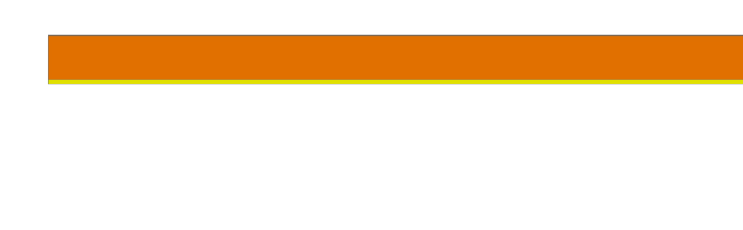
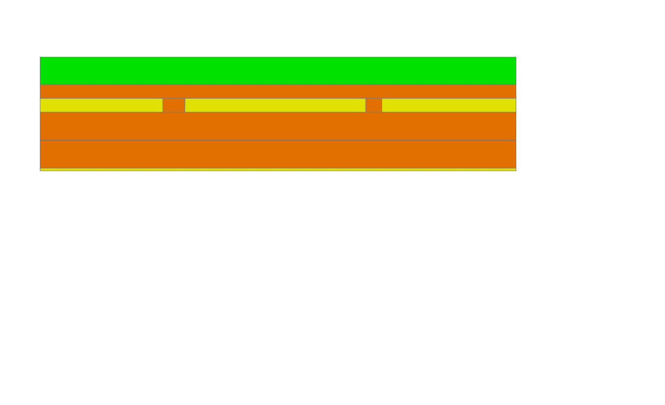
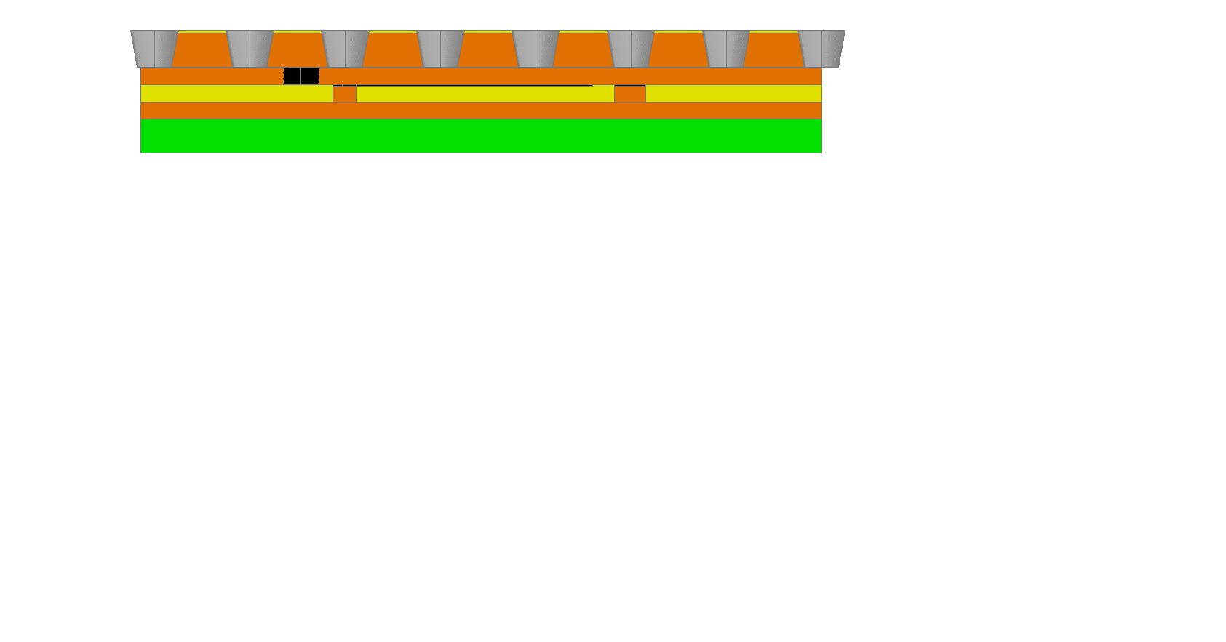
The Low Rate scheme (CMS/SHiP)
Copper layer 5 µm
1
Kapton layer 50 µm
DLC layer: 0.1-0.2 µm (10-200 MΩ/☐)
DLC-coated kapton base material
2
Insulating medium (50 µm)
PCB (1-1.6 mm)
DLC-coated base material after copper and kapton chemical etching (WELL amplification stage)
3

Slide 8
Detector performance:
Lab Tests

Slide 9
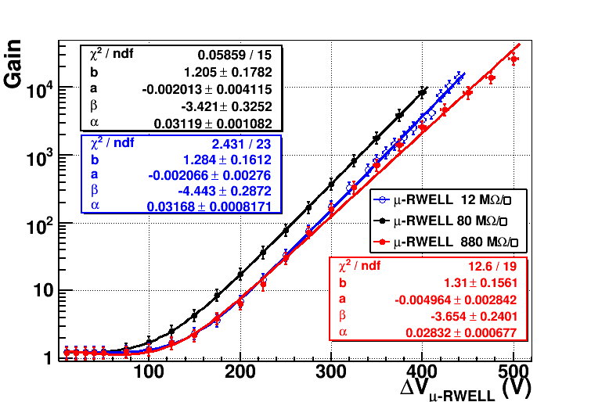
Detector Gain
Prototypes with different resistivity (12-80-880 MΩ/☐) have been tested with X-Rays (5.9 keV), with different gas mixtures, and characterized by measuring the gas gain in current mode.
Ar/iC₄H₁₀= 90/10
WELL kapton thickness = 50µm

Slide 10
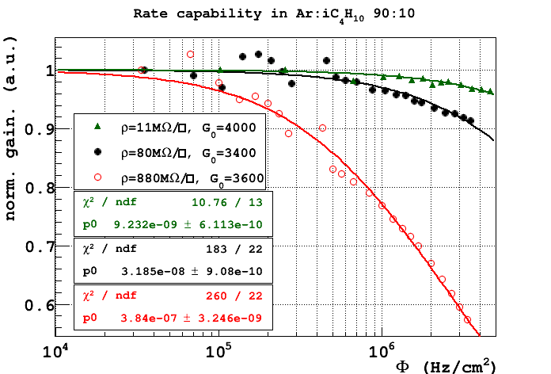
Rate capability with X-rays (single layer)
Rate capability fitted with the function:
local irradiation
Rate for a drop ΔG = -3%
Φ = 77 kHz/cm² - 880 MΩ/☐
Φ = 850 kHz/cm² - 80 MΩ/☐
Φ = 3.4 MHz/cm² - 11 MΩ/☐
for m.i.p.×7
The gain decrease is correlated with the voltage drop due to the resistive layer: larger the resistivity lower the rate capability.
local irradiation ≠ global irradiation

Slide 11
Detector performance:
Beam Tests

Slide 12
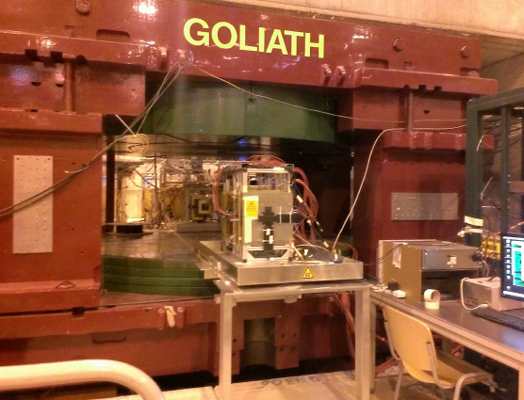
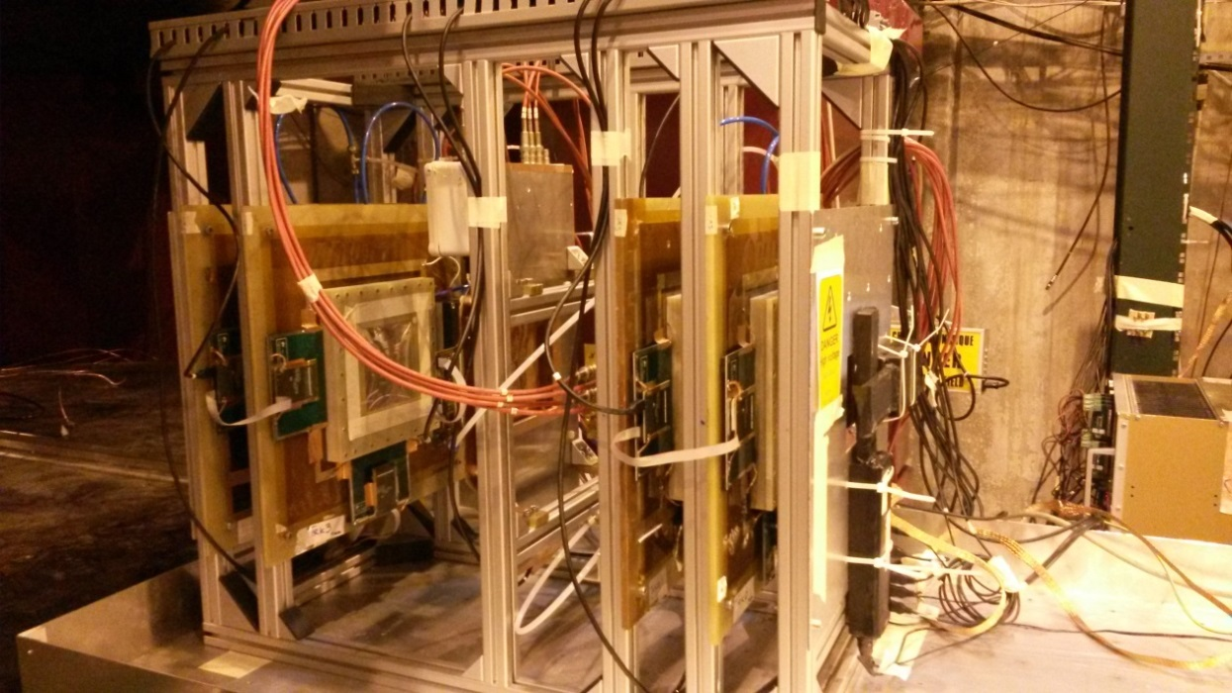
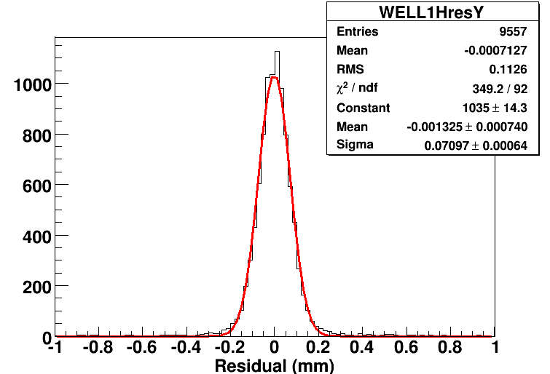
Beam tests results
H4 Beam Area (RD51)
Muon beam momentum: 150 GeV/c
Goliath: B up to 1.4 T
μ-RWELL prototype
12-80-880 MΩ /□
400 µm pitch strips
APV25 (CC analysis)
Ar/iC₄H₁₀ = 90/10
BES III-GEM chambers
σ_{RWELL} = (52+-6) µm
@ B= 0T after TRKs contribution subtraction
GEMs Trackers

Slide 13
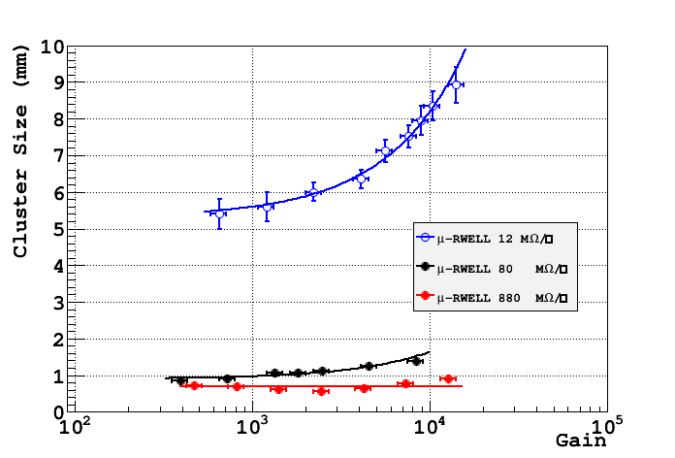
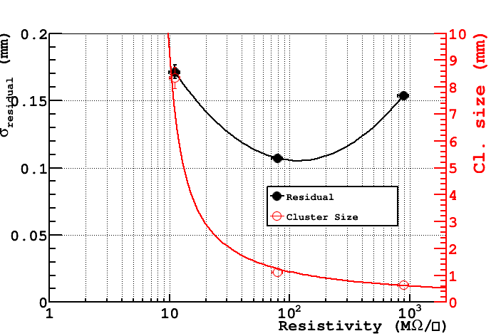
Space resolution vs resistivity
CC analysis
The “space resolution” (σ of the residual – no subtraction of the external trackers contribution) exhibits a minimum around 100MΩ/□.
→ at low resistivity the charge spread increases and then σ is worsening.
→ at high resistivity the charge spread is too small (Cl_size → 1 fired strip) then the Charge Centroid method becomes no more effective (σ → pitch/√12)

Slide 14
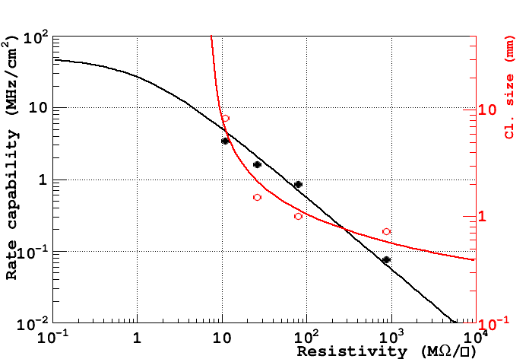
Combining the information
pad r/o
strip/pixel r/o
Too low
Too high
Qualitatively: low resistivity → pad r/out & higher rate
high resistivity → strip/pixel r/out & lower rate

Slide 15
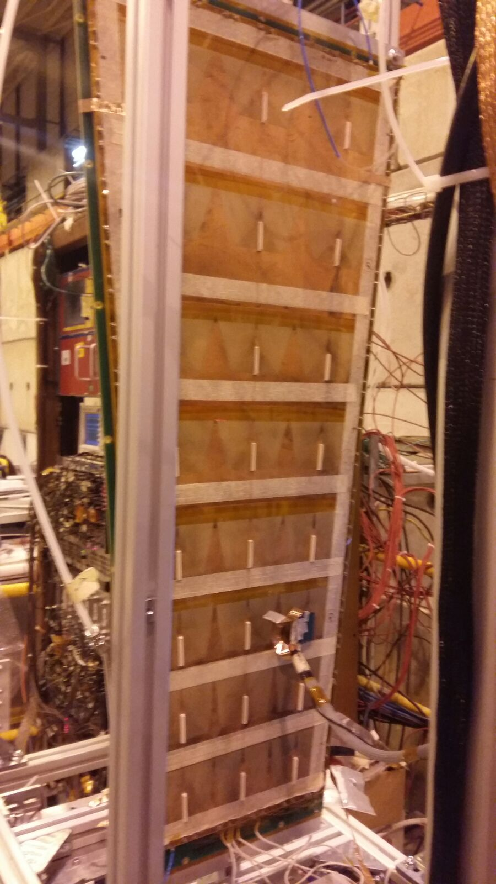
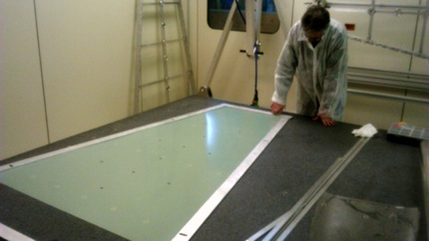
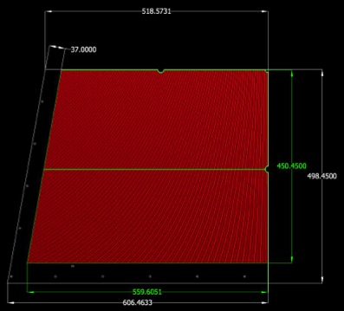
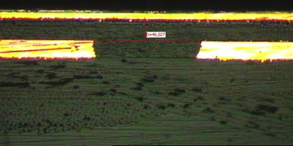
Technology Transfer to Industry
In the framework of the CMS-phase2 muon upgrade we have developed large size µ-RWELLs , in strict collaboration with Italian industrial partners (ELTOS & MDT).
The work is performed in two years with following schedule:
Construction & test of the first 1.2x0.5m² (GE1/1) µ-RWELL 2016 - DONE
Mechanical study and mock-up of 1.8x1.2 m² (GE2/1) µ-RWELL 2016-2017 ONGOING
Construction of the first 1.8x1.2m² (GE2/1) µ-RWELL (only M4 active) 01-09/2017 near future
DONE
1.8x1.2m² (GE2/1) µ-RWELL
~40 times larger than small protos !!!
~200 times larger than small protos !!!
mock-up
ELTOS tests

Slide 16
Towards the High Rate scheme
single resistive layer, edge grounding,
2D evac.
current
d
double resistive
layer, 3D grounding
d’
top layer
r
(1cm)d’
r
d (50cm)
conductive vias
bottom layer
(*) point-like irradiation, r << d
Ω is the resistance seen by the current generated by a radiation incident in the center of the detector cell
Ω ~ ρ_{s} x d/2πr
Ω’ ~ ρ_{s}’ x 3d’/2πr
Ω/ Ω’ ~ (ρ_{s} / ρ_{s}’) x d/3d’
If ρ_{s} = ρ_{s}’ → Ω/ Ω’ ~ ρ_{s}/ρ’_{s} * d/3d’ = 50/3 = 16.7
(*) Morello’s model: appendix A-B (G. Bencivenni et al., 2015_JINST_10_P02008)
Notes:
Let’s switch to the high rate scheme.
To do that try to compare a single resistive layer detector 50x50 cm2 large , with grounding all around its edge and 2D current evacuation,
with a second 50x50 cm2 detector, “orthogonally” grounded every cm2, by means “through-vias” between the top resistive layer
and a second bottom resistive layer. In this second scheme we can imagine that from the point of view of
the resistive layer the detector is practically divided in basic cells 1 cm2 large, and we can speak about a sort of 3D grounding scheme.
The two versions (the single layer & the double layer with through vias) have clearly different performance.
The ratio between the resistance …. Comes out to be of the order 20 … (under the assumption that the resistivity is the same).
The double layer clearly allows better performance in terms of uniformity response (or equivalently in terms of rate capability).

Slide 17
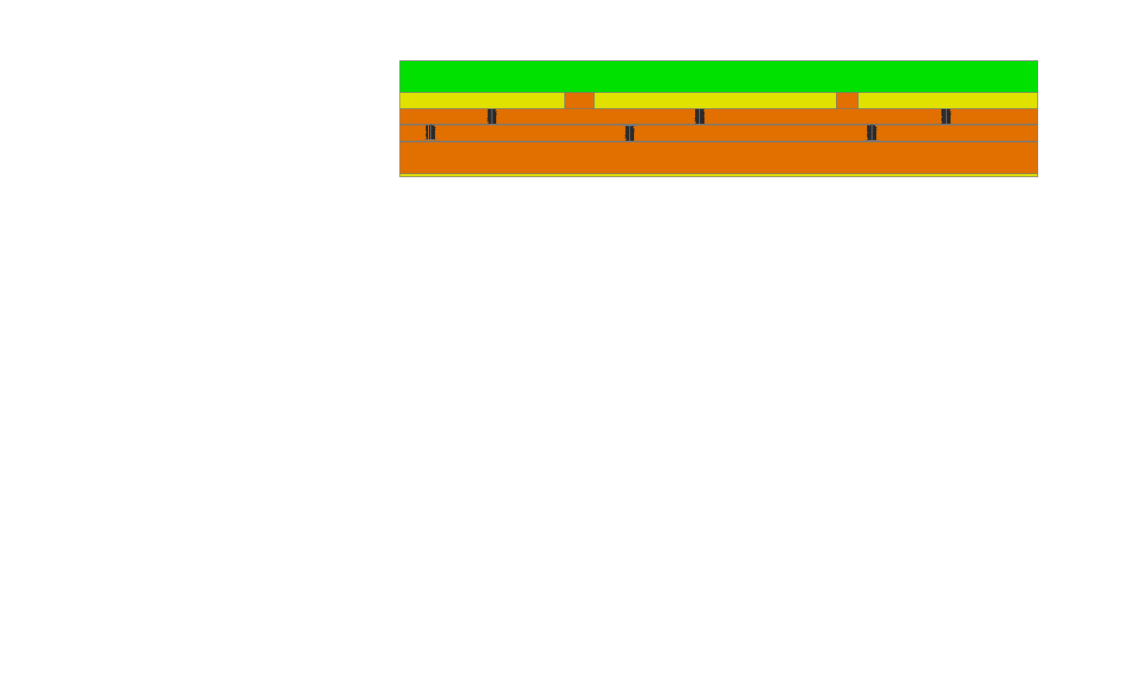
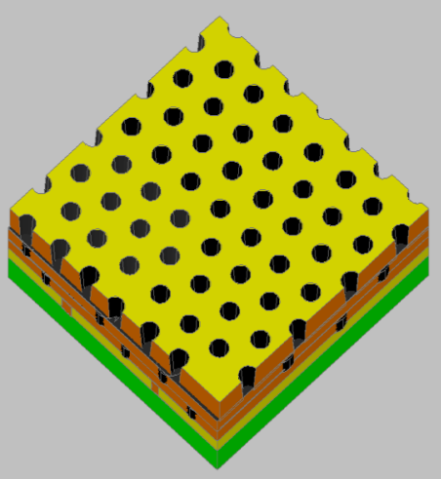
The High Rate scheme (LHCb)
Copper layer 5 µm
1
Kapton layer 50 µm
DLC layer: 0.1 – 0.2 µm
(10-200 MΩ/☐)
2
2nd resistive kapton layer with ∼ 1/cm² “through vias” density
DLC-coated kapton base material
3
2nd resistive kapton layer
insulating layer
pad/strips readout on standard PCB
“through vias” for grounding
4
DLC-coated base material after copper and kapton chemical etching ( WELL amplification stage)

Slide 18
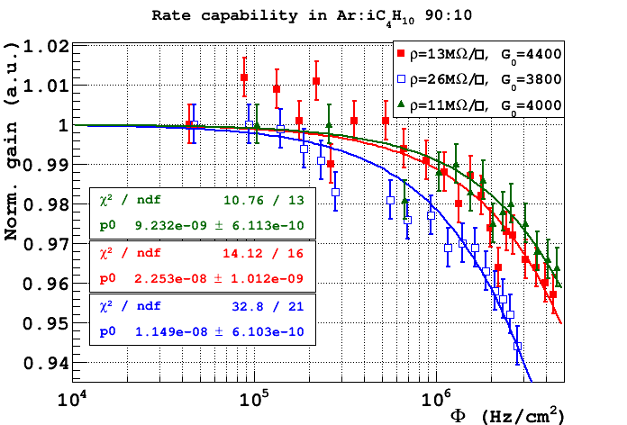
Rate capability with X-rays (double layer)
Double resistive layer w/ 1x1 cm² through-vias grounding pitch
local irradiation
for m.i.p.×7
Φ = 3.4 MHz/cm²; Φ = 2.8 MHz/cm²; Φ = 1.6 MHz/cm²
Local irradiation is practically equivalent to global irradiation

Slide 19
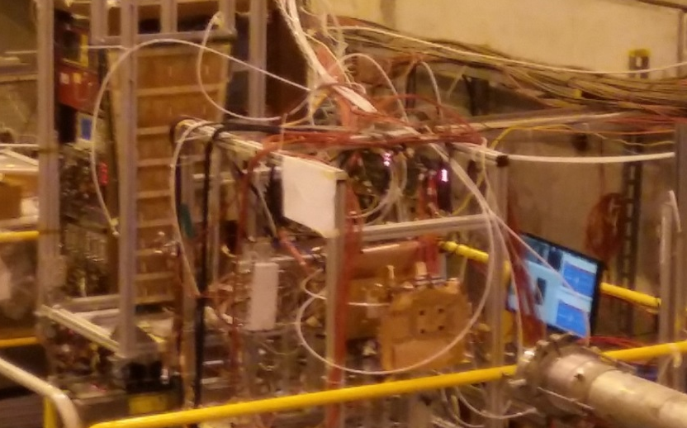
Beam Test (CMS/LHCb collaboration)
H8 Beam Area (18th Oct. – 9th Nov 2016)
Muon/Pion beam: 150 GeV/c
3 μ-RWELL prototypes
40-35-70 MΩ /□
VFAT (digital FEE)
Ar/CO₂/CF₄ = 45/15/40
N° 2 µ-RWELL protos
10x10 cm2
40-35 MΩ/☐
Double resistive layer scheme
400 µm pitch strips
Beam
S3
S2
S1
GEM Tracker 1
GEM Tracker 2
N° 1 µ-RWELL proto
100x50 cm2
70 MΩ/☐
Single resistive layer scheme
800 µm pitch strips
Trigger=S1+S2+S3
GOAL: time resolution measurement (never done before)

Slide 20
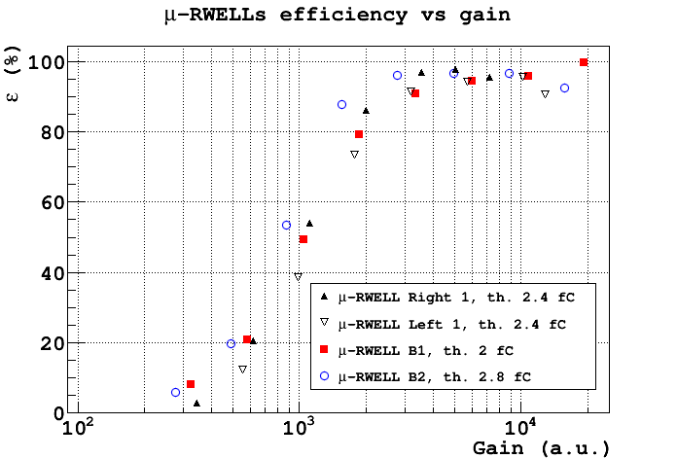
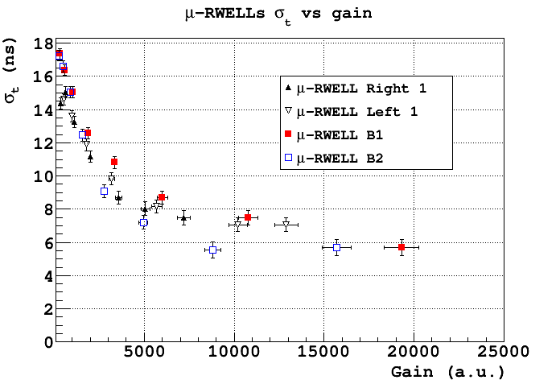
Time Performance
97%
5.7ns
Different chambers with different dimensions and resistive schemes exhibit a very similar behavior although realized in different sites (large detector realized @ ELTOS)
The saturation at 5.7 ns is dominated by the fee (measurement done with VFAT2).
Past measurements done with GEM by LHCb group gave σ_{t} = 4.5 ns with VTX chip [1].
We wish to perform the same measurement with μ-RWELL in order to have a direct comparison with GEM.
[1] G. Bencivenni et al, NIM A 494 (2002) 156

Slide 21
Conclusion
The µ-RWELL is a compact, single-amplification stage, simple to assemble & suitable for large area, MPGD:
  gas gain > 10⁴
  intrinsically spark protected
  rate capability >> 1 MHz/cm² (HR version)
  space resolution < 60µm
  time resolution ∼ 5.7 ns
R&D/engineering in progress:
Low rate (<100kHz/cm²) :
  small and large area prototypes built and extensively tested
  a well defined roadmap towards Technological Transfer to industry
High rate (>1 MHz/cm²):
  first prototypes show very promising performance
  the engineering is going to be started

Slide 22
Spare slides

Slide 23
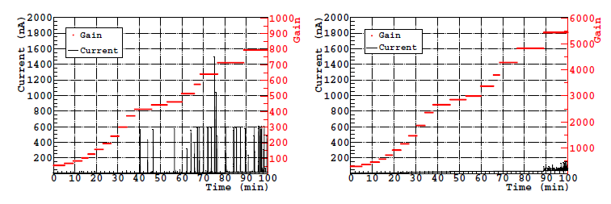
The µ-RWELL performance
Discharge study: µ-RWELL vs GEM
Single-GEM
µ-RWELL
discharges for µ-RWELL of the order of few tens of nA (<100 nA @ max gain)
for GEM discharges the order of 1µA are observed at high gas gain

Slide 24
The µ-RWELL vs GEM
The µ-RWELL is expected to exhibit a gas gain larger than a single-GEM.
Single-GEM:
  only 50% of the electron charge produced into the hole contributes to the signal, the rest of the electron charge is collected by the bottom side of the GEM foil
  the signal is mainly due to the electron motion, the ion component is largely shielded by the GEM foil itself
µ-RWELL:
  100% electron charge produced into the amplification channel is promptly collected on the resistive layer
  the ionic component, apart ballistic effects, contributes to the formation of the signal
  further increase of the gain achieved thanks to the resistive electrode which, quenching the discharges, allows to reach higher amplification field inside the channel
Notes:
What about the Gain & signal … mettere a solita figura della trasmissione attaverso foro gem

Slide 25
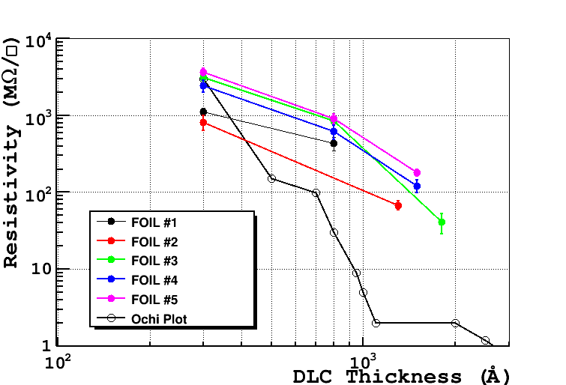
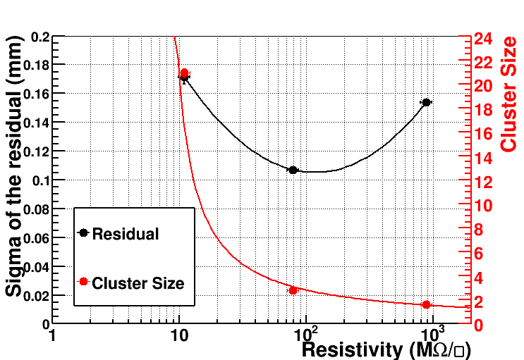
DLC sputtering on Kapton foils (supervised by A.Ochi)
DLC sputtering on large Kapton foils (w/copper on one side) completed @ Be-Sputter Co., Ltd (Japan)
 | Foil 1 (800A) | Foil 2 (1300A) | Foil 3 (1800A) | Foil 4 (1500A) | Foil 5 (1500A)
Average Surface Resistivity MΩ/ | 433±90 | 68±9 | 41±12 | 122±22 | 180±17
Ar/ISO=90/10

Slide 26
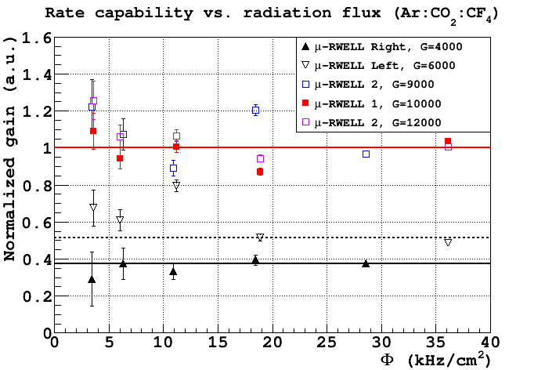
Performance vs Rate
The detectors rate capability (with Ed=3.5 kV/cm) has been measured in current mode with a pion beam and irradiating an area of >3 x 3 cm² (FWHM) (medium size irradiation, ~10 cm² spot)
Double resistive layer
(High Rate scheme)
Single resistive layer
(Low Rate scheme)

Slide 27
GE2/1 u-RWELL ageing test with GE1/1 proto
Courtesy of L. Borgonovi and I. Vai

Slide 28
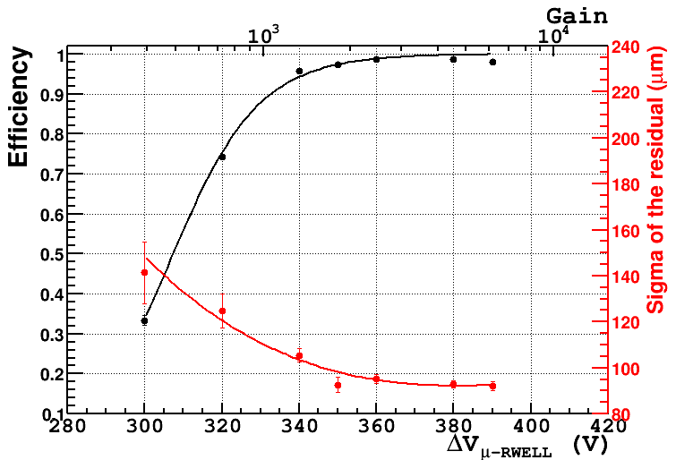
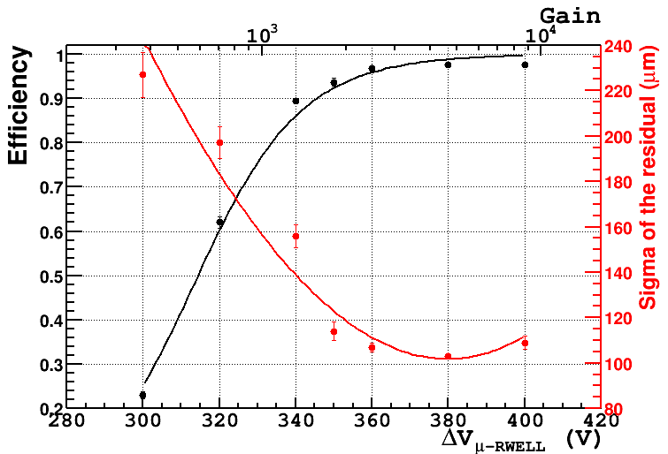
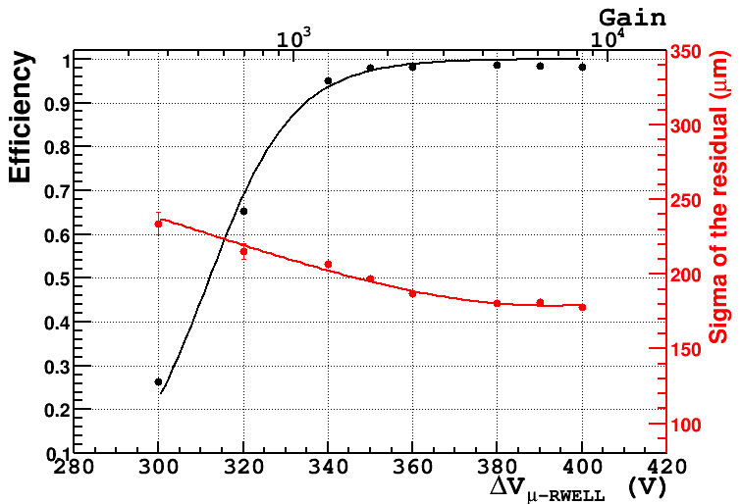
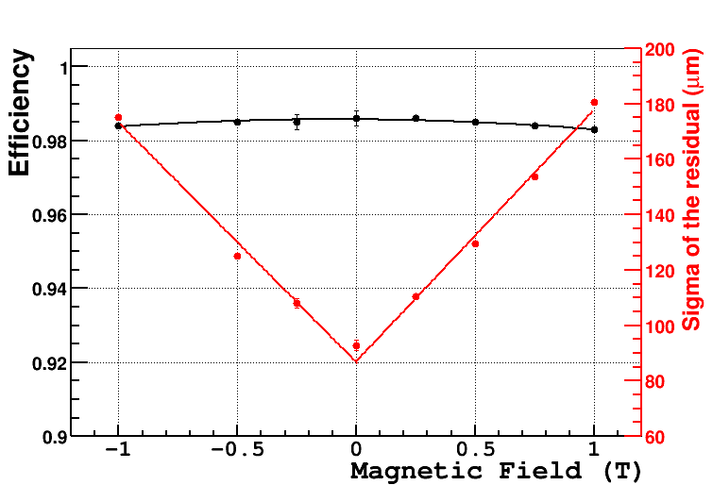
µ-RWELL: B≠0 with Ar/ISO=90/10
CC analisys
June 2015 – θ=0°, B= 0 T
Dec 2014 – θ=0°, B= 0.5 T
June 2015 – θ=0°, B= 1 T
June 2015 - θ=0°
For θ=0° and 0 < B < 1 T σ < 180 µm and ε > 98%

Slide 29
µ-RWELL: B≠0 with Ar/ISO=90/10
CC analisys
June 2015 - θ=0°
80 MegaOhm
For θ=0° and 0 < B < 1 T σ < 180 µm and ε > 98%

Slide 30
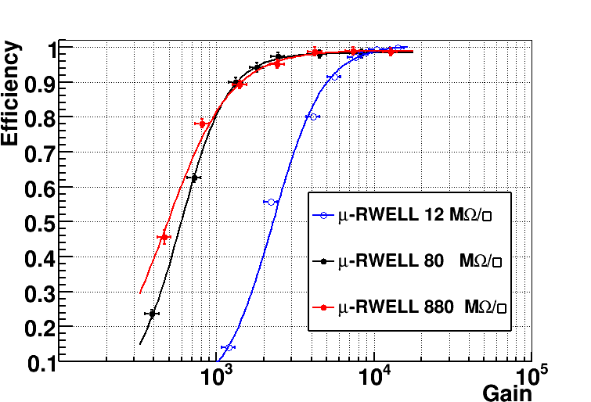
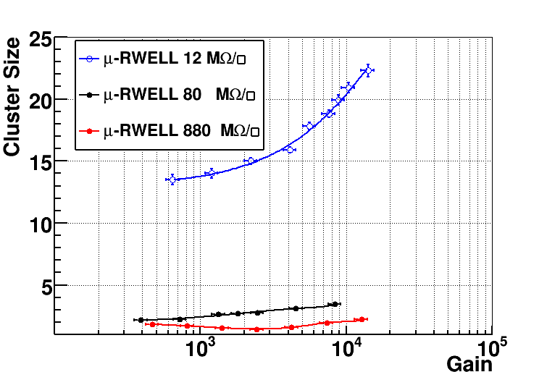
Tracking efficiency
CC analysis
Ar/ISO=90/10
Ar/ISO=90/10
At low resistivity the spread of the charge (cluster size) on the readout strips increases, thus requiring a higher gain to reach the full detector efficiency.

Slide 31
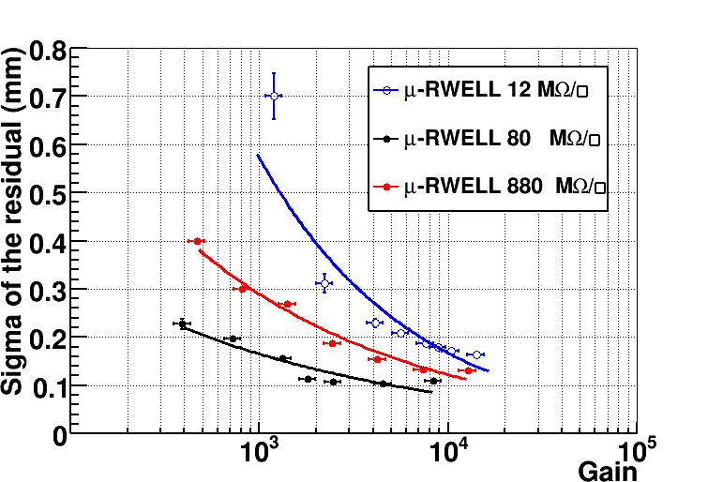
Space resolution: orthogonal tracks
CC analysis
Ar/ISO=90/10
Ar/ISO=90/10
The space resolution exhibits a minimum around 100MΩ/□.
At low resistivity the charge spread increases and then σ is worsening.
At high resistivity the charge spread is too small (Cl_size → 1) then the Charge Centroid method becomes no more effective (σ → pitch/√12).

Slide 32
GE2/1 u-RWELL preparation
Once validated the mechanics, the plan is to build a full scale GE2/1 μ-RWELL with M4 operating sectors.
M4 left and right are mirrored.
Size: 606.5 x 498.5 x 1 mm
Strip layout inspired to the GE2/1 GEM option
Final drawing ongoing (Gatta-LNF)
DLCed foils almost ready (Ochi-Kobe)
Preliminary tests at ELTOS done
M4 left
M4 right

Slide 33
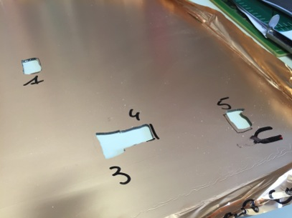
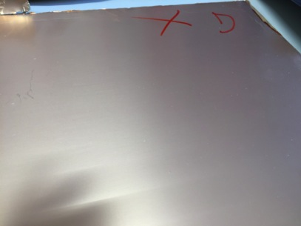
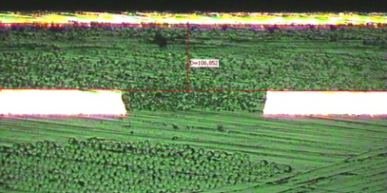
ELTOS tests
From ELTOS tests, it is quite visible that without PACOFLEX the surface is very flat.
Sample of M4 PCB with strips and 1 Pre-preg layer
Sample of M4 PCB with strips and 2 Pre-preg layers
strips
strips
Metallographic cross sections: on the left we have an example with one pre-preg layer (50 um), on the right with two pre-preg layers (100 um)

Slide 34
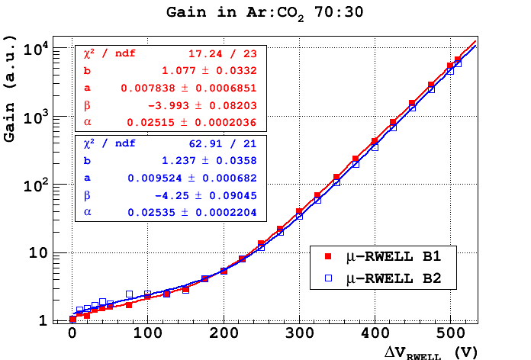
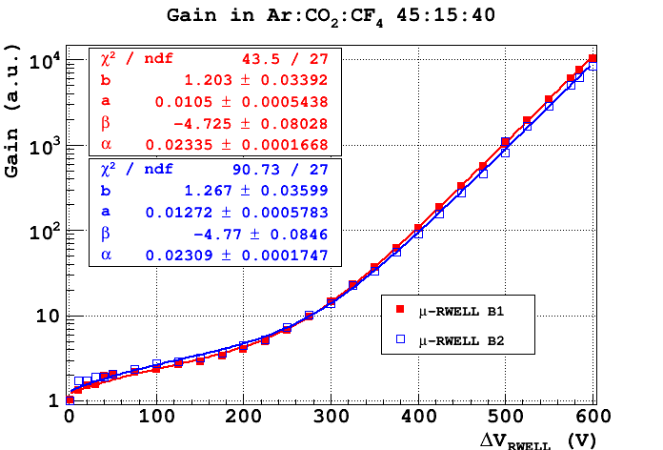
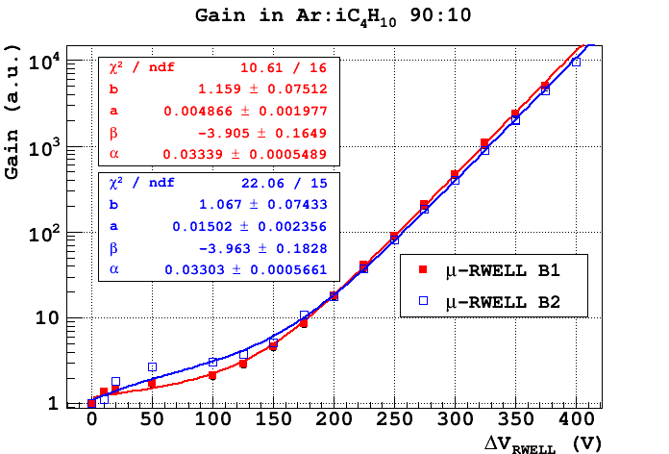
X-ray measurements
Two prototypes with the double resistive layer scheme (ρ=40 MΩ/☐) have been completed last Summer; the detectors have been tested with 5.9 keV X-rays (local irradiation).
Measurement performed in current mode.
Gain measured up to 10000.
Similar behavior for the two chambers.

Slide 35
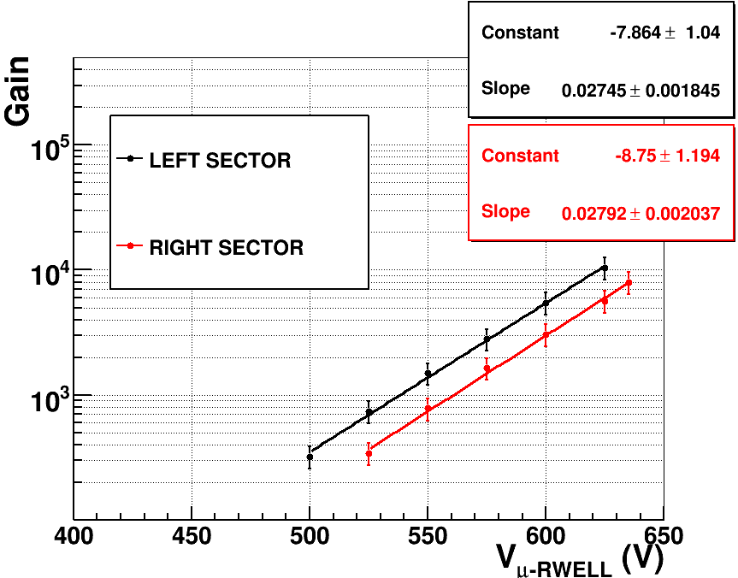
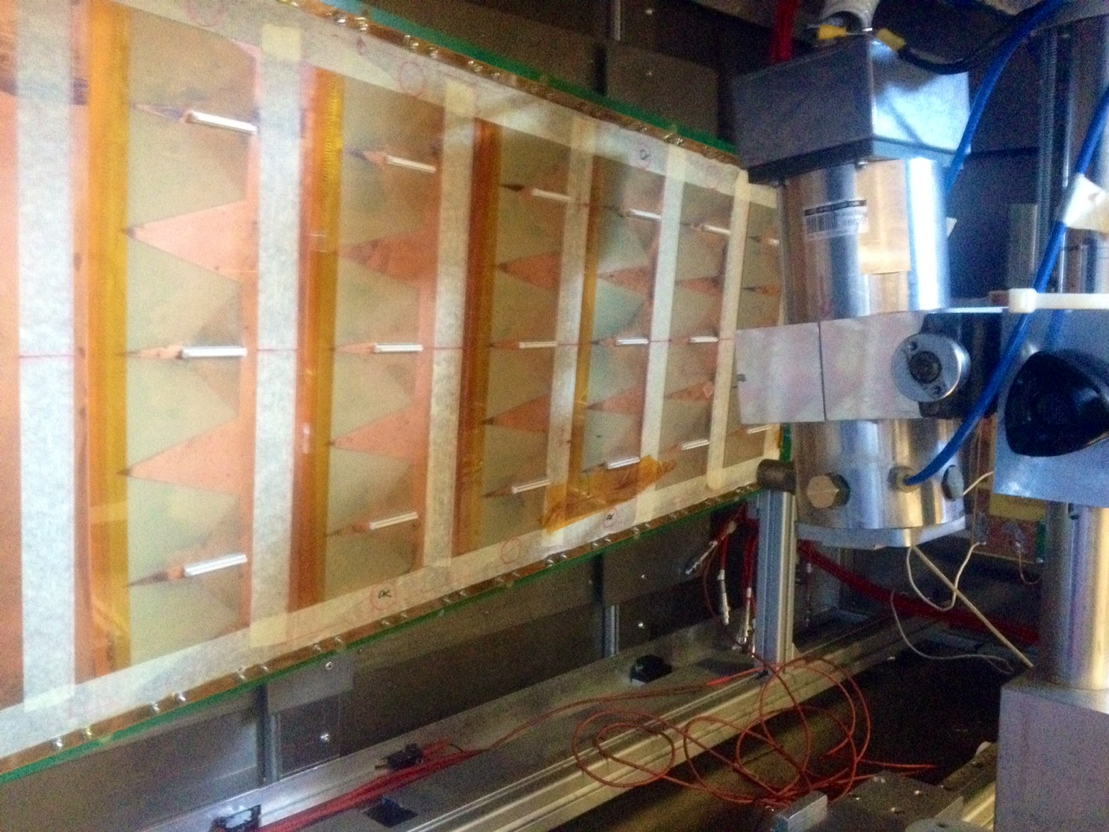
Detector Gain (large area)
The prototype has been characterized by measuring the gas gain, rate capability in current mode with an 5.9 keV X-rays (local irradiation, ~1cm² spot).
A shift of ∼ 25 V has been measured between the two sectors probably due to the different geometry of the amplification stage (to be confirmed with microscope check – left/right asymmetry)

