Slide 1
Pulse-shape discrimination with Cs₂HfCl₆ crystal
C. Cardenas^{1,2}, A. Burger^{1,2}, E. Rowe¹, B. Goodwin¹,
M. Groza¹, M. Laubenstein³, S. Nagorny^{3,4}
¹Department of Life and Physical Sciences, Fisk University, Nashville, TN USA
²Department of Physics and Astronomy, Vanderbilt University, Nashville, TN USA
³INFN – Laboratori Nazionali del Gran Sasso, Assergi, Italy
⁴INFN – Gran Sasso Scientific Institute, L’Aquila, Italy
INSTR-2017, 3 March 2017

Slide 2
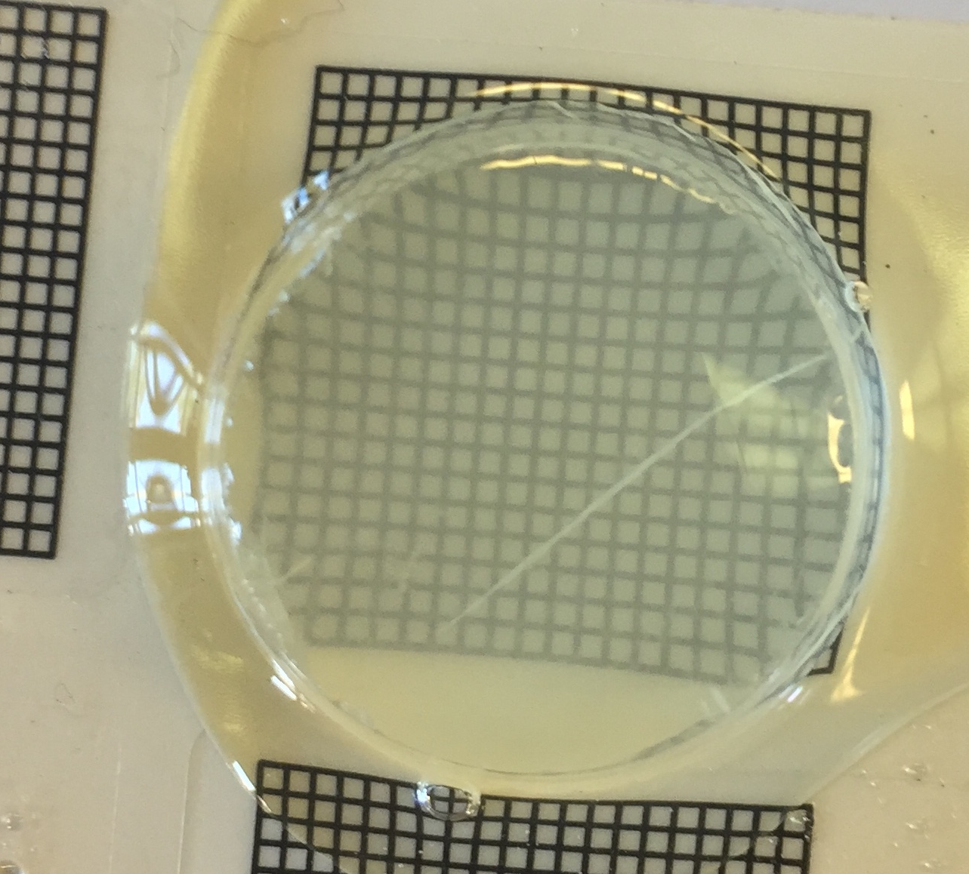
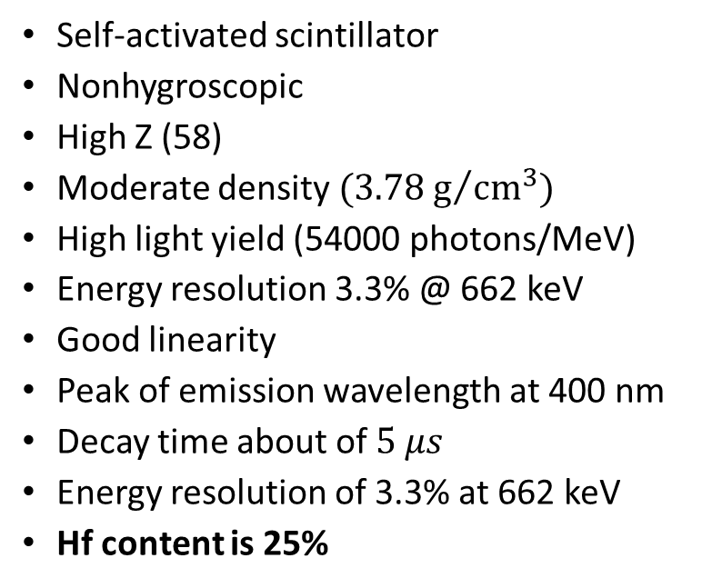
Cs₂HfCl₆ (CHC) crystal sample grown at Fisk University
Self-activated scintillator
Nonhygroscopic
High Z (58)
Moderate density ${(3.78 g}/{{cm}^{3})}$
High light yield (54000 photons/MeV)
Energy resolution 3.3% @ 662 keV
Good linearity
Peak of emission wavelength at 400 nm
Decay time about of $5 μs$
Energy resolution of 3.3% at 662 keV
Hf content is 25%
12.15 g
∅24×7.9 mm
First scintillator containing a high concentration of Hf !

Slide 3
How we can use it?
Q_{α} > 0
easy to detect
Т_{1/2} ≤ 10¹¹ y
Т_{1/2} > 10¹¹ y
Transition energy, keV
difficult to detect
Atomic number, A
Just one experiment
Low sensitivity
Contradiction with theory
T_{1/2} = (3-7)×10¹⁶ y
¹⁷⁴Hf alpha decay
Q = 2497 keV
T_{1/2} = 2×10¹⁵ y
Must be re-measured
with a new technique

Slide 4
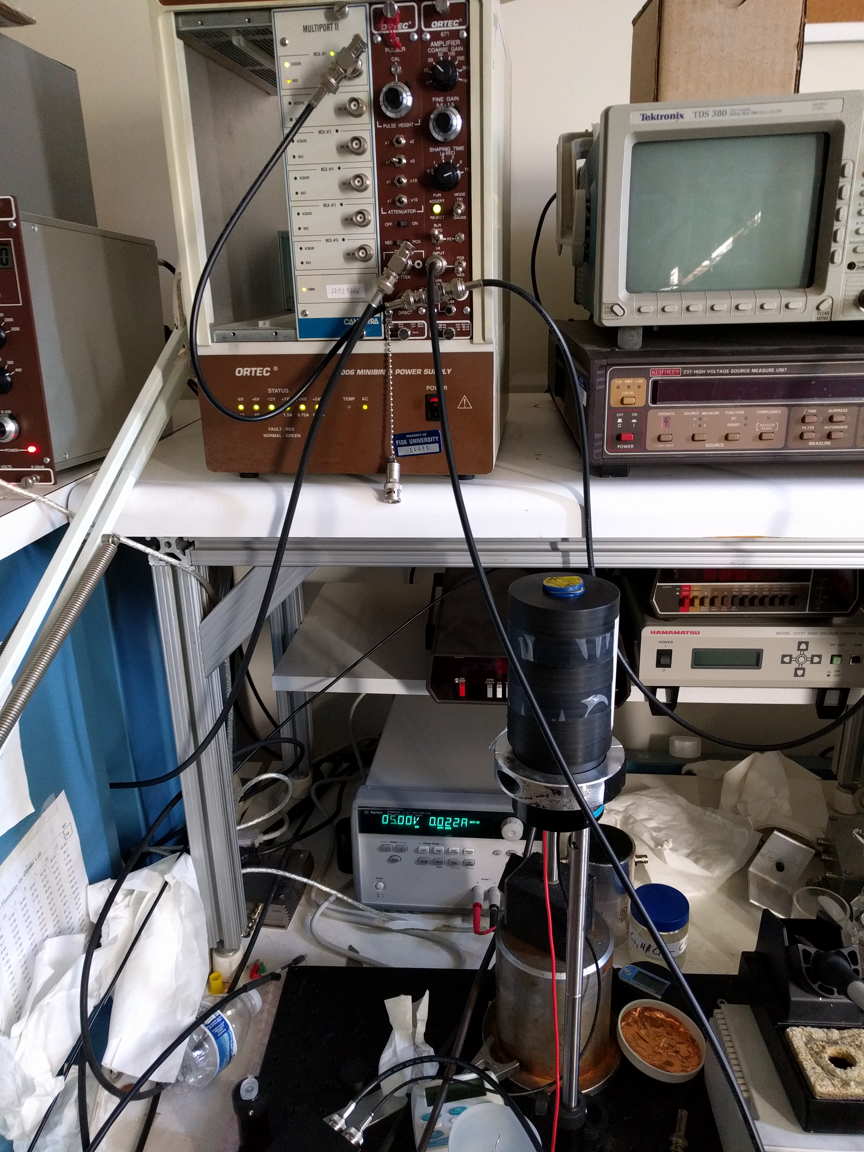
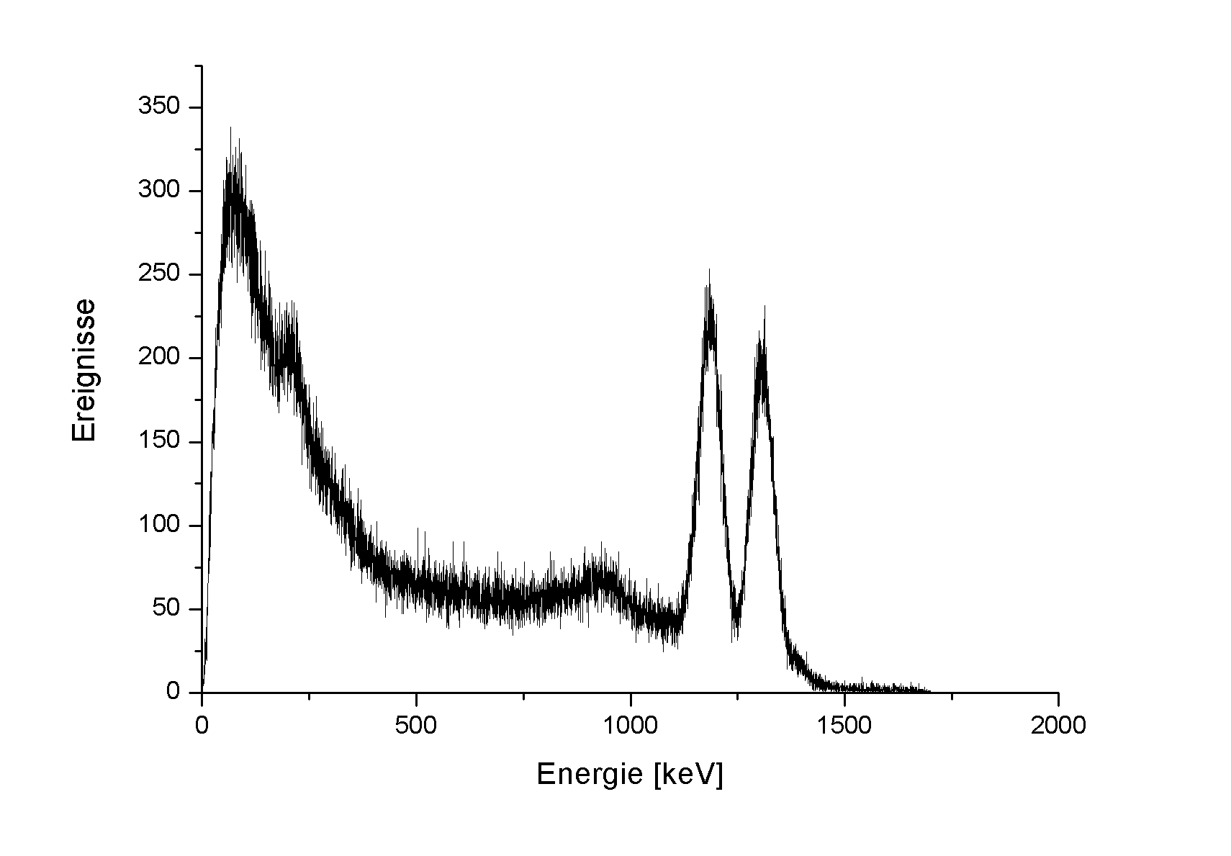
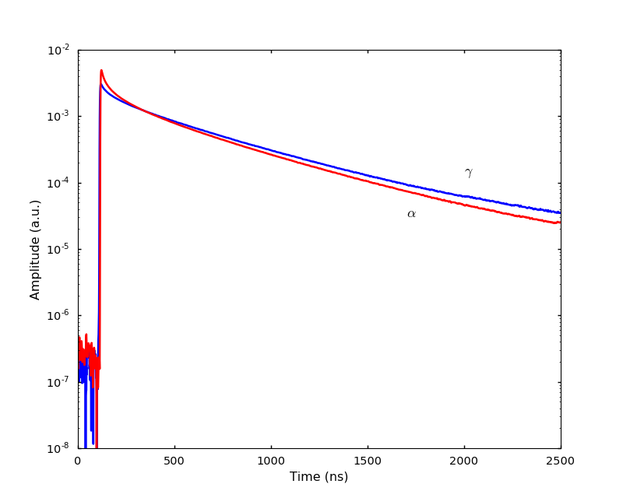
Experimental Setup for crystal characterization
γ source
Dark box
CHC
Reflector
Optical grease
PMT
Pre-Amplifier
Shaping
Amplifier
MCA
Digitizer

Slide 5
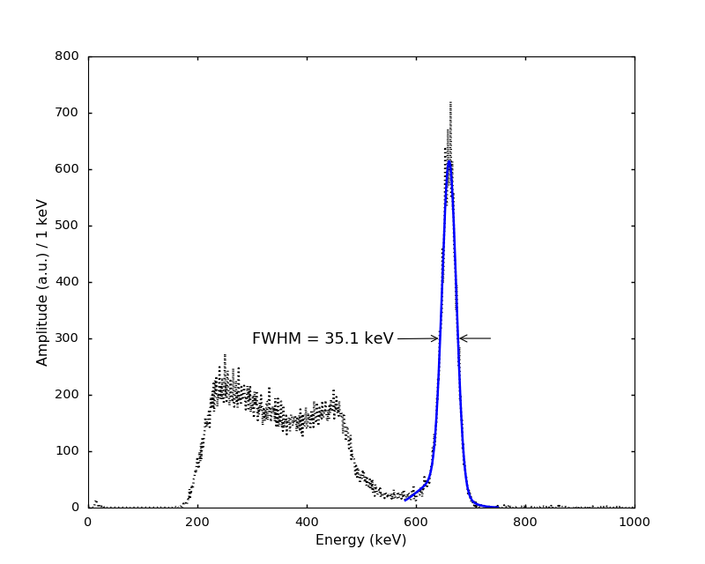
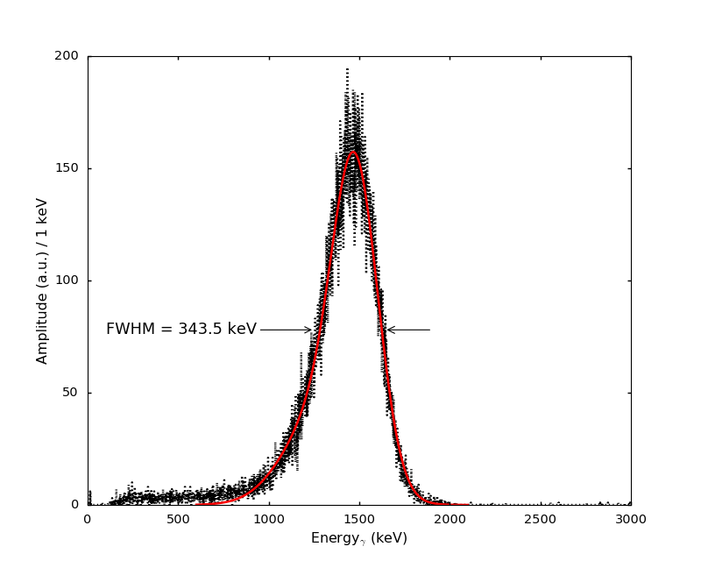
Calibration measurements
¹³⁷Cs source, 662 keV gamma
²⁴¹Am alpha source, 3 mm collimator
5.3%
23.4%
Events considered in further pulse-shape analysis
Notes:
Need to fit the 662 keV peak with exp mod. Gaussian function, so that the peaks of the data and fit function match!!!
Pure 662 keV events considered in further pulse-shape analysis

Slide 6

Quenching Factor for alpha particles
5155 keV is real alpha energy
Energy scale of detector was calibrated with ¹³⁷Cs gamma source
Typically crystal scintillator have a
different response for different particles type
$${QF}_{α}=\frac{E_{α}}{E_{γ−scale}}=0.28$$
23.4%
QF_{α} is very important experimental parameter that allows us to understand where alpha peaks should appear in the gamma calibrated energy spectrum
Actual position of alpha peak
@ 1465.1 keV in gamma scale
Notes:
In alpha particle spectroscopy, the quenching factor is an important characteristic of detector that allows us to understand where our alpha peaks should appear in the gamma calibrated energy spectrum. Quenching factor is dependent on the energy of alpha particle. For more precise characterization of our detector, one must measure this factor in respect with different alpha particle energy. With a preference to use the internal alpha source of our crystal

Slide 7
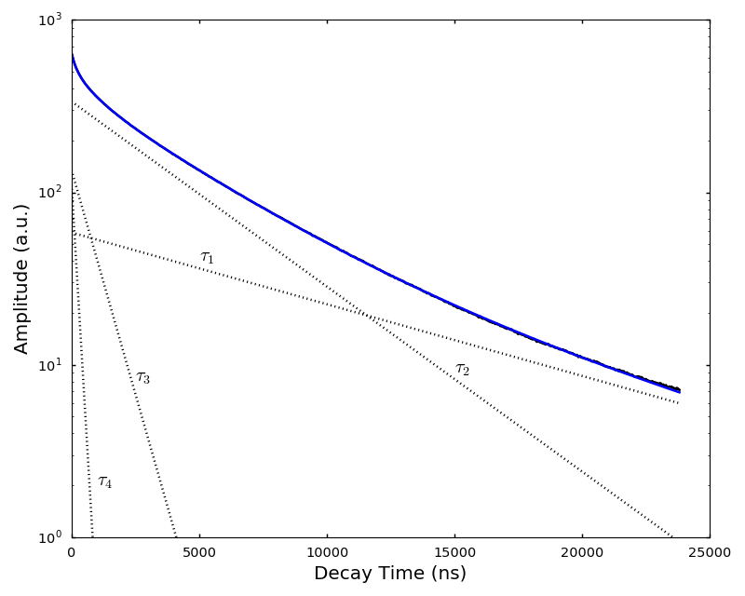
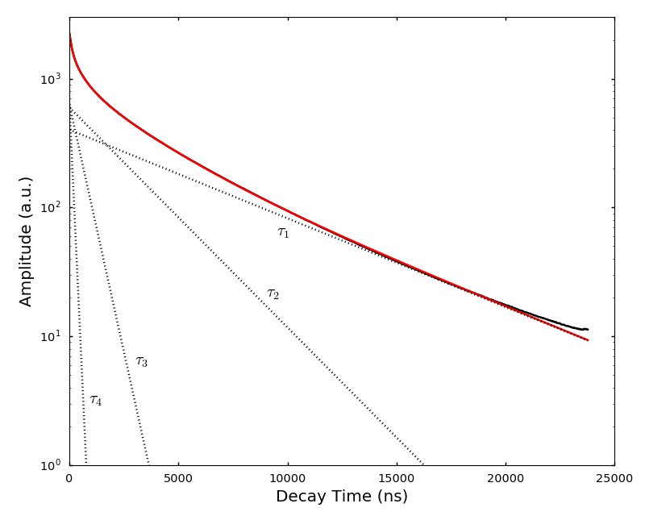
Average pulses
gamma
alpha
Type of irradiation | Decay constants ( μs) and relative intensities
 | τ₁ (A₁) | τ₂ (A₂) | τ₃ (A₃) | τ₄ (A₄)
gamma | 10.4 (27.1) | 4.1 (66.4) | 0.18 (1.0) | 0.84 (5.5)
alpha | 6.3 (56.0) | 2.5 (34.2) | 0.12 (1.7) | 0.56 (8.0)

Slide 8
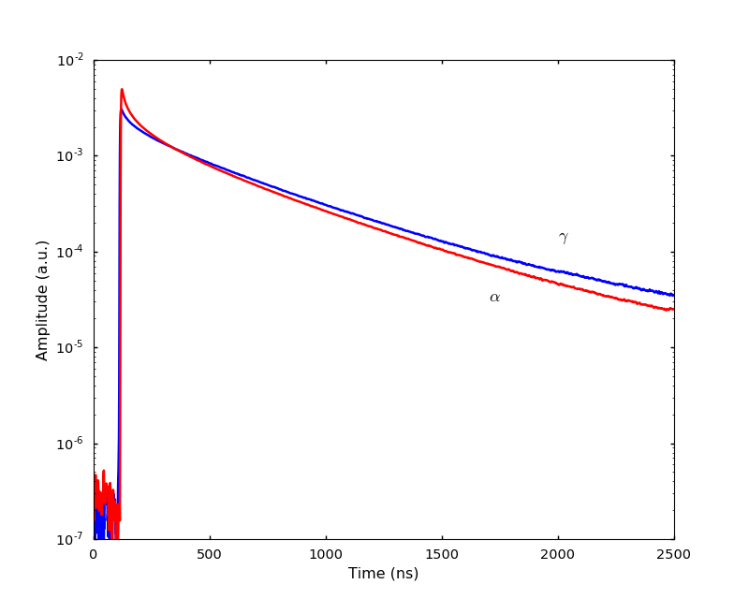
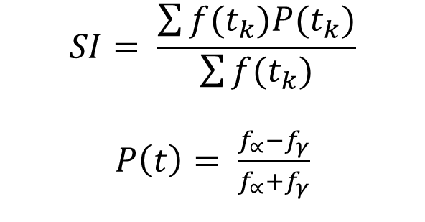
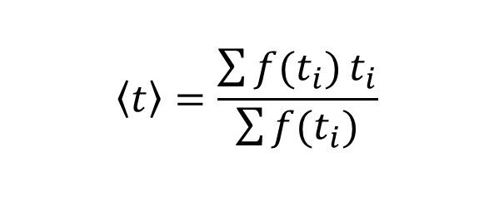
Comparison of average pulses
Difference in pulse shape resulting in the particle discrimination ability
Optimal Filter Method
$$SI= \frac{\sum{f(t_{k})P(t_{k})}}{\sum{f(t_{k})}}$$
$P\left(t\right)= \frac{f_{∝}−f_{γ}}{f_{∝}+f_{γ}}$
gamma
alpha
Mean Time Method
$$\left\langle t\right\rangle =\frac{\sum{f(t_{i})}t_{i}}{\sum{f(t_{i})}}$$

Slide 9
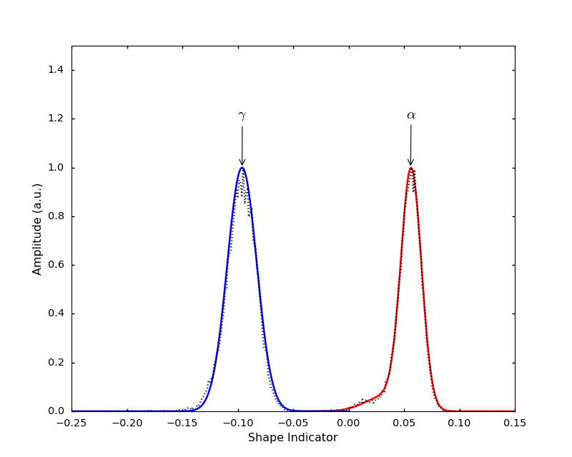
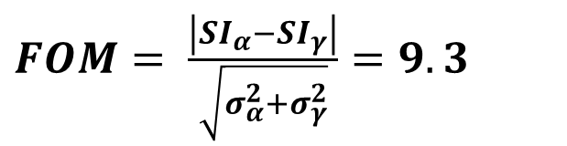
Pulse Shape Discrimination with OF
Gamma
Mean | - 0.96
Sigma | 0.034
Alpha
Mean | 0.55
Sigma | 0.023
$FOM= \frac{\left|{SI}_{α}−{SI}_{γ}\right|}{\sqrt{σ_{α}^{2}+σ_{γ}^{2}}}=9.3$

Slide 10
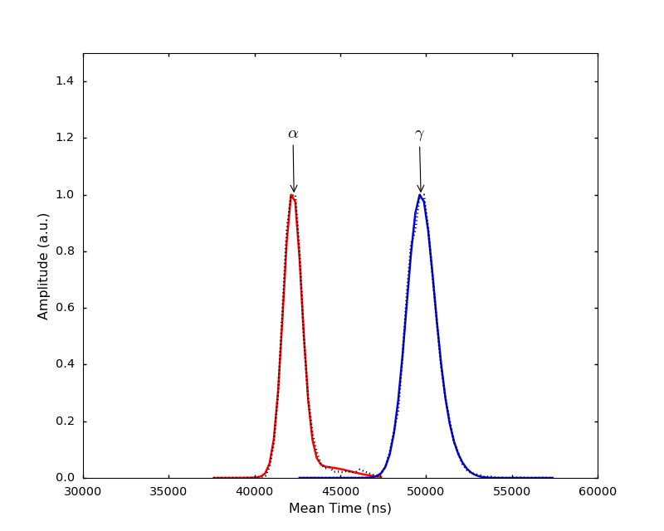
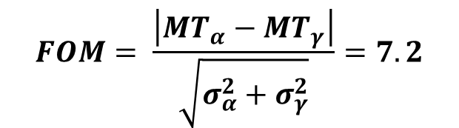
Pulse Shape Discrimination with MT
Alpha
Mean | 42.2 μs
Sigma | 0.6 μs
Gamma
Mean | 49.7 μs
Sigma | 0.9 μs
$$FOM= \frac{\left|{MT}_{α}−{MT}_{γ}\right|}{\sqrt{σ_{α}^{2}+σ_{γ}^{2}}}=7.2$$

Slide 11
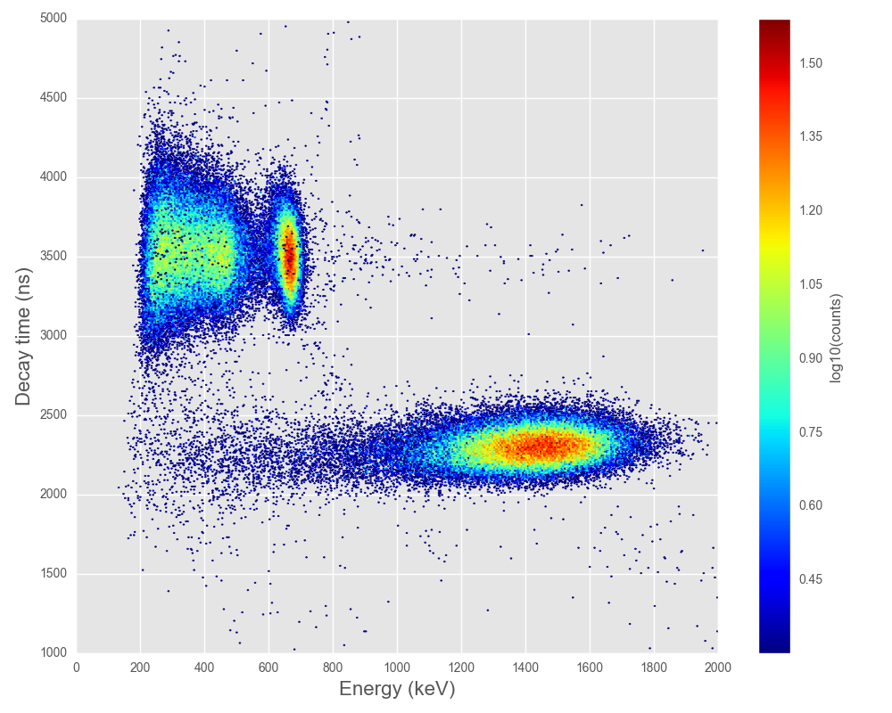
Decay-time vs Energy scatter plot
Gamma, 662 keV of ¹³⁷Cs
Alpha, 5.15 MeV of ²⁴¹Am

Slide 12
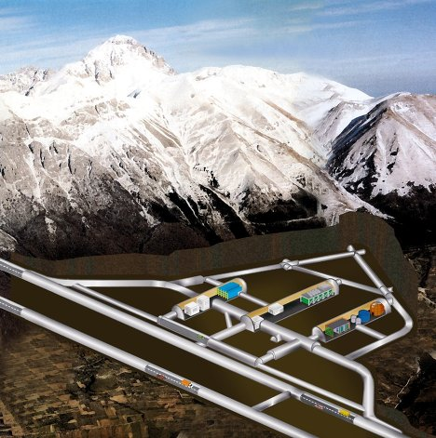
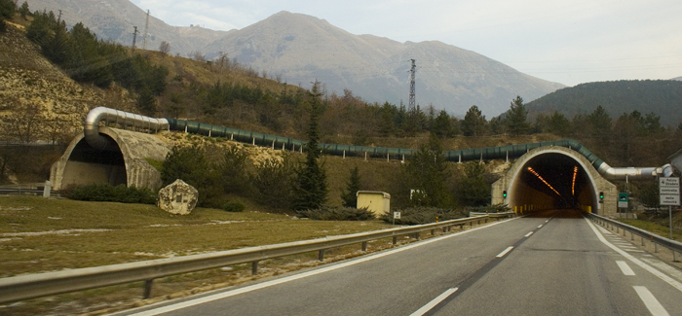
Gran Sasso Underground Laboratory
Average depth ∼ 3650 m w.e.
Muon flux ∼ 2.6×10⁻⁸ μ/s/cm²
Neutrons < 10 MeV: 4×10⁻⁶ n/s/cm²
Gamma < 3 MeV: 0.73 γ/s/cm²

Slide 13
10³
10²
10¹
Above ground
10⁰
Normalised counting rate [d⁻¹ keV⁻¹ kg⁻¹]
10⁻¹
10⁻²
10⁻³
Underground
10⁻⁴
Energy [keV]
500
1000
1500
2000
2500
3000
0

Slide 14
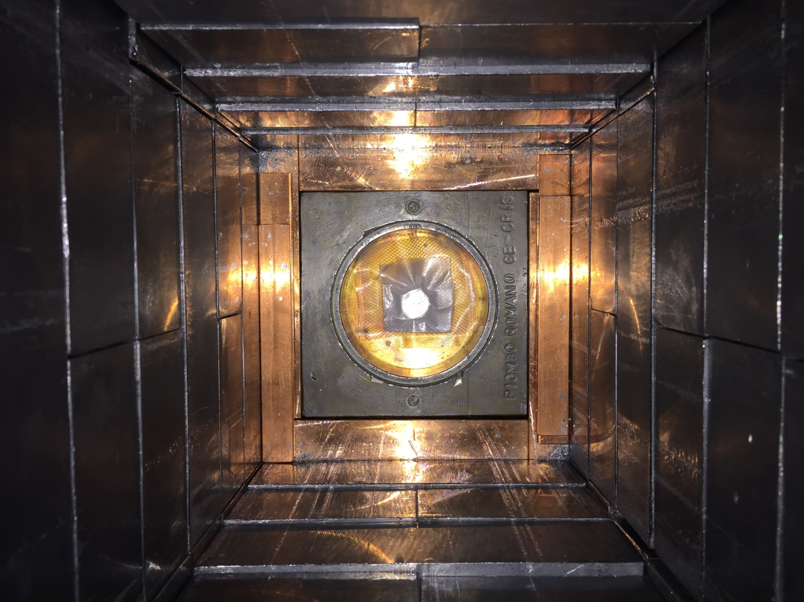
Schematic view of the HPGe detector “Ge-Cris”
Plexiglas box
Radon free N₂ gas
CHC crystal
12.15 g
HP Ge
408 cm³
Cu, 5-10 cm
Pb, 30 cm
FWHM = 1.8 keV @ 1332 keV
CsCl, HfCl₃ and HfCl₃ dist. samples will be measured after CHC crystal

Slide 15
Internal radioactive contamination
measured with 12.15 g CHC crystal on HPGe detector (408 cm³) within 494 hours
Bkg
Bkg
Counts/1 keV
CHC
¹³⁷Cs
662 keV
Counts/1 keV
CHC
¹³⁷Cs
662 keV
¹³²Cs
667 keV
¹³⁴Cs
605 keV
⁴⁰K
1462 keV
¹³⁴Cs
795 keV
Energy, keV
Energy, keV
Main contamination comes from artificial ¹³⁷Cs and cosmogenic ^{132,134}Cs nuclides

Slide 16
Internal radioactive contamination
12.15 g Cs₂HfCl₆ crystal, HP Ge detector (408 cm³) , 493.6 hours
Chain | Nuclide | Activity, mBq/kg
²³²Th | ²²⁸Ra | < 12
 | ²²⁸Th | < 6.3
²³⁸U | ²²⁶Ra | < 8.6
 | ²³⁴Th | < 3.7
 | ^{234m}Pa | < 0.31
²³⁵U | ²³⁵U | < 26
 | ⁴⁰K | < 0.18
 | ⁶⁰Co | < 19
 | ¹³²Cs | 25±8
 | ¹³⁴Cs | 52±6
 | ¹³⁷Cs | 830±90
 | ¹⁸¹Hf | 14±0.7

Slide 17
Summary
Pulse shape for alpha and gamma particles is different in CHC crystal
Pulses are well fitted by sum of four exp, and its amplitudes and times were determined
Excellent particle discrimination was achieved both with Optimal filter method and Mean time analysis
PSD for CHC crystal will be used for background suppression in experiment to search for rare decays of Hf isotopes
Notes:
Measured

Slide 19
Chemical impurities
measured by ICP-MS, expressed in ppb units
Element | CsCl | HfCl₃ | HfCl₃ dist*3 | Cs₂HfCl₆ crystal
La | 8,7 | 2627 | 555 | 132
Ce | <5 | <5 | <5 | 19
Pr | <5 | <1 | <1 | 5,8
Nd | <10 | <10 | <10 | <12
Sm | <15 | <15 | <15 | <15
Eu | <3 | 33 | 25 | 130
Gd | <5 | <15 | <5 | <35
Tb | 11 | <2 | <2 | 6
Dy | 2,2 | <1 | <1 | 16
Ho | <4 | 250 | 204 | <25
Er | <2 | <2 | <2 | <2
Tm | <3 | <2 | <2 | <2
Yb | <5 | <100 | <100 | <50
Lu | <10 | <500 | <500 | <300
Ta | <3 | <8000 | <8000 | <4000
W | <1000 | <1000 | <1000 | <200
Re | <2 | <15 | <15 | <10
Os | <5 | <20 | <20 | <15
Ir | <2 | <4000 | <4000 | <2000
Pt | <2 | <100000 | <100000 | <40000
Tl | <55 | <4 | <4 | <15
Bi | <3 | <2000 | <2000 | <1000
Th | <0,5 | <1 | <1 | <0,5
U | <0,5 | 3200 | 267 | <0,5

Slide 20
Dangerous radioactive contamination
Element | Concentration, ppb | Dangerous isotope | Q_{α}, MeV | Number of expected events in 2 weeks | Number of expected events in 4 weeks
Nd | < 12 | ¹⁴⁴Nd | 1.910 | < 1.7⋅10⁻³ | < 3.4⋅10⁻³
Sm | < 15 | ¹⁴⁷Sm | 2.310 | < 27.8 | < 55.6
 |  | ¹⁴⁸Sm | 1.986 | < 3.2⋅10⁻⁴ | < 6.4⋅10⁻⁴
Eu | 130 | ¹⁵¹Eu | 1.949 | 1.7⋅10⁻⁵ | 3.4⋅10⁻⁵
Gd | < 35 | ¹⁵²Gd | 2.206 | < 8.1⋅10⁻⁴ | < 1.6⋅10⁻³
W | < 200 | ¹⁸⁰W | 2.516 | < 1.4⋅10⁻⁷ | < 2.8⋅10⁻⁷
Os | < 15 | ¹⁸⁴Os | 2.966 | < 3.1⋅10⁻⁵ | < 6.2⋅10⁻⁵
 |  | ¹⁸⁶Os | 2.816 | < 1.2⋅10⁻⁴ | < 2.4⋅10⁻⁴
Pt | < 40000 | ¹⁹⁰Pt | 3.243 | < 7.45 | < 14.9
Bi | < 1000 | ²⁰⁹Bi | 3.137 | < 5.0⋅10⁻⁵ | < 1.0⋅10⁻⁴
in 12.15 g Cs₂HfCl₆ crystal
during 340/680 hours
of background measurements

Slide 21
Previous experiment: MacFarlane (1961)
Surface lab
Passive shield
Active shield
No PSD
About 40 days data taking
100 mg scale samples mass
Enriched ¹⁷⁴Hf to 56%
FWHM = 4% @ 2.3 MeV
Bkg (1-3 MeV) = 9 count/h
Counting gas composition
94% argon, 5% ethylene, 1% nitrogen
¹⁷⁴HfO₂ samle
Notes:
Optimum counting conditions were not realized at the time of Hafnium measurement. Resolution of the alpha peak is poor.

Slide 22
Previous experiment: MacFarlane (1961)
¹⁷⁴Hf
¹⁷⁴Hf
¹⁷⁴HfO₂ + ²¹⁰Po
alpha ²¹⁰Po @ 5.3 MeV
¹⁷⁴HfO₂ + Sm₂O₃
alpha ¹⁴⁷Sm @ 2.3 MeV
Low statistics
Low signal to background ratio

Slide 23
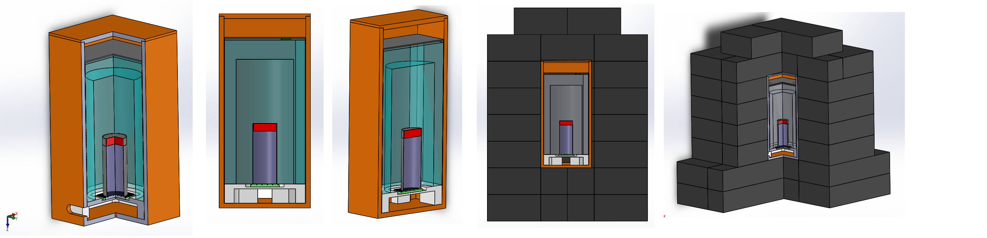
Scintillating detector
Plastic scintillator
CHC
Active light guide
PbWO₄ crystal
SiPM array
Teflon support
Copper box (5 mm)
Passive shield (10-20 cm of Pb)
Underground lab (LNGS)

Slide 24
Scintillating bolometer
During particle interaction in the crystal a fraction of the deposited energy is converted into scintillation. Combining the crystal with cryogenic light detector allows to simultaneous measurement of the energy deposited in crystal (H) and produced scintillation (L)
Light
e/γ events
Simultaneous and independent, double readout of heat and scintillation light leads to an effective discrimination of e/γ from α events by the different L/H ratio
α events
Heat

Slide 25
What we suppose to observe?
m (Cs₂HfCl₆) = 12.154 g
N (Hf) = 11.16×10²¹ atoms
i.a. (¹⁷⁴Hf) = 0.16%
N(¹⁷⁴Hf) = 1.79×10¹⁹ atoms
t = 2 weeks = 0.03833 y
ε = 100%
S = ln 2 ⋅ ε ⋅ t ⋅ N(¹⁷⁴Hf) / T_{1/2} = 15 events (theor T_{1/2} = 3×10¹⁶ y)
238 events (exp T_{1/2} = 2×10¹⁵ y)

Slide 26
Experimental data are
coming soon!

